Slide 1
12.1 Middle Ages
Andrew Drock, Coleton Gabriel and Jessica Rouse

Slide 2
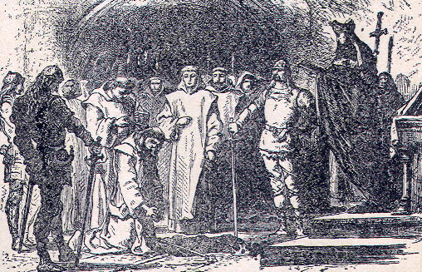
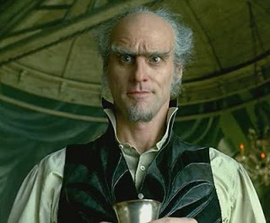
Key terms
Mayor of the Palace-Political power passed from king to Government officials
Count- Rank of a Local officials Scaling from King-Duke-Count

Slide 3
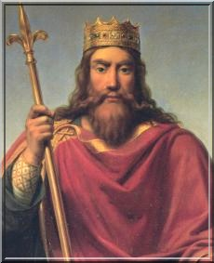
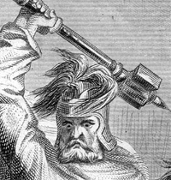
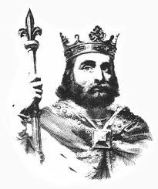
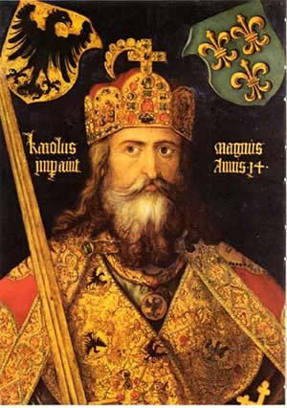
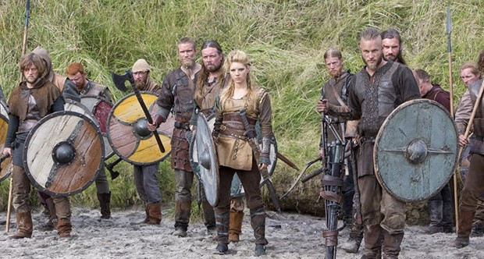
People
Clovis- Formed the First Catholic and Frankish Kingdom 481 A.D
Charles the Hammer- Stopped the Moors from advancing into France battle of Tours. 714 A.D
Pepin the Short- anointed protector of the church defeated the Lombard's. Father of Charles the Great. 752 A.D
Charlemagne- Started the Carolinian dynasty took over Italy and the other Germanic lands forming the first Holy Roman Empire 768 A.D
Vikings- Raiders from Scandinavia raiding the main land of England and coasts of France 800s
Notes:
Clovis Was clever and Brutal
Charles was the first mayor of the palace
Pepin

Slide 4
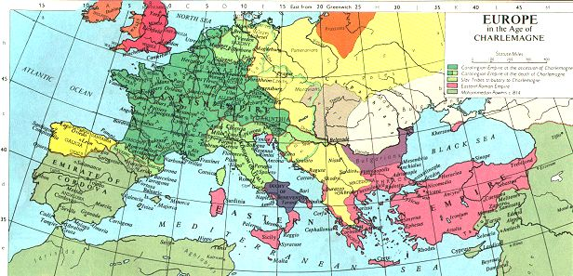
Map of Charlemagne's World

Slide 5
Additional Information
730 A.D The power struggle continues, Pope Gregory II excommunicates Emperor Leo II. (Over Iconoclasm)
Vikings were massive travelers, and big traders. They had a trade route to Constantinople. Archeologists found Viking writing in the Hagia Sophia.
772 A.D Charlemagne conquers Saxony and converts it to Christianity.
843 A.D. After Charlemagne's son died, all his three grandsons fought over his empire and tore it apart.
808 A.D. Jewish merchants open the first bank.
853 A.D. Vikings take over Ireland, and continue to rule until 1014.

Slide 6
Works Cited
http://www.rasmenia.com/2009/04/23/13-french-badasses/
http://www.robertsewell.ca/pepin.html
http://deremilitari.org/2013/06/medieval-warfare-in-the-reign-of-charlemagne/
http://www.thewrap.com/tv/article/history-channel-renews-vi-84291
http://www.histoire-en-ligne.com/spip.php?article157
http://www.vlib.us/medieval/lectures/carolingian_empire.html
http://junkerjane.blogspot.com/2009/12/count-olaf-
forever.html
http://www.heritage-history.com/?c=read&author=harding&book=middle&story=mayors
http://www.foto-out.dk/ayasofya/content/_2721135092_large.html

