Slide 1
Rise Of European Monarchy
Section
Star Charlton , Alan Peterson, Nicole Rasdall

Slide 2
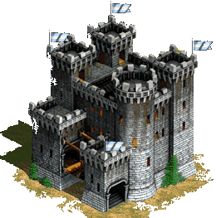
England
In 400 A.D Brittan was abandoned by the Romans invaded by the Germanic Angles, Saxons, Jutes, by the Danes in 886A.D and the Normans during the Norman Conquest.( Guided reading 1)

Slide 3
The Angelo- Saxons
410-500 AD
Ruled by Alfred the Great from 871-899 A.D

Slide 4
Alfred the Great
878 Alfred defeats Guthrum at the battle of Ethandune
Alfred defeats the Danes at Rochester
Naval victory over the Danes in the Solent
899 Alfred dies and is buried at Winchester. His son Edward becomes king.

Slide 5
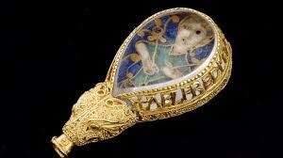
“Alfred ordered me made”

Slide 6
The Norman Conquest
William the Duke of Normandy and Harold Godwinson fought for the throne of England.(Guided reading 2)
At the battle of Hastings in 1066 A.D William defeated Harold
From this victory William was crowned and named William the Conqueror

Slide 7
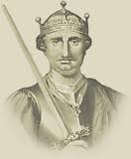
William the Conqueror
William the Conqueror was the first Norman King of England from Christmas 1066 until his death.

Slide 8
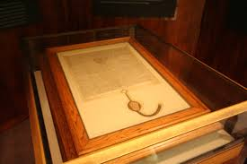
Magna Carta
The Magna Carta was signed in June 1215 between the nobles of England and King John.
Magna Carta is Latin and means "Great Charter".
The Magna Carta is one of the most important documents of Medieval England. This document formed the foundation for Western Civilization.

Slide 9
King John
John was increasing taxes and punishing his enemies without trial (Guided Reading 4)

Slide 10
Rise of the Parliament
Middle class is developed Nobles, Clergy, Middle class, Peasants

Slide 11
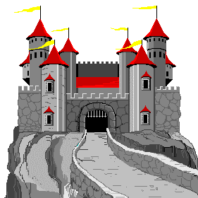
France
The title France derives its name from a medieval tribe called the Franks.

Slide 12
Beginning of Central Government

Slide 13
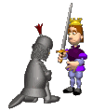
Strengthening the Central Government
King Philip strengthened the government by giving clergy positions to nobles and townspeople.
During his reign the royal domains were more than doubled.
The royal power was consolidated by the feudal lords.
Philip defeated a coalition of Flanders

Slide 14
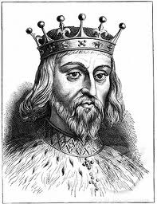
Henry II
Set up a system of common law using traveling judges to apply the law through the land.
1170 A.D four of henrys knights, who believed they were acting on kings command, murdered Thomas a Becket.

Slide 15
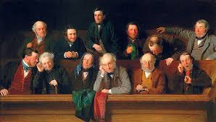
Grand Jury
Petit jury

Slide 16
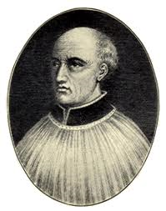
Thomas a Becket
Archbishop of Canterbury
Brought into conflict with Henry II when Henry had the plan to try clergy in the royal courts.
Murdered 1170 A.D
See guided reading number 3

Slide 17
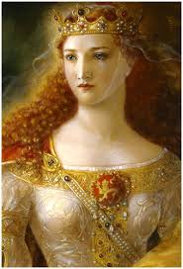
Eleanor of Aquitaine
Married to Henry II
Owned vast lands in France
Although they had a troubling relationship she still had a great influence on royal policies.

Slide 18
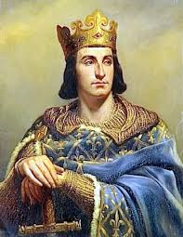
Philip Augustus
Ruled France from 1180-1223 A.D
15 when he succeeded the thrown
Determined to strengthen the monarchy
By 43 he doubled his lands
By appointing local officials who were loyal to the king and forming a semi-permanent royal army, Philip weakened the power of feudal lords

Slide 19
Henry IV
king of England from 1399 to 1413
Henry led a number of expeditions into Wales from 1400 to 1405

Slide 20
Kings
Hugh Capet king of France from 987 to 996
Louis VI king of France from 1108 to 1137
Philip II reigned 1180–1223
Louis IX king of France from 1226 to 1270
Philip IV king of France from 1285 to 1314

Slide 21
Louis IV
Increased the number of towns in France by using town people and awarding them clergy positions(Guided Reading 7)

Slide 22
Pope and leaders of the Empire
Pope clamed power to overthrow king
King clamed power to over throw pope
(Guided reading 8)
Conflict was resolved by allowing the emperor to name bishops and grant them land. A pope could reject unworthy canidated (Guided reading 9)

Slide 24
Works Cited
Editors of Encyclopedia Britannica. “Henry IV”
Encyclopedia Britannica. School and Library products. Web. 6 March,14
Editors of Encyclopedia Britannica. “Philip IV”
Encyclopedia Britannica. School and Library products. Web. 6 March,14
Editors of Encyclopedia Britannica. “Philip II”
Encyclopedia Britannica. School and Library products. Web. 6 March,14

