Slide 1
13.2 Economic and Cultural Revival
By: Tara Jolley and McCoy Meshach

Slide 2
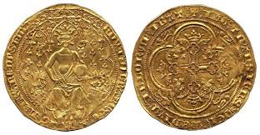
Money Economy

Slide 3
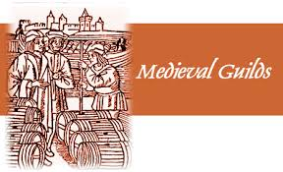

Slide 4
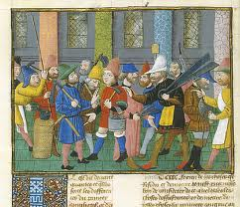
Masters

Slide 5
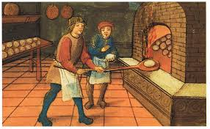
Apprentice

Slide 6
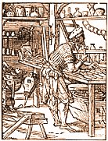
Journeymen

Slide 7
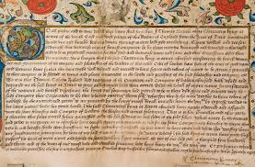
Charters

Slide 8
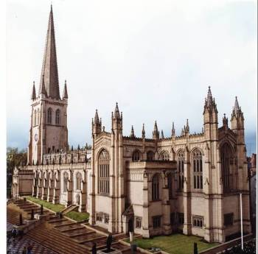
Scholasticism

Slide 9
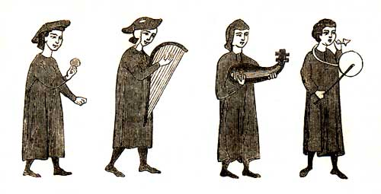
Troubadours

Slide 10
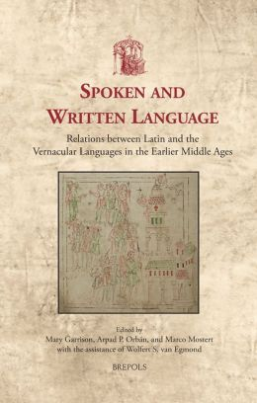
Vernacular

Slide 11
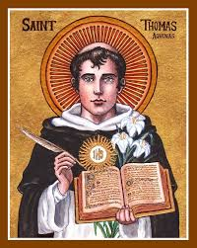
Thomas Aquinas
Wrote “Summa Theolgica”
He was a scholastic thinker in A.D 1200

Slide 12
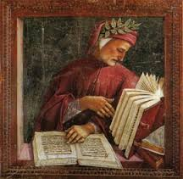
Dante Alighieri
Wrote the “Divine Comedy”
Written in Italian
Describing the imaginary journey from Hell to Heaven

Slide 13
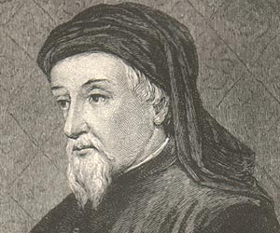
Geoffrey Chaucer
Produced the “Canterbury Tales”
From about A.D 1386 to 1400

Slide 14
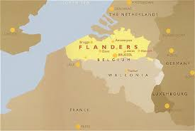

Slide 16
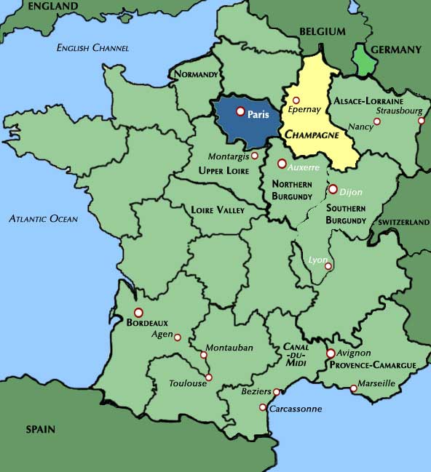

Slide 17
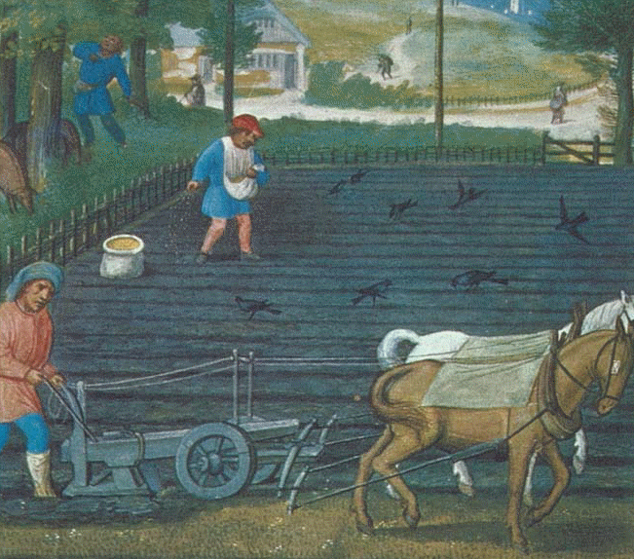
Agricultural Advances
With the Invention of a new heavier plow, farmers were now able to cut through the thick clay soil of Northern Europe and plant more crops.

Slide 18
Expansion of Trade
The revival of towns caused a explosion of trade between cities and villages.
The new Invention of the Money Economy which replaced the barter system and made it easier to buy and sell items.

Slide 19
Universities
Universities started as guilds of Scholars
Books were rare. Many lessons were taught orally
Mainly focused on law, medicine, liberal arts and theology

Slide 20
Scholasticism
A new type of learning that emphasized reason as well as faith in the Christian Church.
Taught in some Universities

Slide 21
Art and Literature
Medieval Literature was mainly written In Vernacular or language of everyday speech. Instead of the using Latin they used the language of their home country.
Narrative poems and comedy's became increasingly popular
Medieval Church were now built in a style called Romanesque. This style combined features from Roman and Byzantine empire

Slide 22
Additional Information
Burghers, name for the rise of the middle class. Also called bourgeoisie in France and burgesses in England.
Commercial Capitalism, economic system in which people invested in trades and goods to make profits.
During the middle ages, they began to eat better which led to them living longer, healthier lives. The better iron-rich diet increased women’s life span which helped them survive childbirth. These affects doubled Europe’s population.

Slide 23
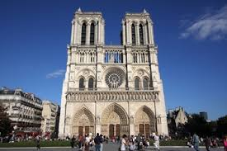
Additional Information, continued.
Justinian had the black plague in 541 but survived it. He wasn’t the same after the Plague which is where he got his brutality. About 10-15 cases
Per year in America still today.
Gothic Architecture,
For example,
Notre Dame.

Slide 24
Pull out guiding reading, we’re going to discuss it.

Slide 25
Work Cited
"Middle Ages, Dynamic Culture of the Middle Ages." Middle Ages, Dynamic Culture of the Middle Ages. N.p., n.d. Web. 06 Mar. 2014.

