Slide 1
13.3 Strengthening of Monarchy
shawnee
By:
Devan Miller
Shawnee Morrow
Nate Offard

Slide 2
Cortes
nate
The gathering of nobles, clergy, and town officials in old Spain.

Slide 3
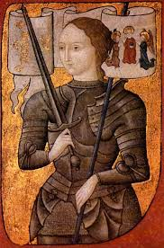
Joan of Arc
shawnee
Gained control of French troops.

Slide 4
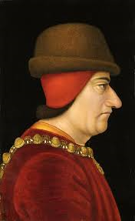
Louis XI
devan
Set out to unite France.

Slide 5
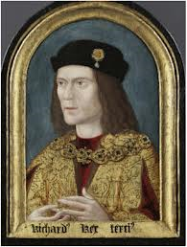
Richard III
nate
Proclaimed himself king.

Slide 6
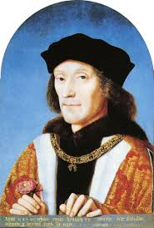
King Henry VII
shawnee
The first Tudor king.

Slide 7
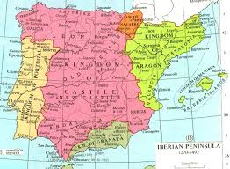
Aragon and Castile
devan
Aragon castile
Mediterranean cost in the center

Slide 8
Additional Info
nate
Henry is the king of Germany.
Conflict between France and England called the hundred years war.
henry was the founder of Tudor dynasty.

Slide 9
More information
shawnee
The first firearm in Crecy.
The battle of agincourt.
Henry broke ties.

Slide 10
Extensive information
devan
Aragon and castile armies ended religious toleration.
Moors and Jews were forced to leave Spain or convert to Catholics.

Slide 11
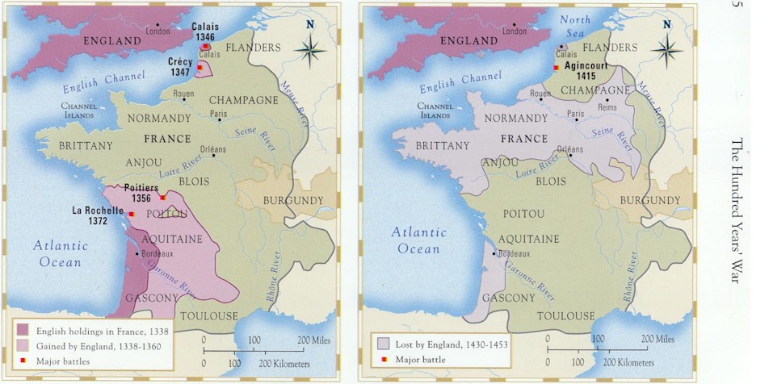
MAP
nate
Crecy Agincourt
France Burgundy

Slide 12
Guided reading pages 329-332
Castile longbow Louis xI
Edward III A.D. 1453 york
Aragon feudal the bold
Seven Joan of arc firearms
Lancaster

Slide 13
Work cited
Mysocialclass.com
Royal.gov.uk
Quia.com
Lancefuher.com

