Slide 1
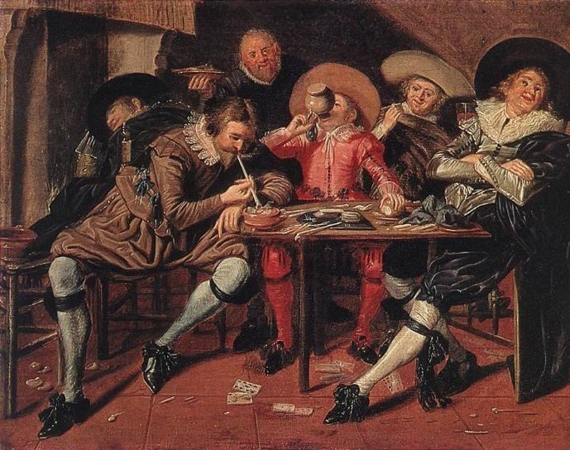
16.1 Italian Renaissance
Andrew Drock and Coleton Gabriel

Slide 2
Dem Key Terms Doe
Humanism – A focus on the Human Nature instead of a Religious
Individualism – Emphasis on dignity and self worth of the Individual
Secular – A worldly view on things (not religious)
Sonnet – Poetry form with 14 lines and fixed Rhyme and meter
Doge – a High merchant or a Very wealthy one Elected to run a Merchant Republic (Venice) (Genoa)
*Key Terms

Slide 3
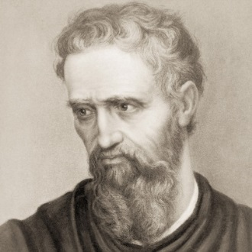
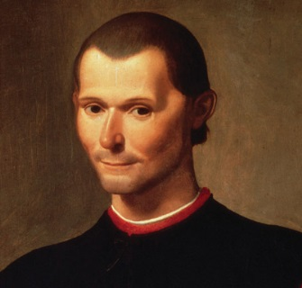
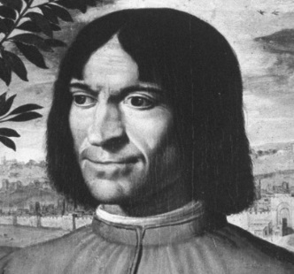
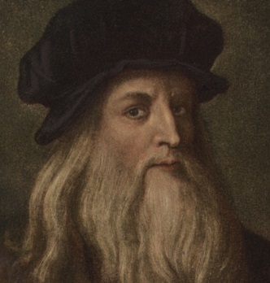
Dem peoples
Michelangelo Buonarroti – Sculptor and painter created the statue of David (Old Jewish King)
Niccolo Machiavelli – Author of The Prince.
Lorenzo de Medici – Ruler ~ Florentine Republic during the Italian Renaissance.(1469 to 1478)
Leonardo da Vinci – Leading Artist of Italian Renaissance. Inspired many. Considered the”light” of the Renaissance.
*Key People

Slide 4
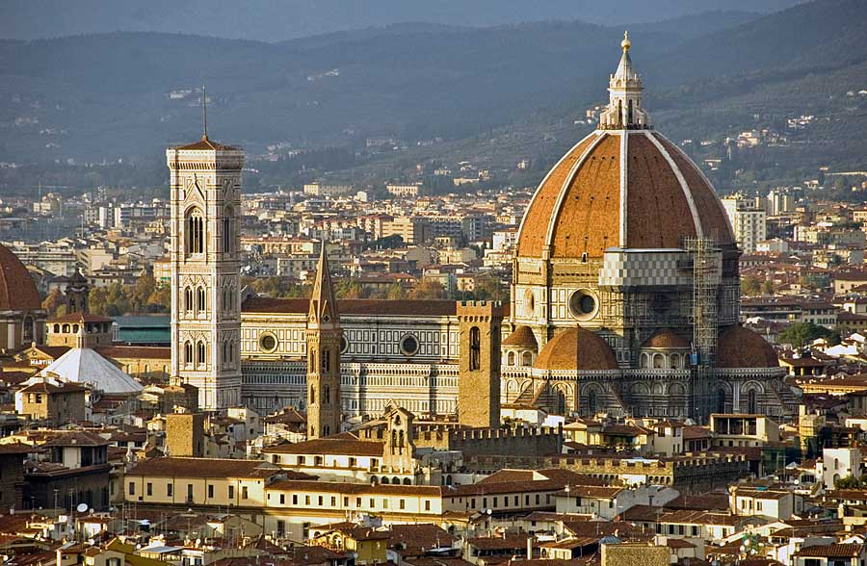
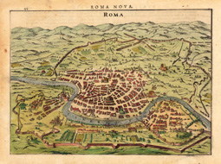
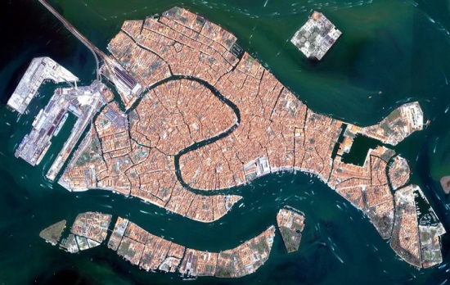
Chill Places
*Key Places
Florence – Was originally a Trading Republic. 1434 ruled by the Medici Family. Rebellion led to the Medici Family ousted they returned to power in 1484.
Rome – Top Dog city. 1500s Leading in architecture and art. Rebuilt the St. Peter’s Basilica
Venice – Head of trade in the Renaissance. Led by a Doge who was elected by the wealthiest families. Connected the West with the Byzantine and Muslim east.

Slide 5
Additional Information
Leonardo da Vinci - Artwork that he has created includes: Head of a Women, Virgin of the Rocks , Leda and the Swan, and many more.
In the Fifteenth-century Italy was unlike any other place in Europe. It was divided up and with different governments.
Florence is where the Italian Renaissance started; large banking city; third largest in Europe.
During the Renaissance , people started to be curious with the world. Starting to advance in technology and have ideas of airplanes and etc.

Slide 6
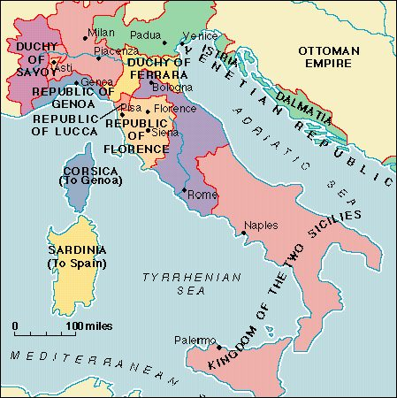
Map of Italy 1494

Slide 7
Citing
"Dirck Hals Paintings - Dirck Hals Merry Party in a Tavern Painting." Dirck Hals Merry Party in a Tavern Painting 50% off. Web. 07 Apr. 2014.
"Leonardo Da Vinci Biography." Bio.com. A&E Networks Television. Web. 06 Apr. 2014.
"Lorenzo De' Medici Biography." Bio.com. A&E Networks Television. Web. 07 Apr. 2014.
"Michelangelo Biography." Bio.com. A&E Networks Television. Web. 05 Apr. 2014.
"Michelangelo Biography." Bio.com. A&E Networks Television. Web. 05 Apr. 2014.

Slide 8
MLA citing

