Slide 1
16-2 Northern Renaissance
John Goebel\Thomas Rash\ Devin Green

Slide 2
Desiderius Erasmus
Date of birth-October 27, 1466
Inspired his colleagues to study
One of the most famous Christian humanist
Also used biting humor
attacked the wealth of renaissance popes
He had a friend named Thomas more a statesmen
Clamed the popes where corrupt
Made notes of a lot of things

Slide 3
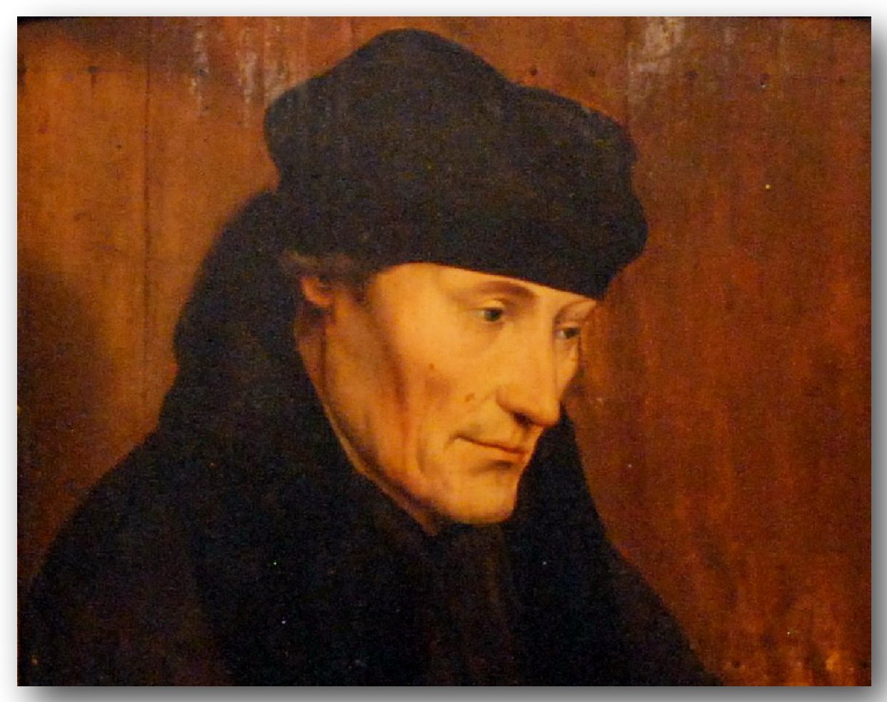

Slide 4
Johannes Gutenberg
Born in 1399
Invented the first printing press
Printed full edition of the bible 1456
more books published
Books less expensive
Revolutionized printing
Sped up publishing

Slide 5
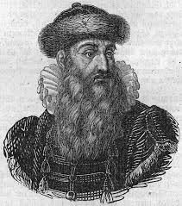

Slide 6
Francois Rabelais
Date of birth February 4, 1494
Most popular renaissance artist
Wrote comic tales
Parodies on a broad spectrum of life
Rejected middle ages
Believed people should enjoy life

Slide 7
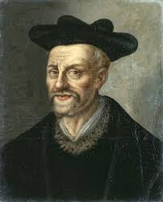
If you wish to avoid seeing a fool you must first break your looking glass.
I won't undertake war until I have tried all the arts and means of peace.
Famous quotes made by François Rabelais
We always long for the forbidden things, and desire what is denied us.
Ignorance is the mother of all evils

Slide 8
William Shakespeare
Date of birth- April 23 ,1564
English poet
Called England's national poet
A famous playwright
had 7 siblings
Wrote of 73 plays
Made 145 sonnets

Slide 9
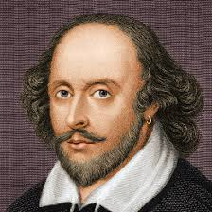

Slide 10
Christian Humanism
Social teachings through Jesus
had more of a religious look on life
wanted to reform Catholicism
They also wanted to restore early church

Slide 11
The French renaissance
Architects used arches to create chateaux
many famous pieces of art where made

Slide 12
English Renaissance
Many authors became famous
Many authors where discovered
Society came under disruptions

Slide 13
Additional Information
artists had much detailed art work
Oil painting became more popular
More medieval style art was used rather than classical
Italian traders of the north appreciated wealth
Northern Europeans began to study with Italian masters

Slide 14
Work cited
English Literature. Web. April 7, 2014.
http://www.britannica.com/EBchecked/topic/188217/English- literature/12806/The-Renaissance-period-1550-1660
The Complete Works of William Shakespeare. Web. April 7, 2014. http://shakespeare.mit.edu/

