Slide 1
The Protestant Reformation
section 16.3
Liam Morice Shawnee morrow
Jordan Beck

Slide 2
Justification by faith
Made just or good by faith in god’s mercy.

Slide 3
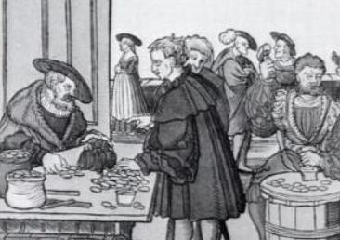
indulgence
Certificate said to reduce or cancel punishments for sins.

Slide 4
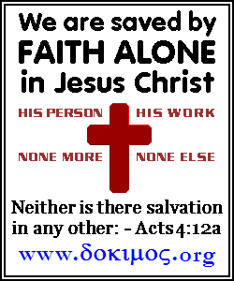
vocation
Callings so People could serve god.

Slide 5
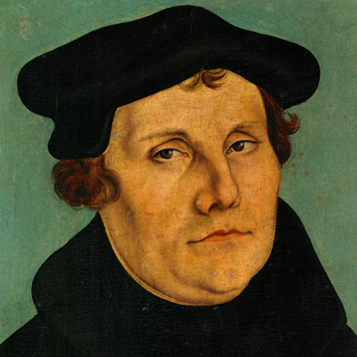
Martin Luther
A German monk who began the protestant reformation.

Slide 6
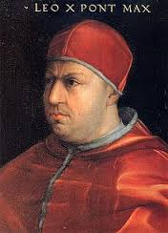
Pope Leo x
Raised money to rebuild St.Peters Basilica.

Slide 7
Additional information
Luther posted 95 theses on the door to protest.
Pope Leo was born at Florence and died in Rome. He was the second son of Lorenzo.
The bible-the source of religious truth. The bible was translated to German.

Slide 8
Additional information
The diet of worms was a council that declare Luther an out law.
Expulsion from the catholic church was called excommunication.
study’s god and religious truths are theologists.
Reformation appeared in Germany, a lot of animosity existed.

Slide 9
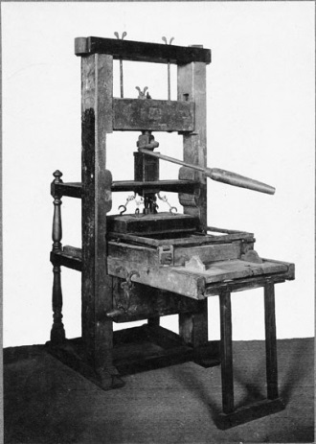
Extensive info
The printing press-The printing press was invented in 1436 by Johannes Gutenberg. Martin Luther used it to print the 95 theses and the Luther bible, which had a huge impact, going out to Germany, France, England, and Italy.

Slide 10
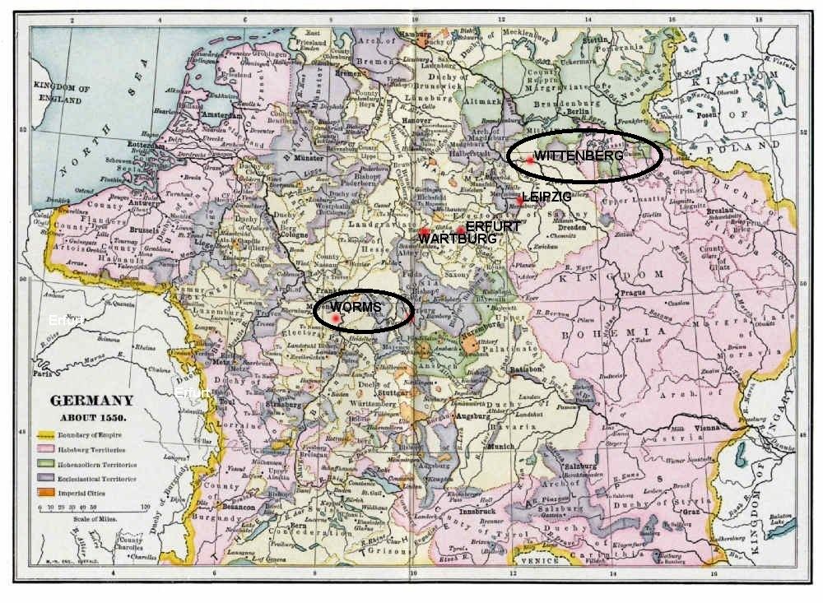

Slide 11
Work cited
"Early Life." N.p., n.d. Web. 1 Apr. 2014.
Pope Leo X. N.p., n.d. Web. 3 Apr. 2014
"The Protestant Reformation." Quia. N.p., n.d. Web. 3 Apr. 2014

