Slide 1
16.4 The Spread of Protestantism
Abbie Riffel & Rachel Breckenridge

Slide 2
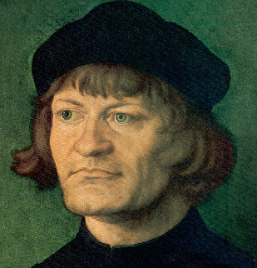
Huldrych Zwingli
A Swiss priest that lived from 1484 to 1531.
Led the protestant movement in Switzerland

Slide 3
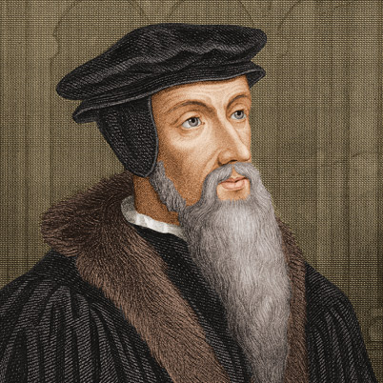
John Calvin
Born in 1509.
Received education in theology, law, and humanism.

Slide 4
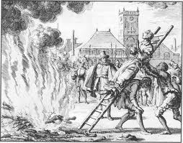
The Anabaptists
Initiated the practice of baptizing, or admitting into their groups
Believed true Christians should form a separate community

Slide 5
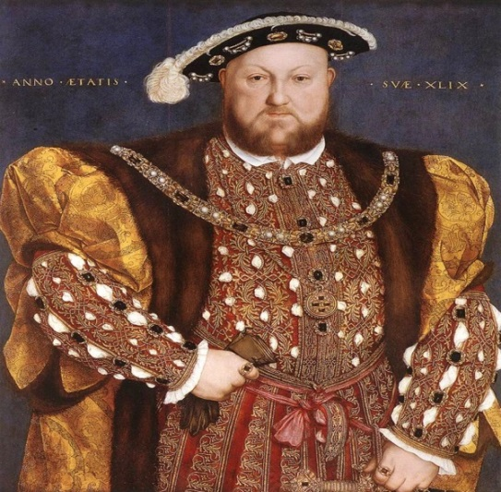
King Henry VIII
Was King of England from 21 April 1509 until his death
Supposedly killed 2 of his wives cause they couldn’t give him a son.
Had 6 wives and 3 kids (1 son, 2 daughters)

Slide 6
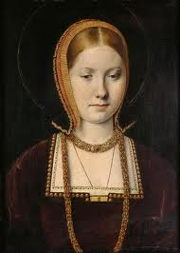
Catherine of Aragon
Had borne six children, only one had survived

Slide 7
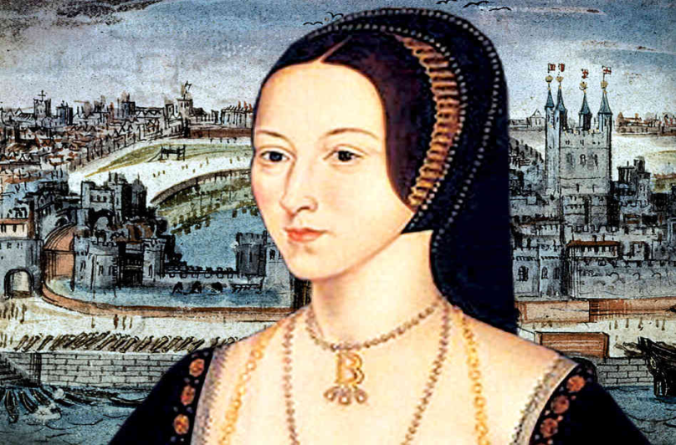
Anne Boleyn
Was Henry’s 2nd wife
Gave Henry another daughter named Elizabeth.
was Queen of England from 1533 to 1536

Slide 8
Bloody Mary
Killed about 300 Christian Protestants.
Did this by having them tied up and setting them on fire.
Widely remembered for the hard line stand that she held
Wanted to rid England off the protestants
Raised in a catholic background.
Credited with restoring the Pope as the head of the church.
First female Queen in England.

Slide 9
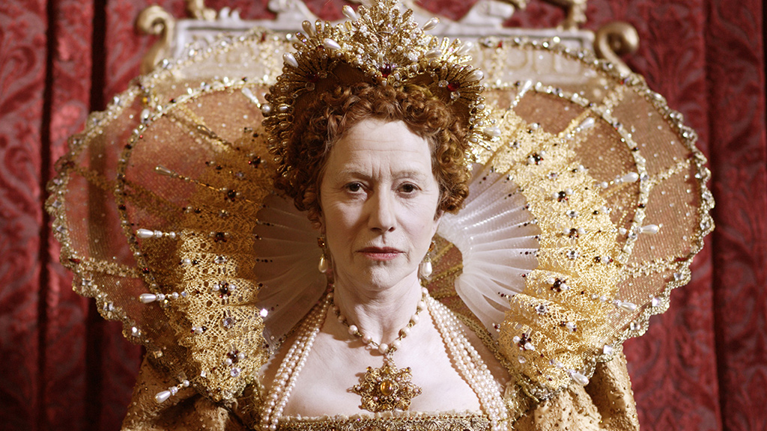
Elizabeth I
To unite her people she followed a moderate course in religion
She made the English church Protestant with some catholic features

Slide 10
Extensive Information
All citizens were required to attend reformed church services several times each week
The consistory inspected homes annually to make sure no one was disobeying the laws

Slide 11
Additional information
People agreed that Martin Luther’s actions were the major trigger for the European Reformation
The protest movements formed the Protestant Reformation
Once Martin Luther posted a 95-page thesis the ideas contained within it began to spread to the many different parts of Europe
People started using Luther’s ideas to help form their own church denominations
Protestantism started and the prominent idea behind this branch of Christianity was justification by faith alone
The whole notion of leaving America and traveling to another world to worship God on their own terms began to appeal to many people.

Slide 12
