Slide 1
16-5 The Catholic Reformation
Ellen DeBold, Sarah Blalock, Ashlee Vastine.

Slide 2
Terms
New style of art and architecture.
Theological school.

Slide 3
People
Pope Paul III
The Jesuits
Ignatius of Loyola

Slide 4
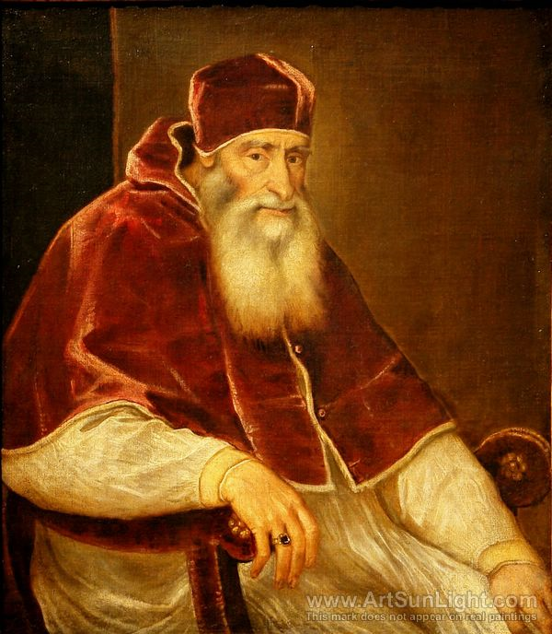
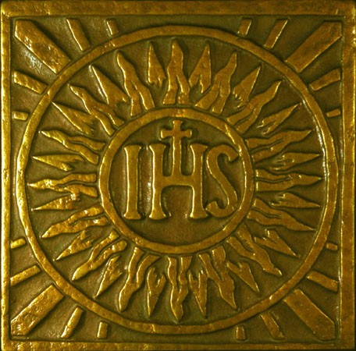
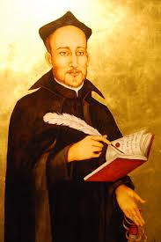

Slide 5
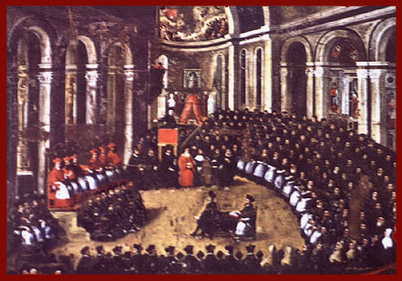
Council of Trent.
Reaffirmed catholic teachings that had been challenged by the Protestants.
Put an end to many church abuses.
Decided that each diocese had to establish a seminary.

Slide 6
The Inquisition
Was strengthened to deal with the protestant threat.

Slide 7
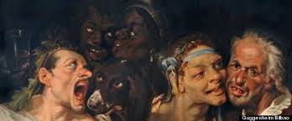
The Arts
Used to further the Catholic Reformation
Rituals and Church art
Rituals should only be read in Latin.

Slide 8
Ignatius of Loyola.
1540- Pope recognized a new religious order.
Jesuits worked to spread Catholicism and combat heresy.

Slide 9
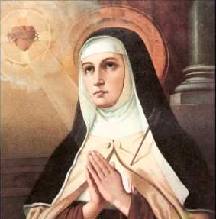
Teresa of Avila.
Spanish nun
Born in 1515 to a noble family
Was made a saint after her death

Slide 10
A Divided Europe
Charles V tried to stop the spread of Protestantism in his domains.
Peace of Augsburg

Slide 11
Reasons Why Europeans in Large Numbers Supported Protestantism
Undoubtedly religious conviction
They seized lands a wealth owned by the church
Townspeople rallied to the new faith
They saw Protestantism as a way to defy an Italian-controlled Catholic church

Slide 12
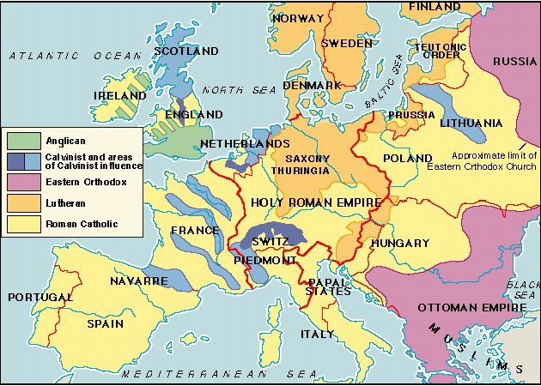

Slide 13
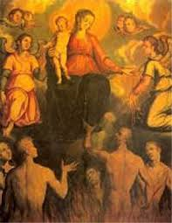
Additional Information
Causes of the Reformation
The Lutheran Reformation
The Diversity of Protestantism

Slide 14
Additional Information
1560 - 1715: Europe witnessed thirty years of international peace
The war began in Bohemia, an area where the Germans, Czechs, Lutherans, Calvinists and Catholics lived in peace.
The Battle of the White Mountain and the collapse of the Bohemian Protestantism was a victory for the Catholics.

Slide 15
Citations
"The Reformation of Religion, 1500-1560." The Reformation of Religion, 1500-1560. Pearson. Web. 03 April. 2014
Kries, Steven. "Lecture 6: Europe in the Age of Religious Wars, 1560-1715." Lecture 6: Europe in the Age of Religious Wars, 1560-1715. 04 Aug. 2009. Web. 03 Apr. 2014.

