Slide 1
17.1 Early Explorations
Tara Jolley and McCoy Meshach

Slide 2
The Start of Key Terms Cartographer

Slide 3
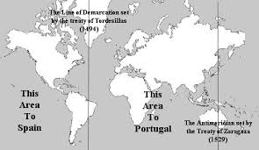
Line of demarcation

Slide 4
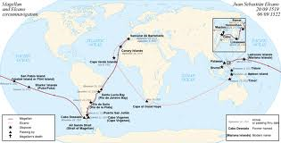
Circumnavigate

Slide 5
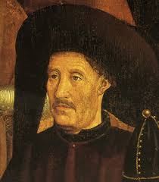
The Start for People Prince Henry the Navigator

Slide 6
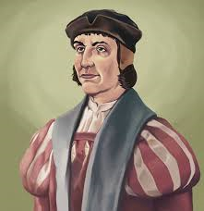
Bartholomeu Dias

Slide 7
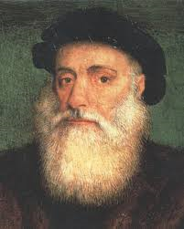
Vasco da Gama

Slide 8
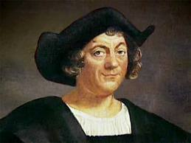
Christopher Columbus

Slide 9
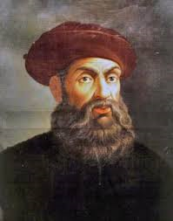
Ferdinand Magellan

Slide 10
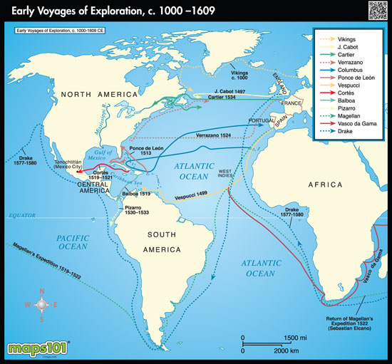

Slide 11
Reasons for Exploration
Wealth
Land
Spreading their Religion
Quicker trade route to Asia

Slide 12
Technology of an Explorer
Compass
Astrolabe
Cartographers
Faster ships with triangular sails
Improved rudder
* Key Terms

Slide 13
Portugal leads the way
Under Prince Henry the Navigator Portugal set there sights on sailing around the southern tip of Africa.
Bartholomeu Dias was the first to accomplish this task and named the southern tip of Africa the Cape of Good Hope.
Vasco da Gama was the first Portuguese man to sail from Portugal to India and establishing a major trade route.
* Key People

Slide 14
Additional Information
Ferdinand Magellan’s death
Diseases brought to the New World
The Age of Exploration ended in the early 17th Century.

Slide 15
Additional Information
Columbus Wasn’t the first to discover America but he did pave the way for the other Europeans.
First discoverer of America
Chinese explores
Other Countries

Slide 16
Works Cited
"Age of Exploration." About.com Geography. Web. 02 Apr. 2014.
“Ferdinand Magellan Biography.” Bio.com.
A&E Networks Television. Web. 03 April 2014.
"Native American Netroots." Native American Netroots. Web. 02 Apr. 2014.
“Exploration of North America.” History.com. A&E television Networks. Web. 02 Apr. 2014.

