Slide 1
Overseas empires 17.2
By Nate Offard . Rebecca Smith, Devan Miller

Slide 2
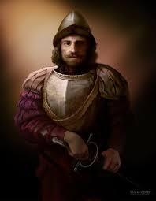
Conquistadors-or conquerors, came to the Americas and landed in Mexico, 1519, about 600 men 16 horses and a few cannons

Slide 3
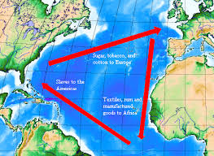
* Key Terms
Triangular trade-slave trade route formed by Africa ,Americas and Europe
The middle passage-area of triangle trade between the west coast of Africa and the Americas

Slide 4
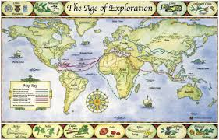
* Key Places
Brazil- colonized by the Portuguese ,south America
Peru- once ruled by the Incas, Spaniards arrived caused conflict, eventually conquered the area
West indies- Spanish empire, by 1600s
Quebec- founded in 1608 by Samuel de Champlain, French
Jamestown-first English settlement, North America, founded in 1607

Slide 5
People
Pedro Alveres Cabral
Portuguese conquistador
Started a trade war with Muslim merchants in 1500 ,had 13 ships
Sighted an island and named it true cross-additional info
Hernan Cortes
Conquistador, landed in Mexico in 1519
Had 600 men ,16 horses and a few cannons
Served governor from 1521 to 1528.-additional info
Montezuma II
Aztec ruler
Met Cortes in 1519.-additional info
Francisco Pizarro
Invaded Incan empire in present day Peru in 1532
Sailed for Spain
Atahualpa -Incan ruler won throne from his brother
* Key People

Slide 6
People (cont.)
Henry Hudson
English navigator
Claimed land for Dutch
Jacques Cartier
Sailed St. Lawrence river
French
Samuel de Champlain
French map maker
Founded Quebec
John Cabot
Italian born
Explored present day Newfoundland
* Key People

Slide 7
Extensive information
Triangle trade
tribal people from Africa, people traded goods with local rulers for them
they were forced on ships to the Americas ,trade route was formed between the Americas England and Africa
The voyage to the Americas was horrible for the Africans, part of trade route was called the middle passage
packed tightly into the hull of the ship, were all chained together
Altogether about 10 to 24 million of them
1 in 5 died
Some tried to resist and managed to escape

Slide 8
Extensive info (cont.)
Conquistadors
Conquistadors came to the Americas, “to serve his god and his majesty, to give light to those who were in darkness and to grow rich as all men desire to do”
Well armed
Brought war to Mexico, the local tribes mainly Aztecs

Slide 9
sources
www.britannika.com
www.latinamericahistory.about.com
www.Aztechhistory.com

