Slide 1
Changing Ways of Life
Chapter 17 Section 3
Nicole Rasdall, Star Charlton, Alan Peterson

Slide 2
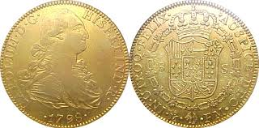
The Commercial Revolution
The Commercial revolution
formed roots of modern financial and business life.

Slide 3
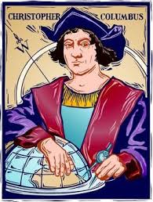
New Business Methods
Overseas venture became a major undertaking
Merchants turned to bankers and wealthy families to help finance expeditions

Slide 4
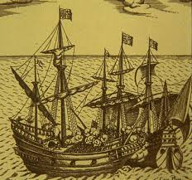
New Business methods continued…
merchants waned to invest in JOINT-STOCK COMPANIES
By combining money and ideas, raw material, and labor.
ENTREPRENEURS were able to make goods and profits
*KEY TERMS

Slide 5
Medici of Florence

Slide 6
Medici
The Medici family, also known as the House of Medici
the family’s support of the arts and humanities made Florence into the cradle of the Renaissance

Slide 7
Fuggers of Augsburg

Slide 8
Fuggers
In 1441 Jakob had married the daughter of a mint master who went bankrupt three years later.
After his death in 1469, two of his seven sons, Ulrich and Georg, profitably expanded the firm’s international trade.

Slide 9
More Key Terms
MERCANTIALISM
New theory
National economic policies
BULLION
Owned gold or silver
BALANCE OF TRADE
Exporting more goods than they imported
*KEY TERMS

Slide 10
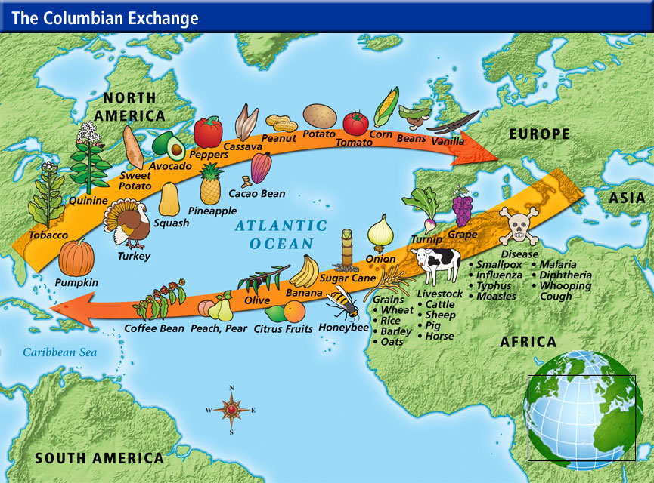
Increase in trade
Countries bordering the Atlantic
Ex. Portugal, Spain, England, Netherlands

Slide 12
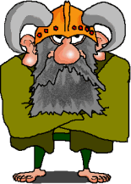
Vikings
The evidence seems to point to Vikings making contact with American Indians
as long ago as the 10th century

Slide 13
Native Americans
Christopher Columbus landed on an island in the Caribbean in A. D. 1492
Europeans killed many Native Americans threw diseases
Europeans concurred Indian territories

Slide 14
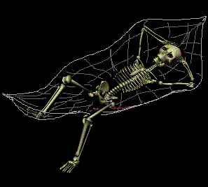
After effects of the Black Death
1450 Europe had a 55 million people population
after the black death the population nearly doubled to 100 million
towns expanded as well and more people moved towards rule areas
https://www.youtube.com/watch?v=rZy6XilXDZQ

Slide 15
Works Cited
"American History Myths Debunked: Columbus Discovered America - ICTMN.com." Indian Country Today Media Network.com. Web. 03 Apr. 2014.
"Black Death ("Hollaback Girl" by Gwen Stefani)." YouTube. Web. 03 Apr. 2014.
"Columbian Exchange - St. Johns Country Day School. Heinrich Learning Resource Center." St. Johns Country Day School. Heinrich Learning Resource Center. Web. 03 Apr. 2014
"StudyGuide: Ch. 33 The Age of Exploration." Study Guide: The Age of Exploration. Web. 03 Apr. 2014.
"NebraskaStudies.Org." NebraskaStudies.Org. N.p., n.d. Web. 03 Apr. 2014
Blendinger, Friedrich. "Fugger Family (German Family)." Encyclopedia Britannica Online. Encyclopedia Britannica. Web. 07 Apr. 2014.

