Slide 1
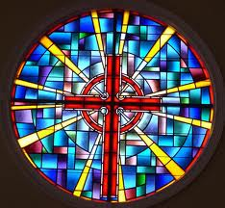
12.3 The Medieval Church Liam Morice Jordan Beck and Rebecca Smith

Slide 2
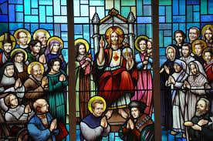
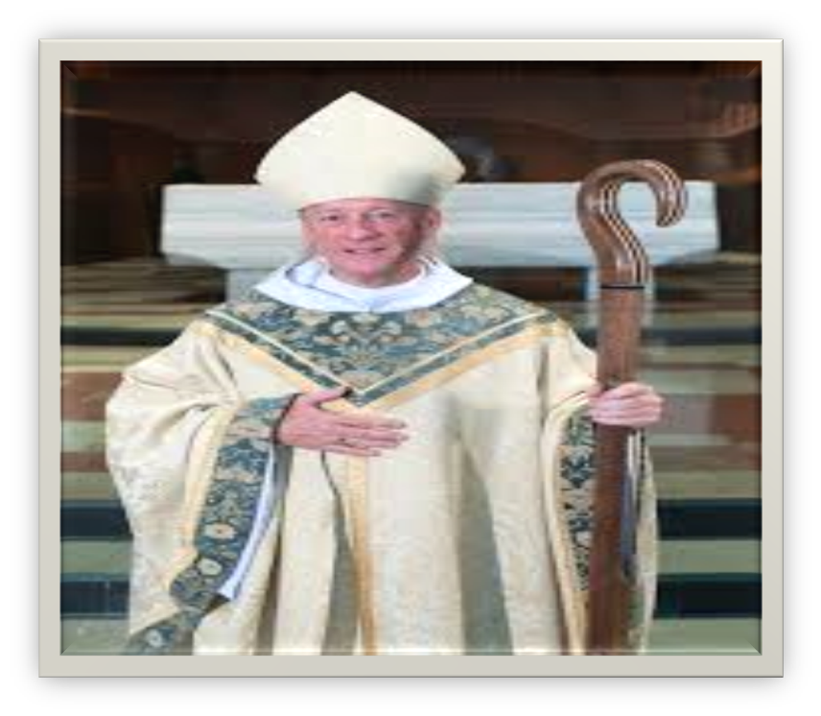
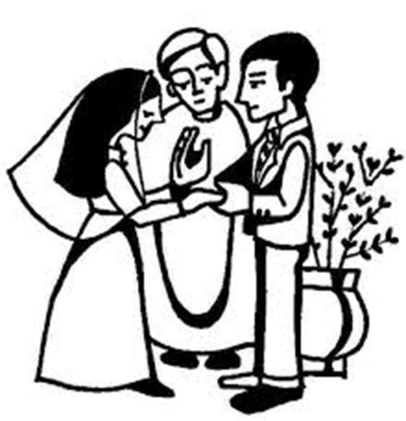
Sacrament – One of the established formal rituals of the roman catholic church such as baptism holy communion or matrimony.
Abbot – The head of the monastery.

Slide 3
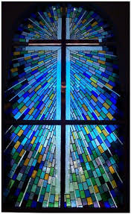
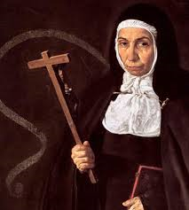
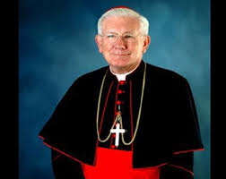
Abbess – The director of the Covent.
Cardinal – High ranking official of the roman Catholic church appointed by the people.

Slide 4
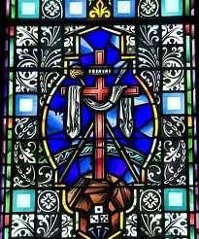
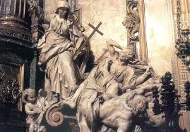
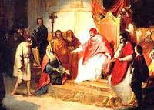
lay investiture - Medieval practice in which secular rulers appointed in inaugurated church officials such as bishops
L
Heresy- The denial of basic church teachings.

Slide 5
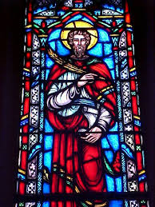
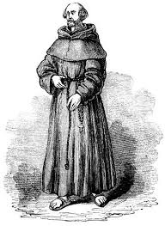
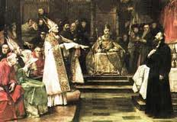
Excommunication - Expulsion from the church
Friar- Wandering preachers

Slide 6
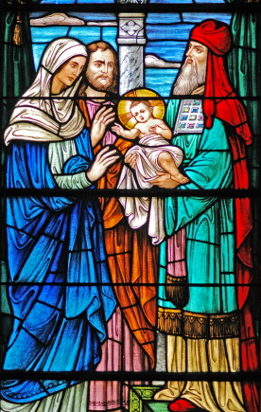
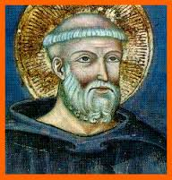
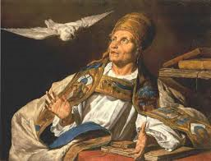
Benedict- founded a monastery.
Gregory I- adopted the Benedictine rule to spread Christianity.

Slide 7
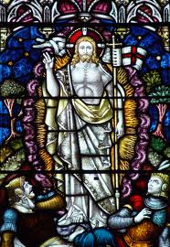
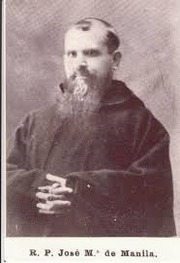
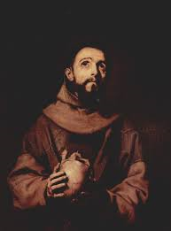
Dominic- a Spanish priest organized the Dominican friars in AD 1215.
Francis of aussi- son of wealthy Italian cloth merchant founded the francism friars about in AD 1210

Slide 8
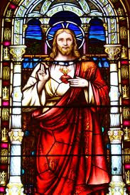
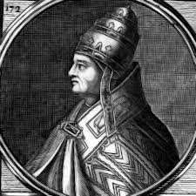
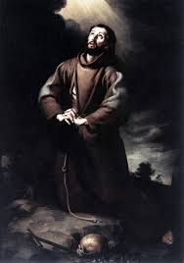
Gregory VII- complete jurdisction over the church officials.
Innocent III- one of the most powerful popes also tried to reform the catholic church.

Slide 9
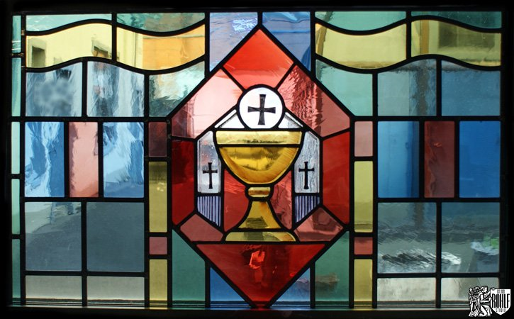
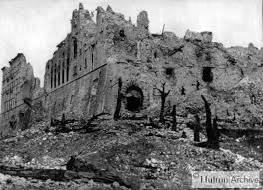
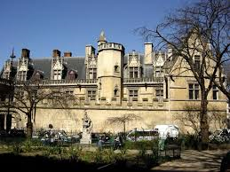
Monte casino- a monastery in 5929
Cluny was the most famous monsetary

Slide 10
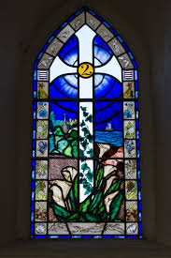
Since the fifth century, the popes of the catholic church had claimed supremacy over the affairs of the church.
By eleventh century, church leaders realized the need to free the lords interference in the appoint men of church officials.

Slide 11
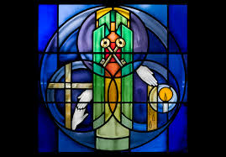
Pope Gregory VII decided to fight this practice elected pope in 1703. Gregory was convinced that he had been chosen by god to reform the church.
The church would appoint clergy and run its own affairs.

Slide 12
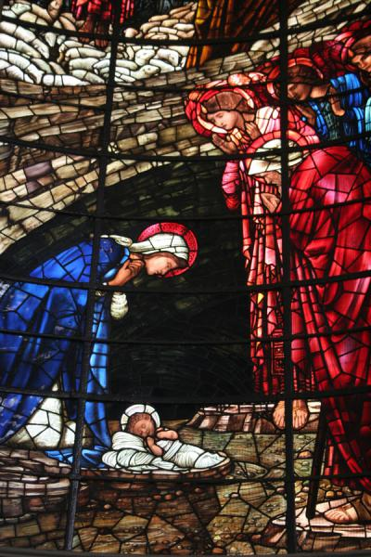
Pope Gregory VII also tried to improve the church’s ability to provide spiritual guidance to the faithful.

