Slide 1
13-1 The Crusades
Ellen DeBold, Sarah Blalock, Ashlee Vastine.

Slide 2
Terms
Expeditions to recover the holy land from the Muslims
^This is the only term.

Slide 3
people
The Seljuk Turks
Pope The Urban II
Saladin
Richard I

Slide 4
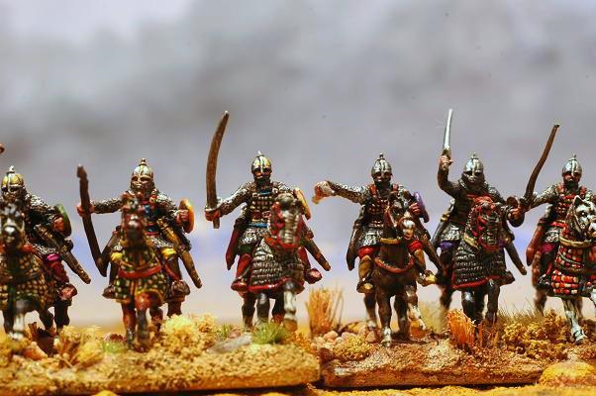
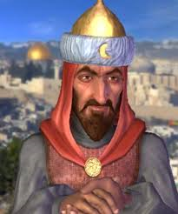

Slide 5
Guided Reading
Muslims
Seljuk Turks, Constantinople
Pope Urban II, 1095
1099
Byzantines, Muslims
Jerusalem
Feudalism
Trade
Technology.

Slide 6
The First Crusade
The First Crusades- The Crusaders took over many of the cities on the Mediterranean coast .
Historians consider the preach by Pope Urban II at Clermont-Ferrand to be the spark that fueled a wave of military campaigns to wrest the Holy Land from Muslim control.
In June 1099, the Crusaders began a five-week blockade over Jerusalem, in June 15, 1099.
The knights, guided by Armenian Christians marched to Jerusalem through Seljuq-controlled territories in modern Turkey and Syria.

Slide 7
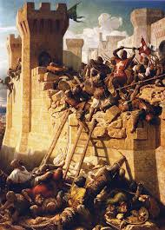

Slide 8
The Second Crusade
The Second Crusade took place from 1145 to 1149.
large armies from England, France, Germany and other smaller nations marched to Constantinople
Within months, large armies from England, France, Germany and other smaller nations marched to Constantinople.

Slide 9
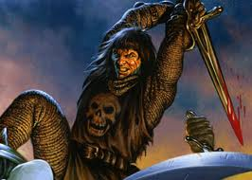

Slide 10
The Third crusade
The third crusade took place forty years after the second crusade.
The Third Crusade was taken over by the leadership of Saladin and Richard the Lionheart.
Saladin Captured Jerusalem in 1187.
On September 2, 1192 Richard and Saladin signed a treaty where Jerusalem was under Muslim control, but let unarmed Christian pilgrims to enter the city.

Slide 11
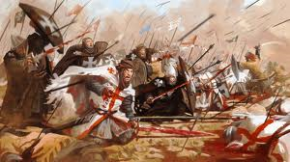

Slide 12
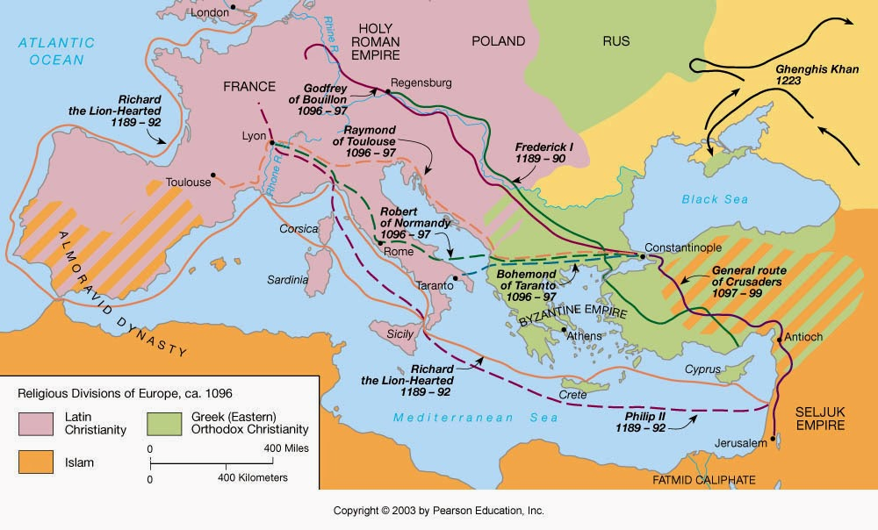
Routes of the Crusades

Slide 13
Citations
Helmut, Nickel. "Heilbrunn Timeline of Art History." The Crusades (10951291). Met Meuseum, n.d. Web. 03 Mar. 2014.
"The Second Crusade." The Second Crusade. Joax, n.d. Web. 03 Mar. 2014
Truman, Chris. "The Third Crusade." The Third Crusade. Buissness Data, n.d. Web. 03 Mar. 2014

