Slide 1
Section 13.4 The troubled churches
By: Abbie Riffel, Rachel Breckenridge, and Tritten Hunt

Slide 2
Key Terms
Pilgrimages- journeys to holy places. Like going to church
Simony- the selling of church positions. Those help wanted adds that you posted for somebody to become a minister.

Slide 3
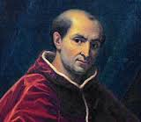
Pope Clement V
A French archbishop
Real name Bertrand De Got
Clement V was the first pope of the so-called "Babylonian Captivity," also known as the "Avignon Exile” (see question 2 on guided reading)
He moved the papacy to France to escape the civil wars that were disrupting Italy. (see question 1 on guided reading)

Slide 4
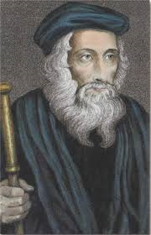
John Wycliffe
A scholar at Oxford University in England.
Criticized the churches wealth, corruption among the clergy, and the popes claim to absolute authority.(see question 6)
Claimed that the Bible was sole authority for religious truth.
The Church didn’t want him to translate the Bible into English because the church doctrine held that only the clergy could interpret God’s words in the Bible.(see question 7)

Slide 5
The Lollards
Wycliffe's followers were known as this
Angrily criticized the church
Destroyed images of saints
Ridiculed the Mass
Ate communion bread with onions to show that it was no different.
The people’s distrust and dislike of the church was the dislike of abuses within the church especially the fees charged for all church activities.(see question 5)

Slide 6
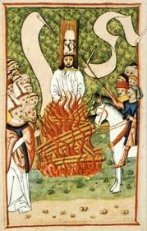
Jan Hus
Called for an end to corruption of the clergy and to excessive papal power within the church.
He was burned at the stake in 1415 because the Holy Roman emperor’s orders were being ignored.(see question 9)
In response of that the Czechs led a revolutionary upheaval in Bohemia
He became important because the Czechs produced religious pamphlets and copies of the Bible in Czech and criticized the corruption of leading church officials. Czechs became aware of their own national identity. They wanted to end German control of their country. They wanted reforms in the Catholic Church in Bohemia.(see question 8)

Slide 7
Great Schism
Lasted from 1378 to 1417
It came about because Roman mobs forced the College of Cardinals to elect an Italian as pope. The pope refused to resign so they elected two different popes.(see question 3)
There were two results that the churches faced which the church faced the dilemma of being led by two popes and it caused serious divisions in the church.(see question 4)
A church council finally met at Constance, Switzerland and ended the schism in 1417

Slide 8
Crusades and Hussites
After the crusades against the Hussites and the compromise they gave the Hussites certain religious liberties in return of their allegiance to the church as a lasting result of the movement.(see question 10)
Crusades plundered without mercy and took what they wanted from the people of what is now known as the Middle East.

Slide 9
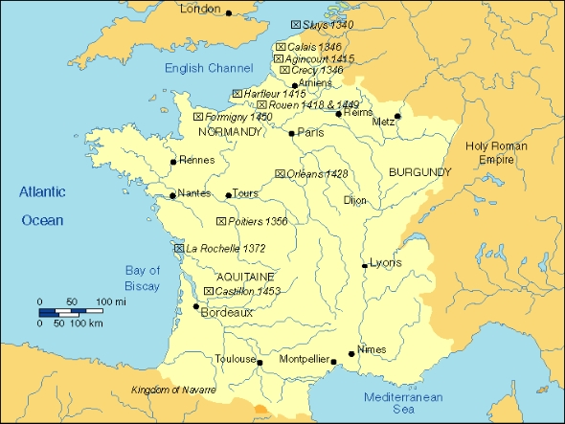

Slide 10
Resources
World History Blue Book- Jackson J. Spielvogel
http://www.historylearningsite.co.uk/cru3.htm

