Slide 1
Strengthening of Monarchy
Lindsey Myers
Rylee Box
Samantha Overturf

Slide 2
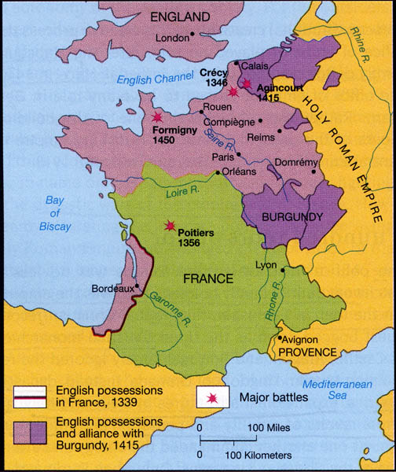
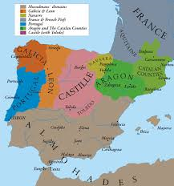
Cortes and Map
Assemblies or gathering.

Slide 3
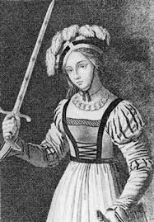
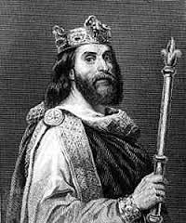
Joan of Arc and Louis Xl
Joan of Arc
1429 A.D.
17 years old.
Could hear Heavenly voices
Led the French army.
She was burned at stake.
Louis Xl
Son of Charles the VII
Strengthened the bureaucracy
United the French feudal land under his crown

Slide 4
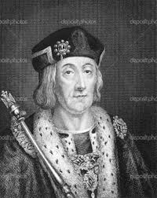
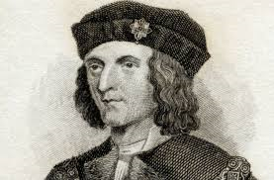
Richard III and Henry VIII
Richard III
King Edward IV’s brother
When Edward died Richard locked his two nephew’s in the Tower of London
Lack of widespread support
Died in 1485 A.D. on Bosworth Field
Fell to the forces of Henry Tudor
Henry VIII
First Tudor king
Became king after he killed Richard
Eliminated royal claimants to the throne
Avoided costly foreign wars
Increased royal power over the nobles
As a result of his ruling, English emerged from War of the Roses strengthened.

Slide 5
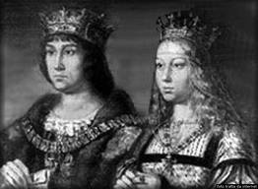
Ferdinand of Aragon and Isabella of Castile
In 1469 A.D. they were married
Had their own laws and officials
Maintained separate governments
Location:
Castile is in the center
Aragon is on the Mediterranean coast
They ended religious toleration
Both owed separate kingdoms

Slide 6
Guided Reading
Feudal Seven Long bow
1453 Joan of Arc York
Aragon Castile
Firearms
Louis XI
Lancaster
Charles The Bold

Slide 7
Answers
Feudal
Edward III
Joan of Arc
1453
Long bow and Firearms
Louis XI , Charles The Bold
York, Lancaster
Aragon and Castile
Seven

Slide 8
Five Extra Facts
Joan of arc is buried in the Winchester Cathedral in Hampshire, England
Aragon died January 7, 1536
Catherine Aragon had two husbands
Richard III wife was Cecily Neville
Louis the XI has a stutter.

Slide 9
Work Sited
http://www.findagrave.com/cgi-bin/fg.cgi?page=gr&GRid=22152
http://tudorhistory.org/aragon/
http://www.richardiii.net/2_1_0_richardiii.php
http://www.nndb.com/people/182/000093900/

