Slide 1
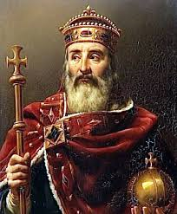
Frankish Rulers
By:
Timmy Toney
Cheyenne Jennings
Eric Ellis

Slide 2
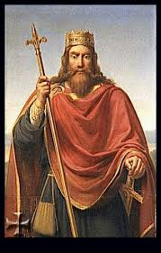
Clovis
became king of the Franks in A.D. 481
Founder of Merovingian dynasty of Frankish kings
Defeated the last roman ruler in Gaul
conquered various Germanic peoples in modern day France
Son of Frankish king Childeris and the Thuringian
first German ruler to accept Catholicism

Slide 3
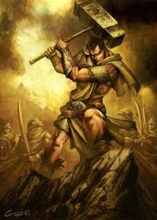
Charles Martel
Known as “The Hammer”
Became Mayor of the palace in A.D. 714
An important military and political leader
Effectively ruled all of the Frankish kingdoms by the end of his reign
Most famous for leading the successful defense of tours France against Muslim forces In A.D. 732

Slide 4
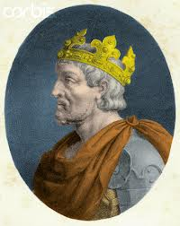
Pepin the short
First Carolingian king of the Franks
Son of Charles Martel and Father of Charlemagne
Ruled Neustria, Burguncy and Provence

Slide 5
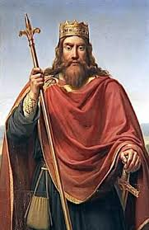
Charlemagne
Known as Karl and Charles the great
Medieval emperor who ruled much of western Europe from 768 to 814

Slide 6
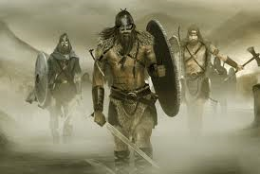
Vikings
Vikings were some of the most brutal human beings that ever lived
When Vikings invaded a country they would claim what they kill, and kill everything
Known for their ships that they used for trade
Had a unique culture including a polytheistic religion

Slide 7
Work Sited
http://www.heritage-history.com/www/heritage.php?Dir=characters&FileName=martel.php
http://historymedren.about.com/library/who/blwwclovis.htm
http://www.infoplease.com/encyclopedia/people/pepin-short.html
http://www.history.com/topics/Charlemagne

