Slide 1
12-2 Medieval Life
Bradley, Riley, Cole, Michaela

Slide 2
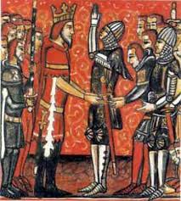
Feudalism
Feudalism is the political alliance of protection between the nobles and the kings
It developed in western Europe
The system was based on giving land to nobles in exchange in military aid and loyalty
in A.D. 900 it took hold of northern France.

Slide 3
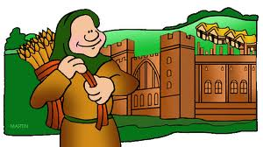
Fief
Fief was a land grant that came with a Castle and Peasants
A Fief needed 15 to 30 Peasant Families
Warriors bought horses and battle equipment

Slide 4
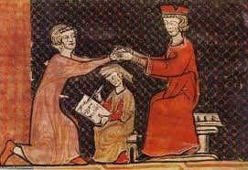
Vassal
A Vassal was a rank of lord which was a noble who served the next higher up
Vassal's owed fealty to there lords
There was female Vassals as well

Slide 5
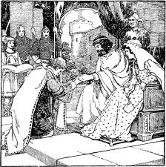
Homage
An official ceremony between a Lord and Vassal
Pledged to be ready for Military service

Slide 6
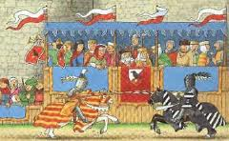
Tournament
Mock battles between Knights to show military skills
Nobles looked forward to them

Slide 7
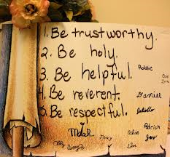
Chivalry
Code in which Knights must follow to be brave and respect women
Knights had several people to help them
Attends helped with horses and kept there gear ready

Slide 8
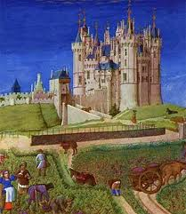
Manorialism
Gave Lords and peasants with food, shelter, and protection
Also called Manorial System, Seignorialism, or Seigniorial System
Started in late Roman Empire

Slide 9
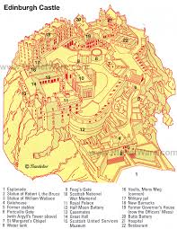
Castle Map

Slide 10
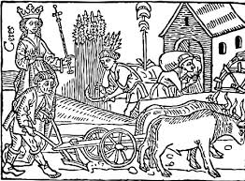
Serf
Bound to manor could not leave with out permission
Grow own food
Daily work consisted of 3 Hours of hard labor
Sunday was the only break day

Slide 11
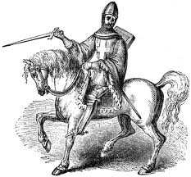
Knights
Protects the village pledges to Lord to full fill his duties
Battles on horseback
Easiest way to become one was to be the son of a Noble
Years of training

Slide 12
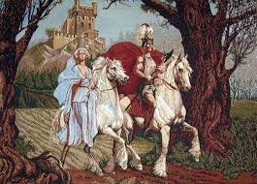
Lords
Almost total authority over anyone
Collected rent
There catsles were build for there protection

Slide 13
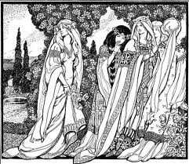
Ladies
Had few rights
Wed as early as 12th birthday
Could take over for lord if need be

Slide 14
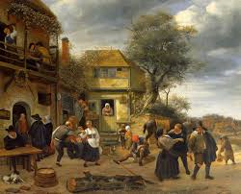
Peasants
Gave the Lord their wealth
Worked on the Lords land
Had to work to survive and Protection

Slide 15
Work-Citied
http://www.britannica.com/EBchecked/topic/206138/fief
http://www.britannica.com/EBchecked/topic/270032/homage-and-fealty
http://www.educationscotland.gov.uk/scotlandshistory/medievallife/knightsandtournaments/
http://www.newadvent.org/cathen/03691a.htm
http://www.britannica.com/EBchecked/topic/362699/manorialism
http://www.clickandlearn.cc/Humanities/DailyLifeSerf.htm
http://westernreservepublicmedia.org/middleages/feud_knights.htm
http://www.lordsandladies.org/life-in-middle-ages.htm

