Slide 1
Economic and Cultural Revival Guided Reading 13-2
By: David Elfrink
Jacob Schmidt
Corey Guay
Nathan Davenport

Slide 2
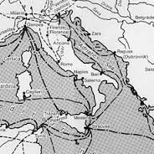
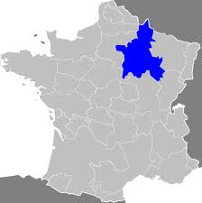
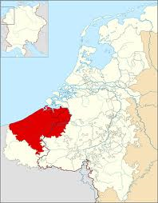
Economic Expansion
Agricultural Advances
Expansion of Trade-
Venice, Champagne, Flanders
Banking-
money economy

Slide 3
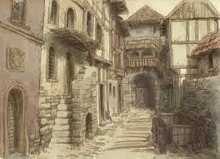
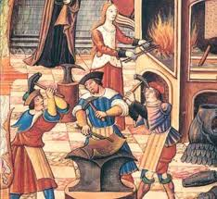
Growth of Towns
Design of the Towns
Guilds-
guilds
masters
apprentices
journeyman
Rise of the Middle Class

Slide 4
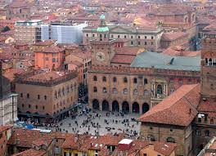
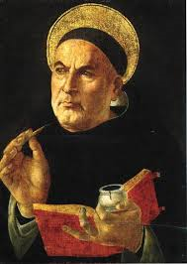
Education
Universities-
Bologna
New Learning-
scholasticism
Thomas Aquinas

Slide 5
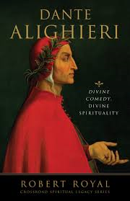
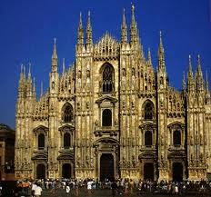
Medieval Literature and Art
Epics and Romances-
troubadours
“Beowulf”
Vernacular Literature-
vernacular
Dante Alighieri
Geoffrey Chaucer
Medieval Art

Slide 6
Citations (for additional information)
http://www.ducksters.com/history/middle_ages_art_literature.php
http://www.ducksters.com/history/middle_ages/daily_life_in_the_middle_ages.php
http://en.wikipedia.org/wiki/Economy_of_England_in_the_Middle_Ages
http://www.historylearningsite.co.uk/medieval_towns.htm
Glencoe World History
by: Jackson J. Spielvogel

