Slide 1
13-4
The Troubled Church
By: Zain Mathena, Logan March, Kenny Brewer, and Claire Blythe

Slide 2
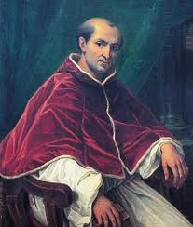
Babylonian Captivity
Increase of interest in the church
Pope Clement V. moved his court from Rome to Avignon. Clement was pope from 1305-1314.
Babylonian Captivity- the long exile of the popes in Avignon
Named after the exile of Jew in Babylon in the 500s B.C.
(Pope Clement V.)

Slide 3
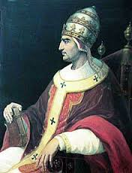
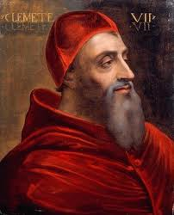
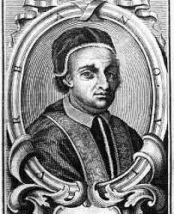
The Great Schism
Pope Gregory XI-attended the University of Perugia- left Avignon and returned to Rome.
After his death, cardinals were fighting over who should be named pope.
One pope in Avignon, one pope in Rome= The Great Schism.
Noblemen called for a reform. Their solution? A general church council.
One council elected a third pope. Another council corrected the error.
(Pope Gregory XI)
(Pope Clement VII)
(Pope Urban VI)

Slide 4
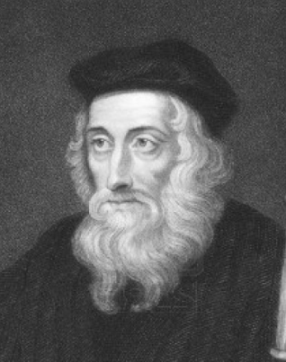
Calls for Reform
The church’s authority weakened.
The church collected 10% of everybody’s money.
Simony-the selling of church positions- was disliked by many church goers.
John Wycliffe- criticized the church.
Wycliffe tried to translate the Bible to English.
His ideas spread even after his death .
44 years after he died, the pope ordered his bones to be burned.
The Lollards- Wycliffe’s followers.
(John Wycliffe)

Slide 5
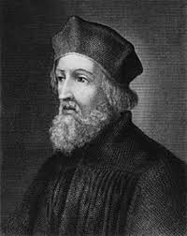
Jan Hus
Czechs became aware of their national identity.
Jan Hus- preacher, received master’s degree in theology in 1348. He earned his living by performing in the church.
A.D. 1415, council at Constance demanded Hus to come to them.
Hus’ followers were the Hussites.
The churches five crusades on the Hussites.
In A.D. 1436, the church made a compromise with the Hussites.
The ideas of Jan Hus still continued to spread.
(Jus Hus)

Slide 6
Works Cited
www.anglican.org
www.historylearningsite.co.uk/medievil_church.htm
www.wycliffe.or/about/ourhistory/johnwycliffe.aspx
www.greatsites.com
www.newadvent.org/cathem/06799a.htm

