Slide 1
The Italian Renaissance 16-1
Timmy Toney
Eric Ellis
Cheyenne Jennings

Slide 2
Humanism
Education and Literature
Scholarship
Humanism
Secular
Individualism
Sonnets
* Key Terms

Slide 3
City Life
Social Groups
Government

Slide 4
Renaissance Cities
Florence
Rome
Venice
Doge
* Key Terms

Slide 5
Renaissance Arts
Architecture
Sculpture
Painting

Slide 6
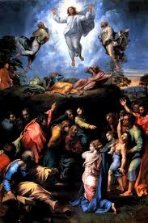
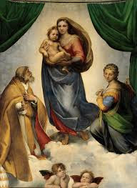
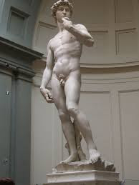
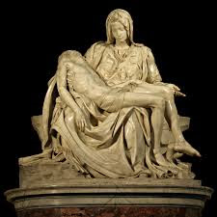
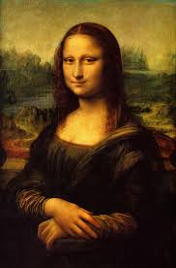
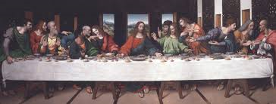
Renaissance Artists
Sistine Madonna
Raphael
Michelangelo
Leonardo
Da Vinci
The Transfiguration
David
La Pieta
The Last Supper
Mona Lisa

Slide 7
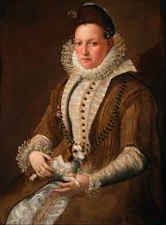
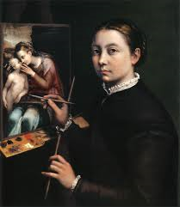
Women and the Arts
Lavinia Fontana
Sofonisba Anguissola

Slide 8
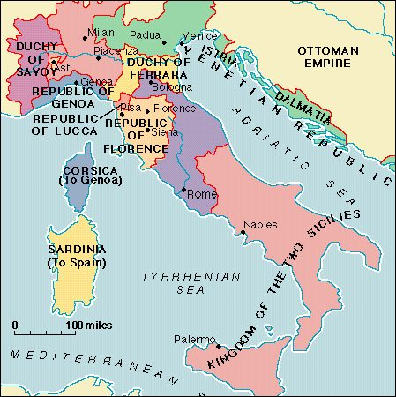
Italian Renaissance Map

Slide 9
MLA Citations
Gilbert, Creighton E. "Michelangelo (Italian Artist)." Encyclopedia Britannica Online. Encyclopedia Britannica. Web. 04 Apr. 2014.
"History of Venice." Venezia. Venezia.ws, 2006. Web. 4 Apr. 2014. <http://www.venezia.ws/history-venice.html>.
"Leonardo Da Vinci." History.com. A&E Television Networks. Web. 01 Apr. 2014.
"National Museum of Women in the Arts." Lavinia Fontana. Web. 04 Apr. 2014.
"Raphael - The Complete Works." Raphael - The Complete Works. Web. 01 Apr. 2014
"Renaissance in Rome." Welcome to Rome.net. Web. 7 Apr. 2014. <http%3A%2F%2Fwww.welcometorome.net. Fenabout-romeFromanartFrenaissance-in-rome>.
"Women in Art- Sofonisba Anguissola." Women in Art- Sofonisba Anguissola. Web. 07 Apr. 2014.

