Slide 1
16.2 The Northern Renaissance
By: Cole Friedmann, Bradley Johnson, Riley Cullinane, Michaela Plotkin

Slide 2
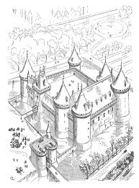
Chateaux
Basically a Castle
Blend of Medieval Gothic architecture and classical arches
Built for Francis 1 and his nobles
Primarily by the Lorie River
* Key Term

Slide 3
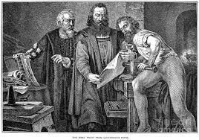
Johannes Gutenberg
Printing Press
1456
Johannes Fust
* Key People

Slide 4
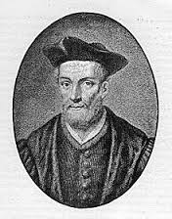
Francois Rabelais
Physician-monk
France’s most popular Renaissance author
Unknown death date
Antoine Rabelais
* Key People

Slide 5
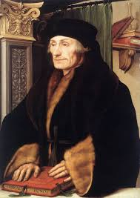
Desiderius Erasmus
Famous Christian Humanist
Knew many languages
Inspired colleagues to learn Greek and Hebrew
Translator
* Key People

Slide 6
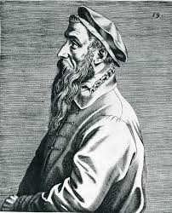
Pieter Brueghel
Italian Renaissance artist
Italian technique Homeland technique
* Key People

Slide 7
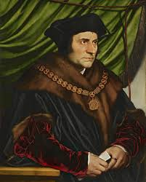
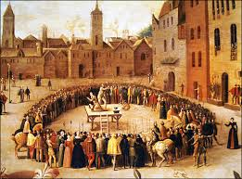
Thomas More
* Key People
Statesman
Milk street, London. (Feb 7, 1478)
St.Anthonys school
Comedy's, Greek and Latin literature
Lincolns inn

Slide 8
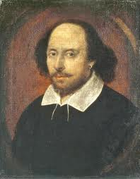
William Shakespeare
medieval legends, classic mythology
Anne Hathaway
Suanna and Judith
Venus and Adonis
William did have an Earring these became popular during the English Renaissance
* Key People

Slide 9
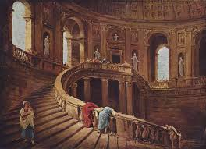
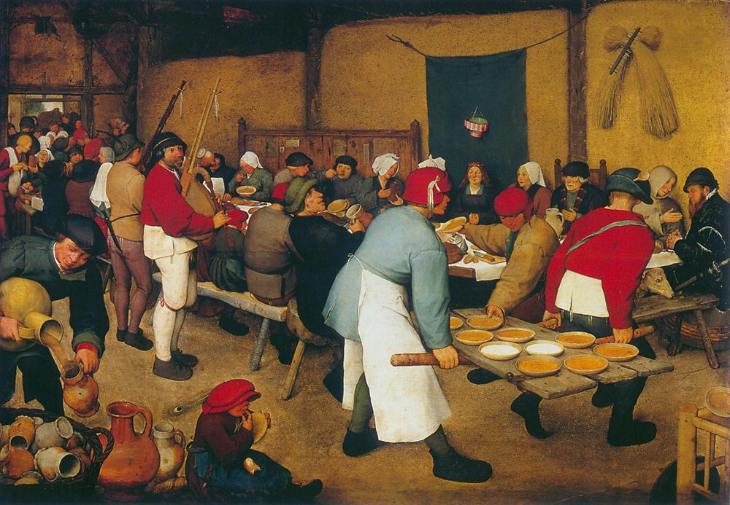
French Renaissance
Lorie River Valley
Inspired by Petrarch's Sonnets
Personal essay

Slide 10
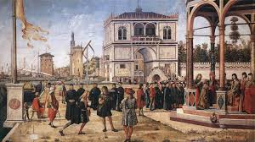
English Renaissance
1485
Many conflicts
Tudor family vs York family
Drama
English Court

Slide 11
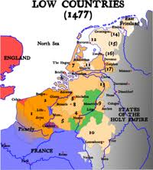
Low Countries

Slide 12
MLA
Screech, M.A. "Francois Rabelais (French Author)." Encyclopedia Britannica Online. Encyclopedia Britannica. Web. 04 Apr. 2014.
Bellis, Mary. "Johannes Gutenberg - Printing Press." About.com Inventors. About.com, 05 Mar. 2014. Web. 01 Apr. 2014.
Nauert, Charles. "Desiderius Erasmus." Stanford University. Stanford University, 22 Sept. 2008. Web. 04 Apr. 2014.
"The Life of Sir Thomas More (1478-1535) [Biography for the Tudor Writer, Statesman, Philosopher, and Advisor to King Henry VIII]." Web. 04 Apr. 2014.
"A Short History of French Art - 2." Renaissance Art in France. Web. 04 Apr. 2014.
"Bruegel, Pieter the Elder." WebMuseum: Web. 03 Apr. 2014.

