Slide 1
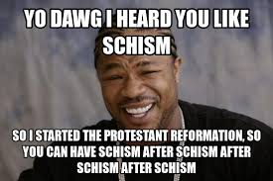
16.3
The Protestant
Reformation
By: Calvin Smith, Phillip Whitesides, & Walter Harris

Slide 2
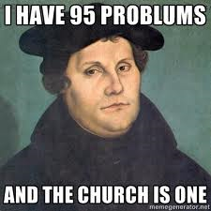
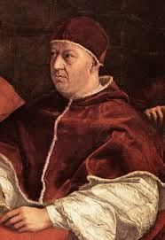
People You Should Know…
Martin Luther Born November 10th and died
February 18th
Christian theologian and
Augustinian monk
Pope Leo X Born December 11th and died
December 1st
Skillful administrator, became Pope
at age 37

Slide 3
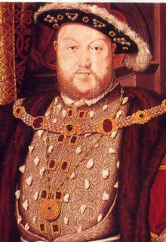
The Break with Rome
Broken the back of the Church in England
Difficult to know whether Henry planned the break from Rome

Slide 4
Very Important Terms!
Justification by Faith.
Indulgences.
Vocation.

Slide 5
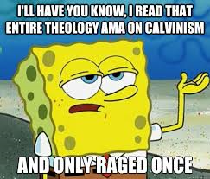
Calvinism
Placed after Lutherism
The 2nd major part magisterial Protestantism

Slide 6
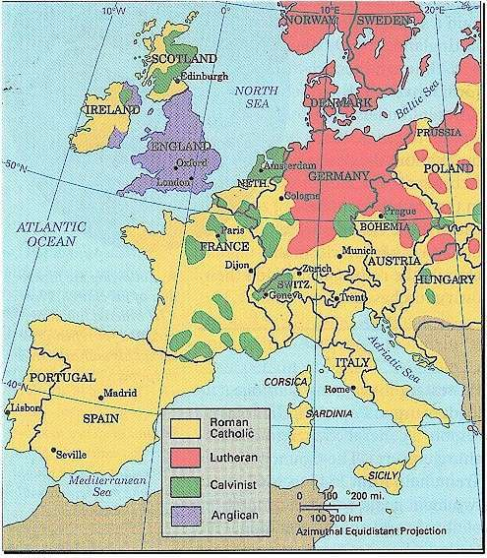
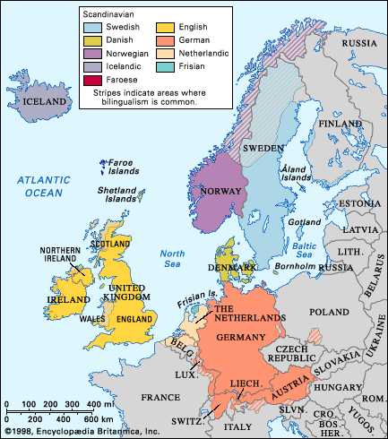
Maps

Slide 7
MLA Format
"The Break with Rome." The Break with Rome. Web. 04 Apr. 2014.
PBS. Web. 04 Apr. 2014.
"Martin Luther." Martin Luther. Web. 01 Apr. 2014.

