Slide 1
16.4 The Spread of Protestant
By: Kyle Robinson, Scott Brasier and Robbie Frey

Slide 2
Key Terms
Theocracy-church ran state
Predestination- gods plan, created by John Calvin
* Key Terms

Slide 3
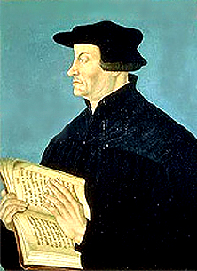
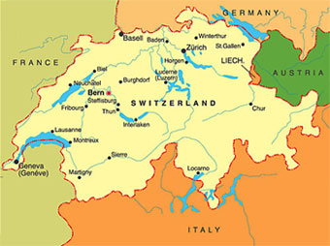
Huldrych Zwingli
Zurich

Slide 4
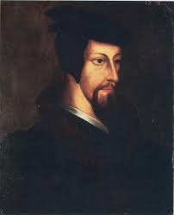
John Calvin
Geneva

Slide 5
The Anabaptists

Slide 6
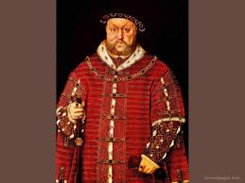
Henry VIII

Slide 7
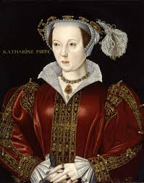
Catherine of Aragon

Slide 8
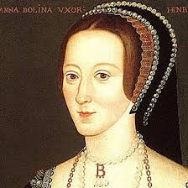
Anne Boleyn

Slide 9
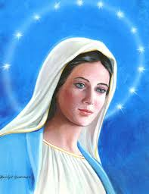
Mary

Slide 10
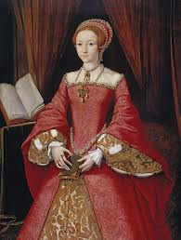
Elizabeth I

Slide 11
Extra info
Zwingli achieved a theocracy
War broke out over protestant
Inspected houses annual
John Calvin published a book “institutes” which was the Christian religion
Protestants punished for:
Fighting
Swearing
Drinking
Gambling
Dancing

Slide 12
Additional Info
John Knox
Followed Calvin
Established Calvinistic Protestantism national religion of Scotland
Sola Scriptura
Doctrine stating that scriptures are the only authority for Christian matters
Protestantism Had 500,000,000
The belief originated in Germany

Slide 13
Citations
“Protestant Reformation”- Theopedia, an Encyclopedia of Biblical Christianity. Web. 03 Apr. 2014
“Library.” Protestantism Origins, Protestantism History, Protestantism Beliefs. Web. 03 Apr. 2014

