Slide 1
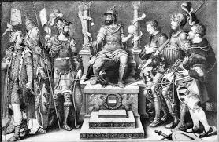
16.5 The Catholic Reformation
By: Josh Felts

Slide 2
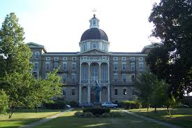
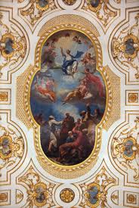
Key Terms
Seminary: the school for educating priests
Baroque: an ornate, dramatic artistic style

Slide 3
People
Pope Paul the III: set out to reform the Church
Jesuist: a religious order
Ignatius of Loyola: a Spanish noble

Slide 4
The Catholic Reformation
The intellectual counter-force to Protestantism.

Slide 5
Additional Information
The Catholic Reformation, aimed at correcting the sources of the Reformation, and pronounced since the pontificate of Pope Paul III, was both retaliatory.
The basic structure of the Church was reaffirmed, there were noticeable changes to answer complaints that the Catholic Reformers tacitly were willing to admit were legitimate.
By the 1540s, the Counter Reformation was well underway.

Slide 6
Additional Information
It can be assumed that the Catholic Church could never have predicted the force of the Protestant Reformation.
Founded in 1534, the Society of Jesus or the Jesuits, formed the backbone of the Catholic or Counter Reformation.
By the 17th century, the Jesuits had become some of the greatest teachers in your, especially in France.

Slide 7
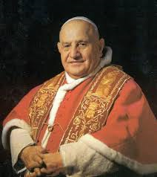
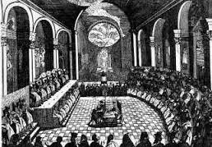
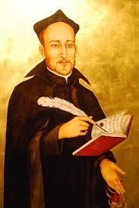
Extensive Information
1563
Pope Paul calls for Council of Trent ends
reforms
___|_________|______________|________
1540
Ignatius of Loyola
founds Society of Jesus

Slide 8
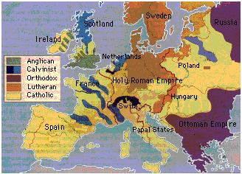
Map

Slide 9
Work sited page
“The Catholic Reformation. History Learning Site, 2013. Web. 4 April 2014. http://www.historylearningsite.co.uk/The- Catholic-Reformation.htm
http://www.theopedia.com/Catholic_Reformation
http://www.historyguide.org/earlymod/lecture5c.html

