Slide 1
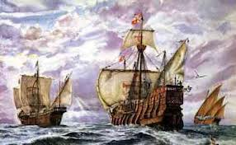
Early Explorations Chapter 17: Section 1
By: Nathan Davenport
David Elfrink
Corey Guay
Jacob Schmidt

Slide 2
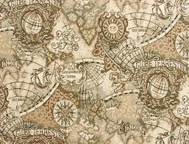
Age of Exploration
Age of Exploration
Technology of Exploration-
cartographers
* Key Terms

Slide 3
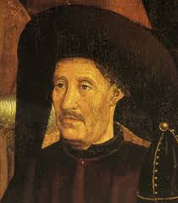
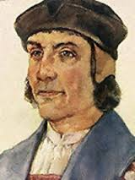
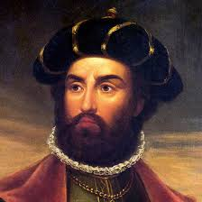
Portugal Leads the Way
* Key People
Portugal Leads the Way
People-
Prince Henry the Navigator
Bartholomeu Dias
Vasco da Gama
Places-
Cape of Good Hope

Slide 5
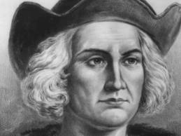
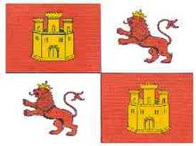
Spain’s Quest for Riches
* Key People/Terms
Columbus Crosses the Atlantic-
Christopher Columbus
Dividing the World-
Line of Demarcation

Slide 6
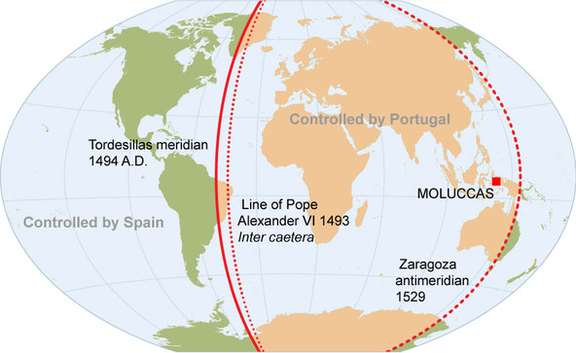

Slide 7
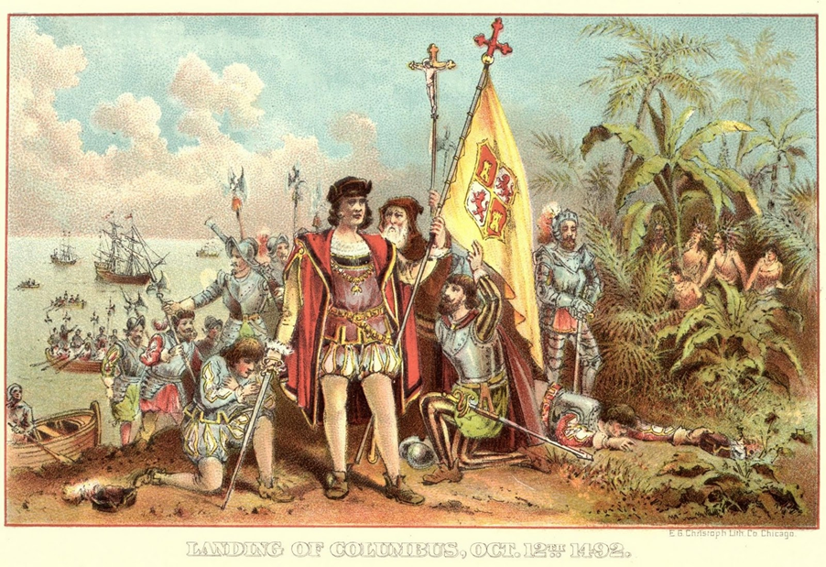

Slide 8
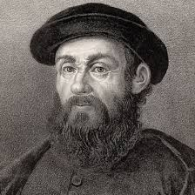
Voyage of Magellan
* Key People/Terms
Voyage of Magellan-
Ferdinand Magellan
Straight of Magellan
circumnavigation

Slide 9
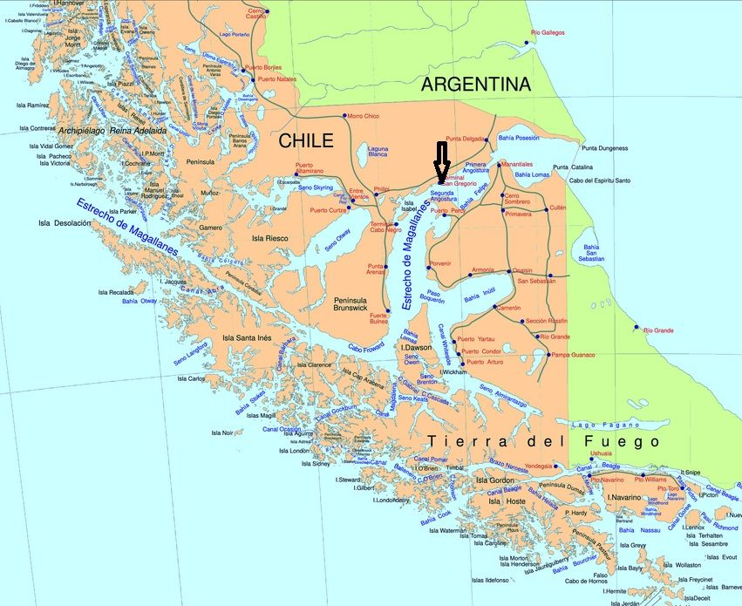

Slide 10
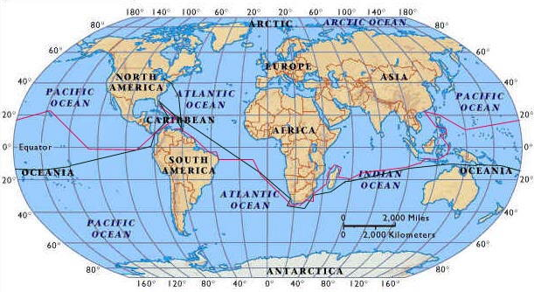

Slide 11
MLA Citations
"Ferdinand Magellan." History.com. A&E Television Networks. Web. 04 Apr. 2014.
Hernandez, Felipe. "Age of Exploration Infographic." History.com. A&E Television Networks. Web. 04 Apr. 2014.
"Interesting Facts About the Cape of Good Hope." Travel Tips. Web. 04 Apr. 2014.
History Staff. "Christopher Columbus." History.com. A&E Television Networks, 2014. Web. 04 Apr. 2014.
Madrid, Carlos. "Guampedia." Guampedia. 13 Aug. 2010. Web. 04 Apr. 2014.

