Slide 1
17.2
Overseas empire
By: Claire Blyth, Lindsey Myers, Samantha Overturf

Slide 2
Terms
Conquistador
The Triangular Trade
The Middle Passage

Slide 3
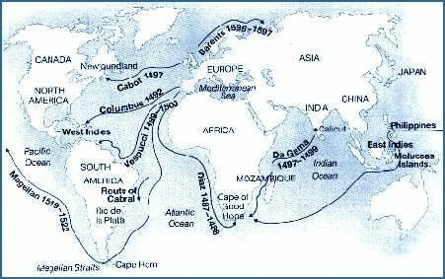
Maps

Slide 4
Treaty of Tordesillas
Portugal’s main interest was land in Africa and Asia
Pedro Alvares Cabral
Expanded to Molccas (the spice islands)
Colonized present-day Brazil
Brazil grew to be Portugal’s most important colony
Portugal
* Key People

Slide 5
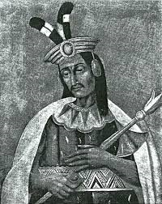
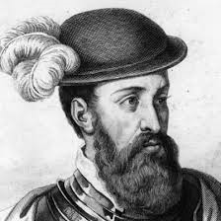
*Key People
Hernan Cortes
Guided by a native woman (Malinche) who learned Spanish, he allied with local enemies of the Aztecs.
The ruler offered gifts of gold, but the Spaniards wanted much more.
Fighting broke out, but in the end Cortes ruled Mexico
Francisco Pizarro
Spain

Slide 6
Spain’s major goals:
Ecomedia System
European diseases killed millions of Native Americans with the first 50 years of Spanish rule
Building an Empire

Slide 7
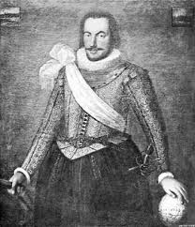
Colonies of the netherlands
Resources
Land
1600 was the golden age.
Ships
Amsterdam
First Dutch Expedition
Henry Hudson
1621
1700’s
Trade
Surrounding lands
*Key People

Slide 8
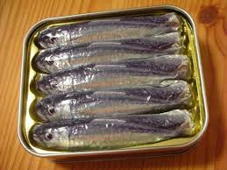
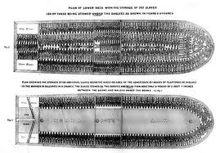
Slave trade
* Key Terms
The triangular trade
Carried goods
Traded with local rulers
The middle passage
Packed slaves below deck…
3000 miles
10 to 24 million (1 in 5)
Sold to Europeans

Slide 9
Slave trade continued…
An enslaved persons life
When they arrived…
Sold to plantation owners
Europeans believed…
Viewed as nothing

Slide 10
france
1524, hired Giovanni Da Verrazano
Da Verrazano
Jacques Cartier
Samuel De Champlain
Converted Native Americans
Trade
With Native Americans
They traded…

Slide 11
England
Over sea trade
Settlements in America
Jamestown
Northern areas farms…
Natives Christians
Pushed natives…
Disease and food shortages

Slide 12
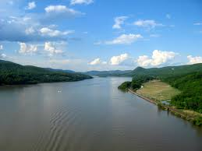
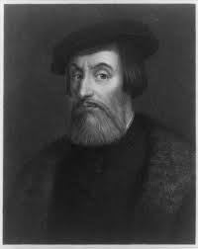
Hernan Cortes- lived 1485-1547
Did everything through violence and ruthlessness
Brazil broke from Portuguese rule (1822)
New emperor was the son of a Portuguese monarch
Henry Hudson-sailed for English 3 times, once for Dutch
Hudson River named after Hudson
Francisco Pizarro born in Spain, died in Peru
Extra Facts

Slide 13
Minster, Christopher. “Biography of Hernan Cortes” Latin American History. About. Web. 07 Apr. 2014
“The Portuguese in Brazil.” OECD. Web 07 Apr. 2014.
Caswell, John Caswell. “Henry Hudson (English Navigator and Explorer)” Encyclopedia Britannica Online. Encyclopedia Britannica, 06 Jan. 2014. Web. 07 Apr. 2014.
“Francisco Pizarro.” Soylett Communications. Web 07 Apr. 2014
WORKS CITED

