Slide 1
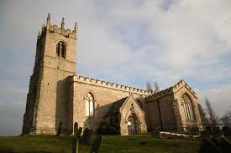
The Medieval Church
By: Calvin Smith, Phillip Whitesides, & Walter Harris

Slide 2
Extended Definitions! (Part 1)
Sacraments- is a sacred Christian rite recognized as of particular importance and significance.
Abbot- meaning father, is a title given to the head of a monastery in various traditions, including Christianity.
Abbess- is the female superior of a community of nuns.

Slide 3
(Part 2)
Cardinals- Roman Catholic Church a high ecclesiastic appointed by the Pope to the College of Cardinals and ranking above every other that ecclesiastic but the Pope.
Lay Investiture- was the most significant conflict between Church and state in medieval Europe.
Heresy- is any provocative belief or theory that is strongly at variance with established beliefs or customs.

Slide 4
(Part 3)
Excommunication- is an institutional act of religious censure used to deprive, suspend, or limit membership in a religious community or (as in the case of the Catholic Church) to restrict certain rights within it, such as the reception to Holy Communion. Some Protestant groups use the term disfellowship instead.
Friars- or occasionally fray, is a man who is a member of a mendicant religious order in Catholic Christianity.

Slide 5
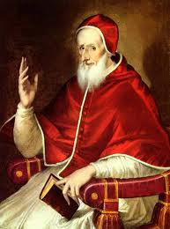
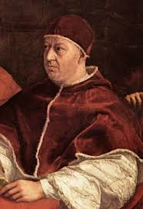
People of the Church!
Pope Pius V…
Leo X…

Slide 6
The Medieval Church
Located in Medieval England.
They pay 10% of what they earn in a year to the Church. (this tax was called Tithes)
The Church also did not have to pay taxes. (lucky)
Most famous Cathedrals were at Canterbury and York.
The Control the Church had over the people was total.

Slide 7
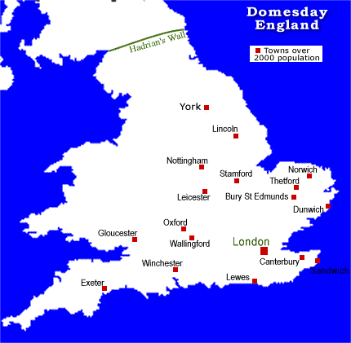
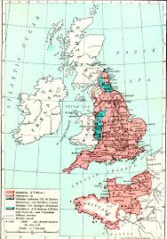
Maps!

Slide 8
Work Citied Page.
http://www.historylearningsite.co.uk/medieval_church.htm
http://www.pbs.org/godinamerica/people/catholic-church.html

