Slide 1
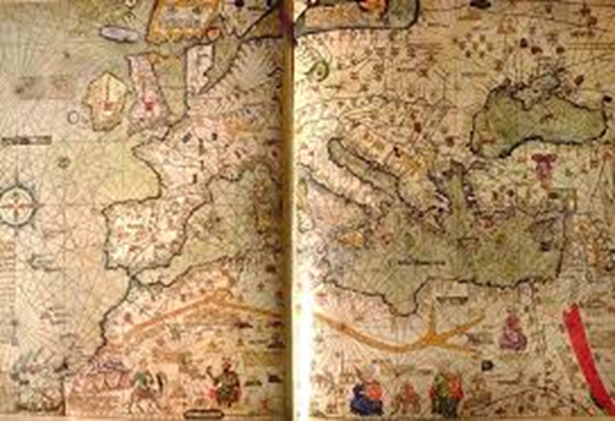
Rise of European monarchy
England
Germany
France
By Robbie Frey,
Scott Brasier,
Kyle Robinson

Slide 2
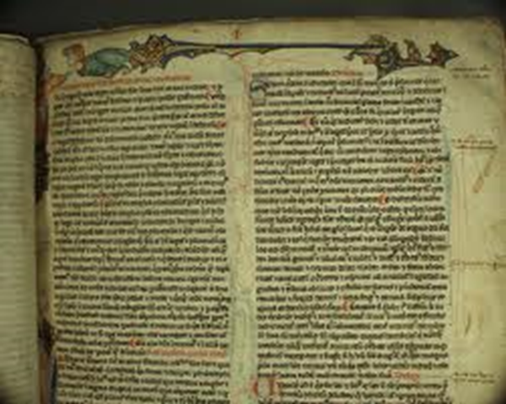
Key terms Common law
Means there should be one
royal law for all English people
Developed by Henry II
Allowed Citizens were allowed to buy or sell
Uses traveling judges
Law equal through the land

Slide 3
Grand jury
In each community
Submitted the name of suspects
Evaluated accusations against persons charged with crime
Determined whether the evidence warrants a bill
Don’t decide if someone is guilty of criminal charges

Slide 4
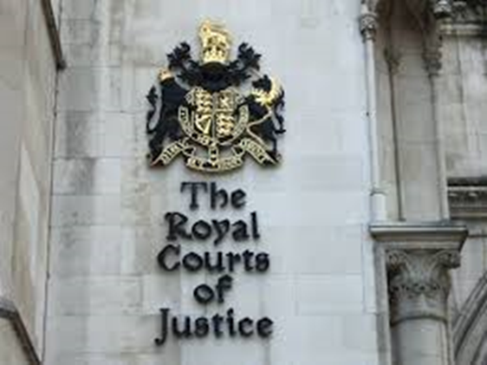
Petit jury
Developed to establish the guilty or innocence
Determines whether the accused is guilty or innocent
Chosen by citizens of a district
Questions facts

Slide 5
Middle class
5. What where the four social classes during Henry III’s reign?
The new social class
Didn’t fit into the medieval social order
the other social class: nobles, clergy and peasants

Slide 6
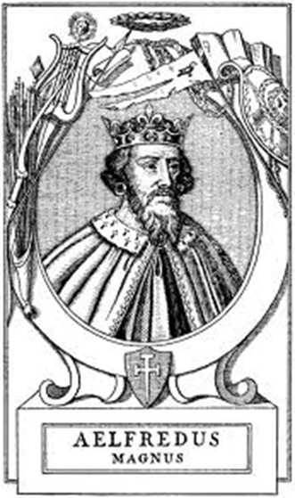
Alfred the Great
United the Anglo-Saxon kingdom
Defeated Danes in 886 A.D
His united kingdom was known as “Angleland”
Or now known as England
Alfred ruled Anglo-Saxon from 871 to 899 A.D.
He intended to revival learning
He founded schools
Then hired scholars to translate books to Anglo-Saxon
He also hired scholars to write about England
The followers after him where weak rulers
The last Anglo-Saxon king, Edward the Confessor
After his death three rivals claimed the throne (all info from pg. 308 red book)

Slide 7
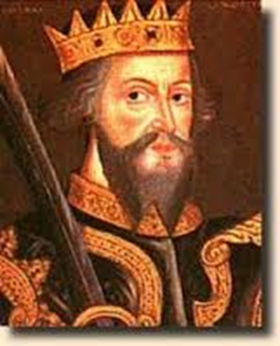
William the Conqueror
2. After Edward the Confessor died, who were the two people who fought for the throne?
The fight for England's throne was between him and Harold Godwinson
won the battle of hasting
He was then crowed king
He took Anglo-Saxons land, keeping some
But gave the rest to Norman vassal for military service
He set up a council of nobles to advice him
He named local officials called sheriffs to collect taxes
Williams son henry I ruled from 1100A.D. to 1135A.D.
(from pg. 309 first paragraph red book)

Slide 8
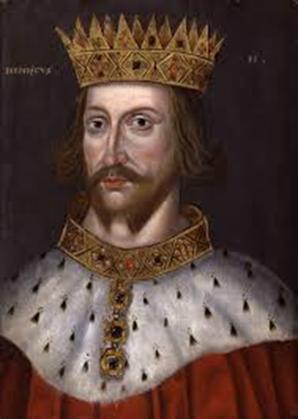
Henry II
He set up the common law system
Using traveling judges to apply law equally through the land
In each community judges met with a grand jury
Then a petit jury was soon established
This was to established the guilt or innocence of the accused
(from pg. 309 second paragraph red book)

Slide 9
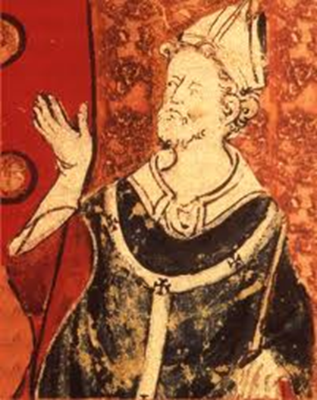
Thomas a Becket
3. Why did Thomas a Becket oppose Henry II’s reform of England's courts
The archbishop of Canterbury
He had a conflict with Henry’s royal court
Four of henry’s knights
Who believed they were acting on the kings orders
Murdered Becket in his cathedral
(from pg. 309 third paragraph red book)

Slide 10
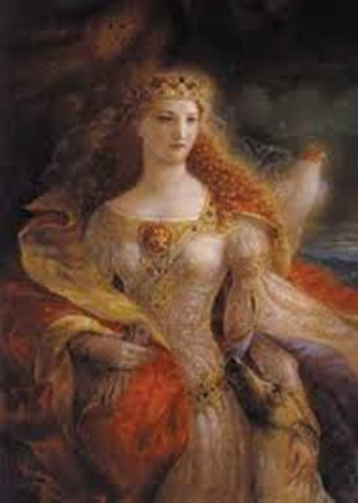
Eleanor of Aquitaine
At the height of his power he ruled western France as well as England
Once married to a French king
Who owned vast land in Southwestern France
Henry married Eleanor
Even though Henry’s soured
Eleanor continued to influence royal politics through their son
Richard I and john

Slide 11
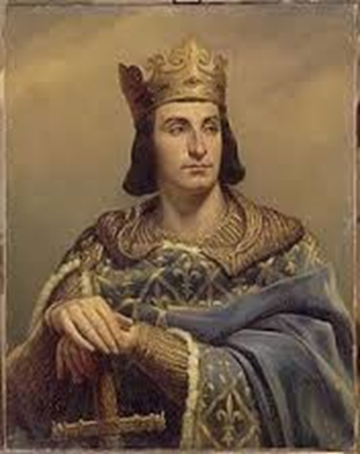
Philip Augustus
faced formidable obstacles to his authority in France
father had been dominated
at court- just a figure head
began to lay the groundwork for
the resurgence of royal power in
France through his marriage to
Isabelle d’Hainault
Lived (1137–80)

Slide 12
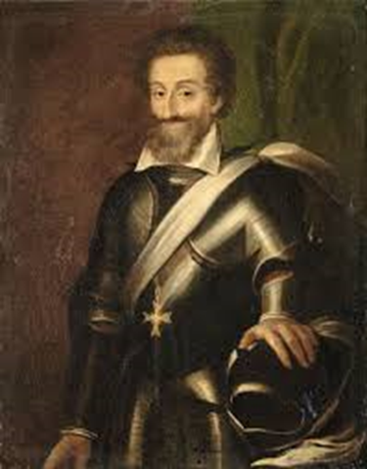
Henry IV
8. What was the main point of the conflict between the pope and the leader of the Holy Rome Empire?
9. How was the conflict
resolved at the Concordat
Of Worms?
granted religious freedom to Protestants by issuing the Edict of Nantes
reign as king of France, from 1589 to 1610.
During his rule a major quarrel broke out with the pope Gregory VII
The pope proclaimed Henry disposed of the German noble and wanted to elect a new ruler.
Henry gave in
The he headed south to Italy to get forgiveness from the pope
Gregory finally pardoned him
But the struggle in the holy empire still resumed
Then the German city of worms came up with a solution
This was called the concordat of worms which allowed the emperor to name bishops and give them land
but popes and monarchs still struggled with power over territories.

Slide 13
Questions 1,4,6,7
1. List in order the succession of people who took over Britain from the Celts, its earliest inhabitants.( On pg. 308 names of places not people.)
4. Why did a group of nobles force john to sign the Magna Carta? (On pg. 310 tells about power)
6. Who where the five important and powerful French kings during A.D 987- A.D 1314? ( On pg. 311, 312 they are listed in order)
7. What measure led to and increase in the French kings’ power over the feudal lords? (On pg. 312 involves money, power, and government affairs)

Slide 14
cited
http://faculty.history.wisc.edu/sommerville/123/123%20104%20Common%20Law.htm
http://the-orb.net/textbooks/muhlberger/law_and_admin.html
http://www.thefreedictionary.com/grand+jury
http://campus.udayton.edu/~grandjur/faq/faq1.htm
http://www.britannica.com/EBchecked/topic/454004/petit-jury
http://epicworldhistory.blogspot.com/2012/10/philip-ii-augustus.html
http://www.biography.com/people/henry-iv-9335199

