Slide 1
12.1 Frankish Rulers
Lindsey Hines, Hannah Kessels, Jacob Remmler

Slide 2
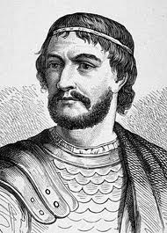
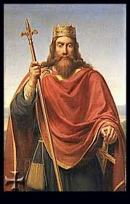
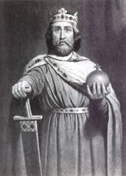
Significant People
Clovis: Was a brutal and harsh warrior who became king of the Franks .
Charles Martel: Led the battle of tours.
Pepin The Short : the son of Charles Martel who was given the title “Defender of the Pope”
Charlemagne: Also known as Charles the Great . He became the first Frankish king.
The Vikings : From Scandinavia (Norway, Denmark, and Sweden) left their home land due to food and land shortages.
Charles Martel
Clovis
Charlemagne

Slide 3
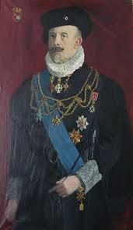
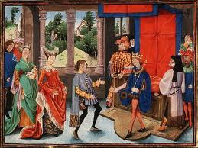
Key Terms
Mayors of the Palace: In 700 AD there was a Frankish official who had a lot of power in the government.
Counts: A noble who acted as a local official in the Frankish Empire.
Count
Mayors of the Palace

Slide 4
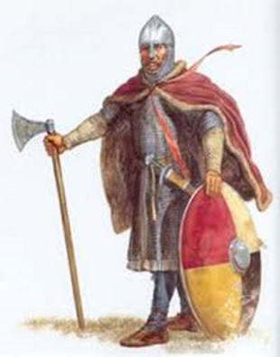
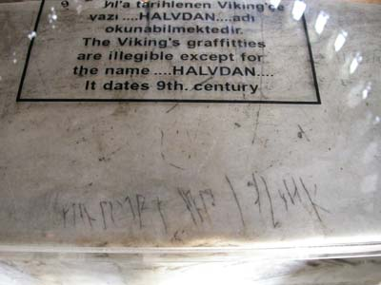
THE VIKINGS
The Vikings were massive explores and eventually made it to Constantinople. They also went to China, and eventually made their way to the United States. Some of the Vikings stayed in Constantinople.
There has been documented proof of Viking writing inside of the Hagia Sophia. The writing has been translated into the name Halvdan. There are rumors that Halvdan was a body guard to the emperor .

Slide 5
Guided Reading
Who were the Merovingian's? found on page 294
Name three important Merovingian rulers and their characteristics. Found on page 295
Who was Charlemagne? Found on 295
Name three of Charlemagne’s major accomplishments. Found on page 295
What happened after Charlemagne’s death? Found on page 296
Who were Louis the Pious’s three sons and where did they rule? Found on page 296
What four peoples invaded Europe in AD 800-1000? Found on page 296
Name three characteristics of the Vikings. Found on page 296
What was the result of the Viking raids? Found on page 296

Slide 6
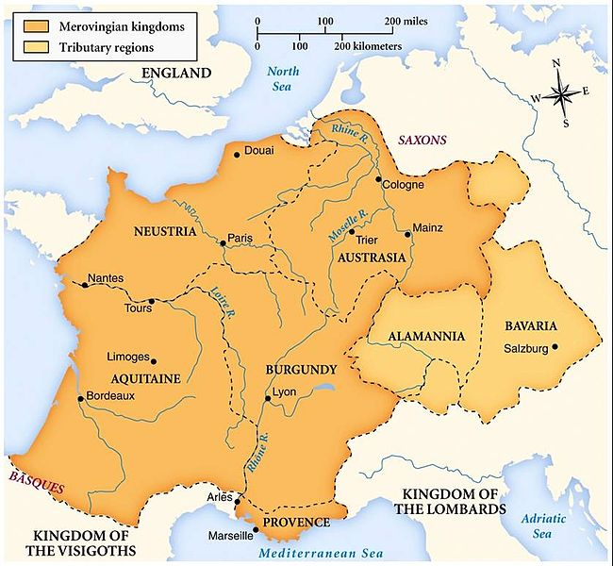
about the Merovingian's
During the Early Middle Ages, the Merovingian kingdoms were the most powerful and important to emerge after the downfall of the Western Roman Empire.
Merovingian kings' had long hair. They believed having long hair gave them magical powers that helped them survive the conversion to Christianity.
Clovis was the first important ruler of the Merovingian Dynasty. He was known as the founder of the French State.
After the decline the king became a figurehead known by his beard, long hair, crown and throne

Slide 7
Map of the middle ages
Viking invasions
Battles of Tours

Slide 8
http://www.ancient.eu.com/news/3574/
http://www.bibliotecapleyades.net/merovingians/merovingios_01a.htm

