Slide 1
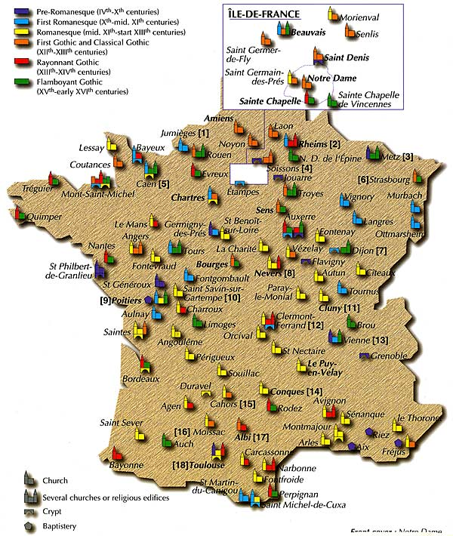
12.3 The Medieval Church
By: Myranda Pease
Donnie Meyer
Leah Lindemann

Slide 2
Key Terms
Sacraments: baptism, anointing of the sick, matrimony, penance, Eucharist, confirmation, holy orders; rituals of the church
Abbot: the head of the monastery
Abbess: convent director
Cardinals: high church officials
Lay investiture: secular rulers chose the church officials
Heresy: denying the church teachings
Excommunications: terminated from the church
Friar: wandering preachers

Slide 3
Important Terms
Benedict: roman official who founded a monastery in Italy
Monte Cassino: Monastery founded by Benedict; model for monks
Pope Gregory I: adopted the Benedictine Rule and spread it around Europe
Cluny: Monastery in eastern France
Pope Gregory VII: monk elected by the cardinals; believed that the pope should be head honcho over all the church officials
Innocent III: most powerful pope; tried reforming the Catholic Church
Francis of Assisi: founded the Franciscan friars; son of a wealthy cloth merchant
Dominic: Spanish priest organized the Dominican friars

Slide 4
The Medieval Church
Pope was more than just one leader(#1 pg. 303)
- political
- social leader
- spiritual
Only one way you could receive God’s grace—sacraments
Sacraments took place in the churches, or masses(#2 pg. 303)
- spoken in Latin
- Eucharist was shared
Church was a hierarchy
Average person learned about the faith from statues, paintings and stain glass windows
Popes, bishops, and priests were a secular clergy(#3 pg. 304)
Nuns and monks formed the regular clergy(#3 pg. 304)

Slide 5
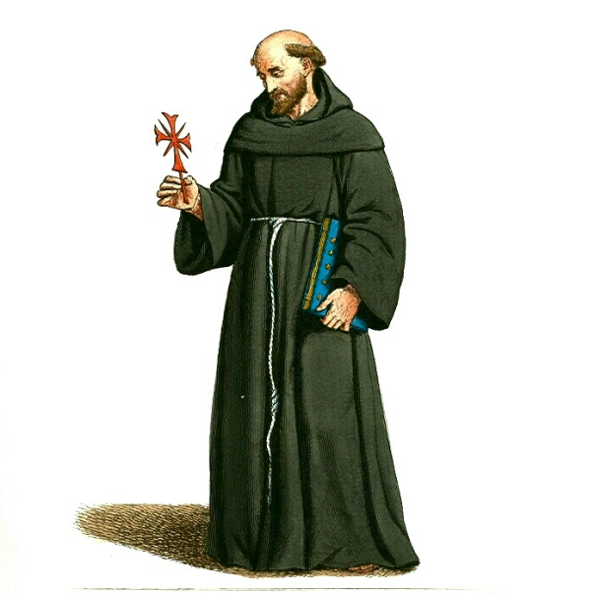
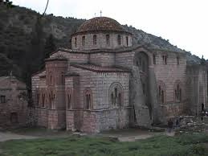
Monastic Life
Silence was the rule
Monks dressed simple (robes)
One monk would read biblical passages during meals while others meditated
Nuns prayed, but also did other things(#4 pg. 305)
-production of cloth, tapestries and banners
-read books of ancient religious works and classical writings
Monks and nuns spread Christian teaching among peasants(#5 pg. 305)
By late 500s and early 600s monasteries spread teachings in Ireland(#6 pg. 305)
Most western Europeans were Catholics by
the 11th century(#7 pg. 305)

Slide 6
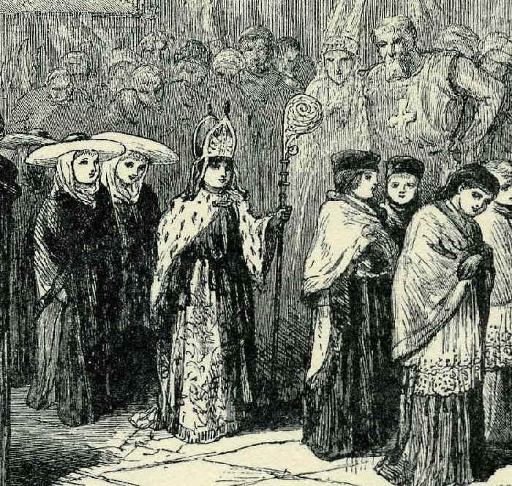
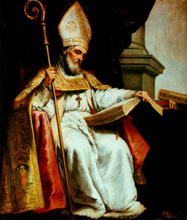
Power of the Church
Bishops and abbots were also Nobles(#8 pg. 306)
Church had ties that boosted its wealth and political power
-often took away from the spirituality of the church
Knights would fight over the land given to them by church leaders

Slide 7
Church Reform
Reformers say that it should be secular rulers who appointed church officials(#9 pg. 306)
Heretics were threatened with excommunication from the church
-the reform movement had a lot of excommunications(#10 pg. 306)
The church set up a court known as the Inquisition(#11 pg. 307)
Well educated friars where the Franciscans and Dominicans(#12 pg. 307)

Slide 8
Additional and Information
The church dominated everyone life
Peasants worked for free on Church land
-pays 10% of what they earned a year to the Church
This tax was called tithes, could be paid in money or goods
What the church got in these taxes were kept in tithe barns, which is one of the reasons why the church was so wealthy
The Church had to pay a lot of taxes
Peasants lived in Cruck houses
- filthy, usually no more than two rooms
http://www.historylearningsite.co.uk/medieval_church.htm

Slide 9
