Slide 1
Rise of European Monarchy
Overview By:
Grant Harfst
RikkiJo Carrier
Damian King

Slide 2
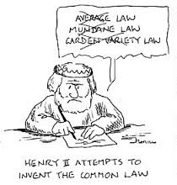
Common Law

Slide 3
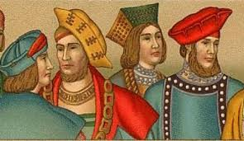
Grand Jury

Slide 4
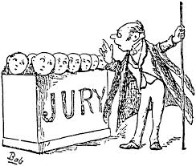
Petit jury

Slide 5
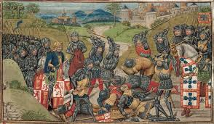
Middle ages

Slide 6
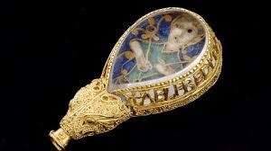
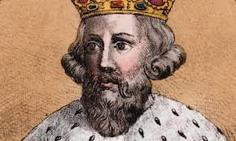
Alfred the Great
(849 A.D.- 899 A.D.)

Slide 7
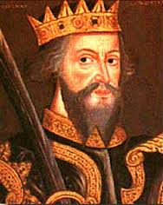
William the Conqueror
At the age of eight he became the duke of Normandy

Slide 8
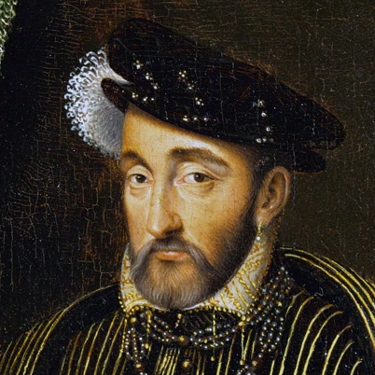
Henry II
( 1133-1189)

Slide 9
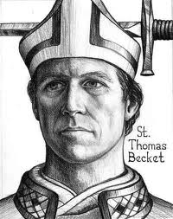
Thomas A Becket
Henry II and Thomas A Becket were close friends.
(1118-1170)
Buried at Canterbury Cathedral

Slide 10
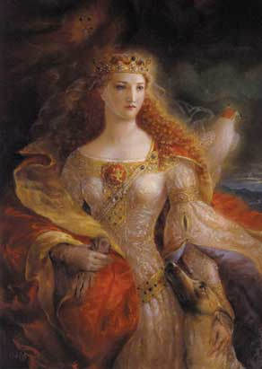
Eleanor of Aquitaine
Married to Louis VII
Then later married Henry II and had 8 children with him.

Slide 11
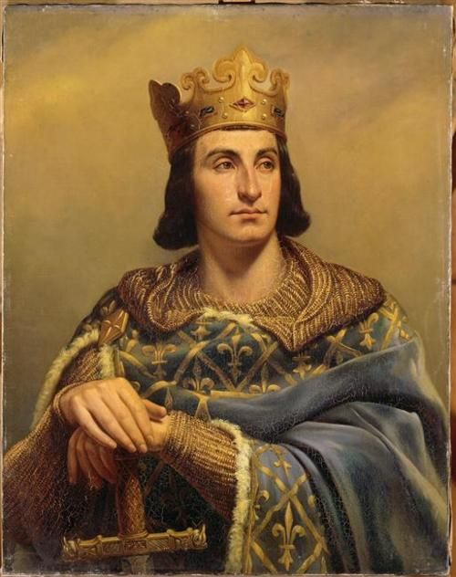
Philip Augustus
Father of Louis VII
(1165-1223)

Slide 12
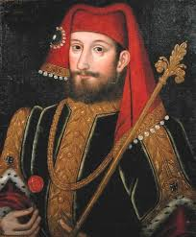
Henry IV
(1553-1610)
Converted to the catholic religion after being king of France in 1589.

Slide 13
Guided Reading
1. pg. 308
2. pg. 309
3. pg. 309
4. pg. 310
5. pg. 310
6. pg. 311
7. pg. 312
8. pg. 312
9. pg. 312

Slide 14
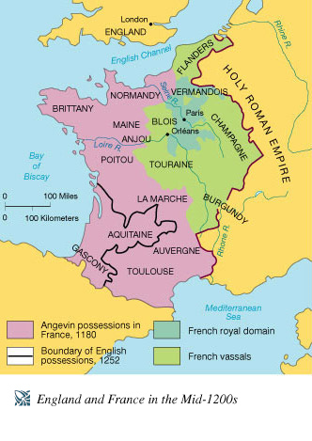
Map

Slide 15
Citations
"Alfred The Great." BBC News. BBC, n.d. Web. 06 Mar. 2014.
"William the Conqueror Biography." Bio.com. A&E Networks Television, n.d. Web. 04 Mar. 2014.
"King Henry II." King Henry II. N.p., n.d. Web. 05 Mar. 2014.
"Thomas Becket." Spartacus Educational. N.p., n.d. Web. 6 Mar. 2014
"Eleanor of Aquitaine Biography." Bio.com. A&E Networks Television, n.d. Web. 06 Mar. 2014.
"Henry IV Biography." Bio.com. A&E Networks Television, n.d. Web. 06 Mar. 2014.
Pacaut, Marcel. "Philip II (king of France)." Encyclopedia Britannica Online. Encyclopedia Britannica, n.d. Web. 06 Mar. 2014.

