Slide 1
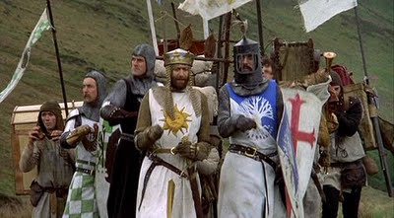
The Crusades
Elissa Love, Sarah Hill, Nick Smith, Garrett Bollinger

Slide 2
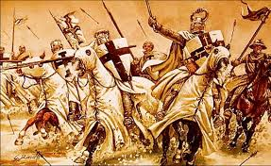
Explaining the Crusades
A series of nine military expeditions to recover the holy land from the Muslims. From the Latin word crux meaning “cross”

Slide 3
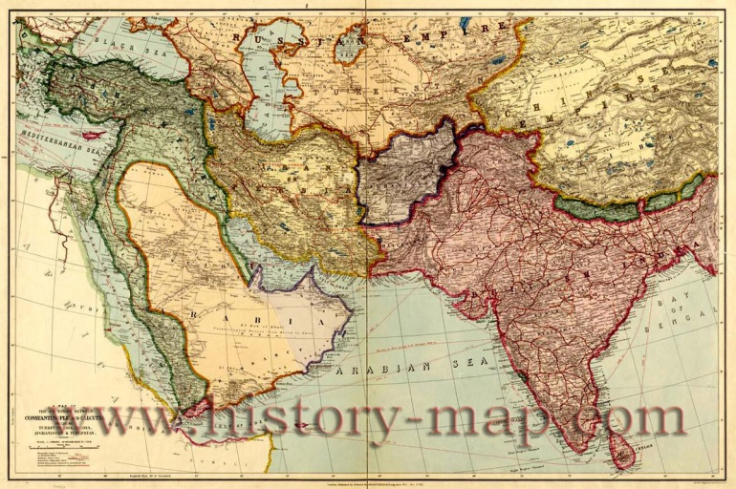
General Info
Muslims occupied Jerusalem
They let Christians and Jews live and travel there for 400 years.
The Seljuk Turks closed Jerusalem to Jewish and Christian pilgrims.
They also threatened the city of Constantinople.

Slide 4
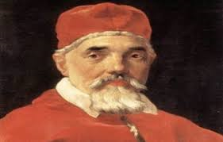
First crusade A.D. 1096
Pope Urban II called for the first crusade.
Three armies from Europe met in Constantinople in A.D 1097
On their way, they sometimes killed entire populations.
A couple months after they reached the besieged Jerusalem in A.D 1099 the Crusades entered and slaughtered the Muslim and Jewish inhabitants.

Slide 5
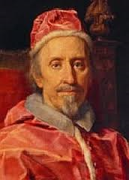
The second Crusade
After 50 years, the Seljuk Turks reconquered parts of Palestine.
Pope Eugenius IV calls for second crusade
The Turks easily defeated the Christians, due to an in effective military leadership.

Slide 6
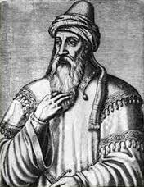
Third Crusade
Saladin unites Muslim forces and recaptures Jerusalem in A.D. 1187
Holy Roman Emperor Frederick Barbarossa of Germany, King Phillip Augustus of France and King Richard I of England assemble armies.
Unable to defeat Saladin
Saladin allows Christian pilgrims access to Jerusalem.

Slide 7
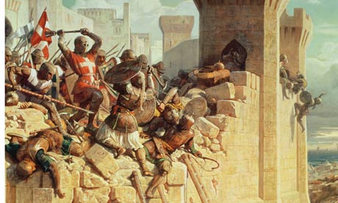
Effects of the Crusades
Broke down feudalism, and increased the kings authority.
Kings began to levy taxes, organize armies, and take land from nobles who had died in the Crusades
Demands for luxury goods increased
Muslims unite against a common enemy
Crusaders learned to build better ships and weapons.
No other Crusades have been successful in winning permanent control over the Holy land.

Slide 8
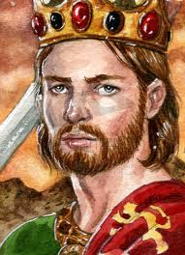
Key terms
The Seljuk Turks- Muslim people from central Asia, they took Jerusalem in late A.D 1000’s. Their conquest left Palestine in chaos, and the hazards of pilgrimage increased.
Pope Urban II- called for the first crusade in A.D 1095.
Saladin- Was a diplomatic & forceful leader. United the Muslim forces, captured Jerusalem.
Richard I- part of third crusade with many other kings, well known as the “Crusade of Kings”.

Slide 9
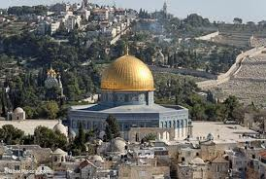
Additional Info!
Pope Urban was born in A.D 1035
His real name is Chatillon-sur-Marne
Saladins real name was Salah al-Din Yusuf.
For the crusaders Dome of the Rock was the Temple of Solomon.
Saladin welcomes Jews back to the city after the third crusade.

Slide 10
Work Cited
http://www.metmuseum.org/toah/hd/crus/hd_crus.htm
http://www.history.com/topics/crusades
The Blue world history book
http://www.bibleplaces.com/domeofrock.htm
http://medievaleurope.mrdonn.org/crusades.html
https://www.google.com/search?q=crusades&source=lnms&sa=X&ei=B-8ZU6uPF-qSyAGSlIHoCA&ved=0CAYQ_AUoAA&biw=1366&bih=651&dpr=1
http://www.history-map.com/picture/000/Constantinople-countries-Calcutta-between.htm

