Slide 1
Chapter 13 section 2
By: Claire Schulte
Emily Huesgen
Bobbi Francis

Slide 2
Key Terms
Money Economy – (Economy Based on Money)
Money Economy led to the use of banking
Money chargers determined to value of various currency
exchanged for another currency equal in value
first form of bankers
Guilds –
Business associations where merchants and artisans organized them selves into in the AD 1100’s
Each guild had a separate primary function
Masters

Slide 3
Key Terms
Masters-
Were artisans who owned their own supplies such as shops and tools
Employed less skilled artisans as helpers
Controlled craft guilds
Apprentices-
Worked for a master without pay
Part of ones apprenticeship to become a master
Journeymen -
Apprentice that receives pay
Could only work under a master
To become a master they had to submit a special sample of work – a masterpiece
Charters –
Documents that gave them the right to control their own affairs
Many towns remained part of a kingdom or feudal territory

Slide 4
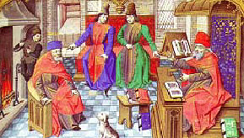
Key Terms
Scholasticism
New type of learning
Emphasized reason
Faith in interpretation of Christian doctrine
Sought to reconcile philosophy with church teachings
Troubadours
Composed lyrical poems and songs about love and feasts of knights
Helped define the ideal knights
Celebrated in code of chivalry
Vernacular
Languages of everyday
Instead of latin people spoke languages of their country

Slide 5
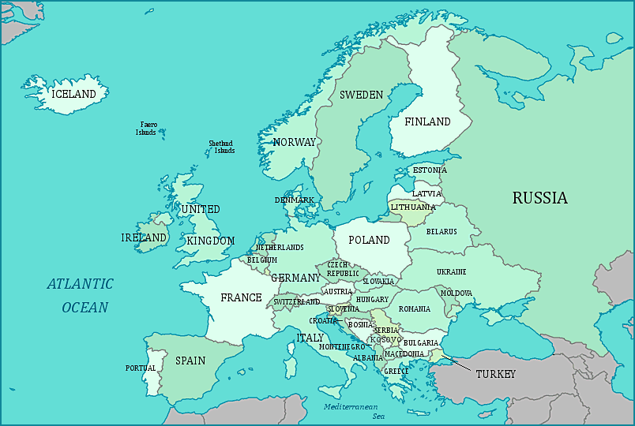
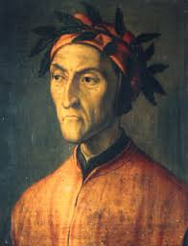
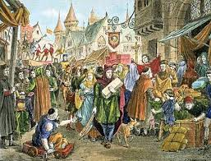
People and Places
Venice –
Italian town
Controlled Mediterranean
Trade with Pisa and Genoa after 1200 AD
Flanders –
Region including present day northern France and southern Belgium
Center of trade in Europe’s Northern coast
Champagne –
Famous fair
Eastern France located in almost the exact center of Europe
Bologna –
Italy
Specialized in law and medicine
Law School
Thomas Aquinas –
Most important scholastic thinker in AD1200
Summa Theologica
Reasoning was that Gods gift could answer questions to basic philosophical questions
Dante Alighieri –
Wrote The Devine Comedy
A poem about an imaginary journey from Hell to Heaven
Geoffrey Chaucer –
Wrote The Canterbury tales

Slide 6
Guided reading
1. pg 322) Heavier Plow, collar harness
2. pg 323-324) Location : Western Europe
Construction : Well traveled roads, waterways, walls were built around towns
Result : No sanitation which caused many diseases
3. pg 323) Barter was replaced by Money Economy
4. pg 324) maintain monopoly
5. pg325) Were merchants, bankers, and artisans; organized municipalities
6. pg 326) Law, Medicine, liberal arts, Theology
7.pg 326) emphasized reason as well as faith
8. pg 328) Everyday speech
9. pg 328) stone beams, thinner walls, stained glass, pointed arches.

Slide 7
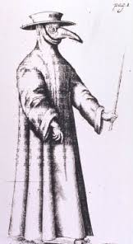
How the Plague affected Constantinople
AD 542 Constantinople was struck with The Black Death or the bubonic plague
This particular strain took place during the 15th century during Justinian’s reign
People feared the Black Death would annihilate the human race
Justinian had caught the disease and survived but it left him with a different mind
Constantinople was flooded with dead bodies
Dumped where ever there was room available, water, burned
Work slacked
People afraid to leave their homes
Ring around the Rosies

Slide 8
Extensive Information
Language of the late medieval literature
Was vernacular
Writing made literature accessible to commoners with the use of vernacular
AD 1300 big literary works in vernacular appeared
Early Medieval churches were built with the styles of Roman and Byzantine
Romanesque cathedrals were replaced with a style called gothic
Gothic cathedrals were more open compared to Romanesque

Slide 9
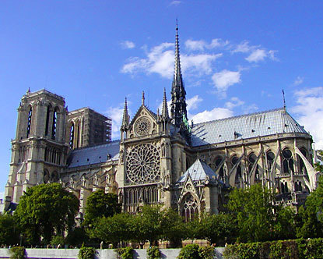
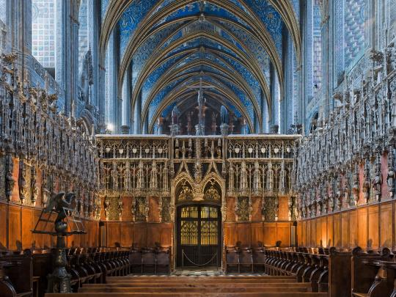
Additional Information
Banking and trade
A money economy emerged
People began investing in trade to make a profit known as commercial capitalism
Medieval towns
Were surrounded by large and expensive stone walls
had narrow, winding streets
Crowed houses causing fire hazards
Smelled bad and had awful air pollution
Water pollution was hazardous from butchers depositing blood and other waste products
Rivers were not for drinking water
Gothic style
First appeared in the twelfth century
Brought to perfection in the thirteenth
Two innovations
One was the round barrel vault with ribbed vaults
And pointed arches
The flying buttresses a heavy arch support of stone

Slide 10
Works Cited
www.yourchildlearns.com
www.ancientdigger.com
usatoday30.usatoday.com
www.academicapparel.com
Snippets-and-slappits.blogspot.com
Izquotes.com
WORLD HISTORY (Red book)
WORLD HISTORY (Blue book )

