Slide 1
13-3
Jimmy Gammill
Tristan Nolan
Josh Franek

Slide 2
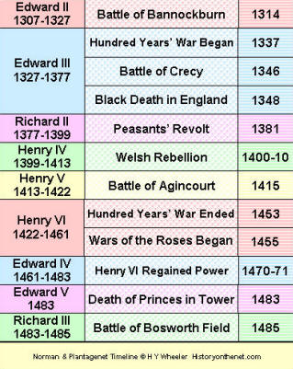

Slide 3
The 100 Years War
Began as a feudal dispute between France and England.
A.D. 1337 to A.D. 1453
Major tech. developments- longbow and firearms
(all are from the worksheet)

Slide 5
Joan of Arc
French were constantly defeated until led by Joan of Arc.(worksheet)
She was a deeply religious person.
Experienced visions and believed that saints commanded her to free France.
Her sincerity persuaded Charles to accompany the French army to Orleans.
The English captured Joan in 1430 and charged her with witchcraft.
Joan was condemned to death as a heretic.
(all others are from blue W.H. book)

Slide 6
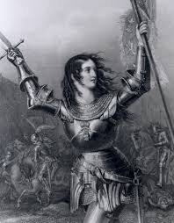

Slide 7
weapons
Use of longbow and firearms.
Cannons also used.
Maces, and hammers (axe and hammer)
Shield
Lance
(All from W.S. and/or picture)

Slide 9
Louis XI
Known as the spider for his devious ways
Strengthened the use of taille- an annual direct tax on land or property
King of France
Added Anjou, Maine, Provence, and other regions to his kingdom
Above are from blue book and below from W.S.
Encouraged a war between a ruler, Charels the Bold, and the Swiss that led the division of Burgundy and the unification of France

Slide 10
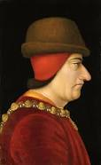

Slide 11
War of the Roses
Between the house of York, led by Edward and Richard, and the house of Lancaster, led by Henry Tudor
Name for the civil conflicts
Noble factions fought to control the monarchy until 1485, when henry tudor established a new dynasty
Henry ended the wars of the Nobles by abolishing their private armies.

Slide 12
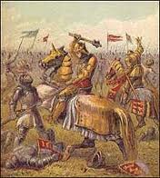

Slide 13
Henry VII
First Tudor king
Worked to create a strong royal government
Very thrifty
Didn’t overburden the nobles and the middle class with taxes
Won the nobles and the middle class’s favor and they provided support for his monarchy
(blue book)

Slide 14
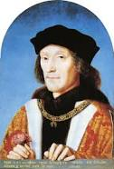

Slide 15
Edward III
King Edward of England was also the duke of Gascony.
He was also a vassal to the French King.
Edward declared war on Philip, beginning the hundred year war.
Edward claimed sovereignty over all England and France in A.D. 1328.

Slide 16
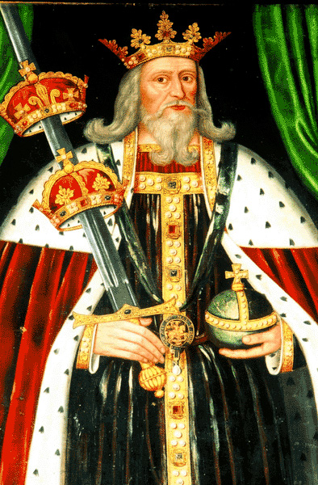

Slide 17
Castile and Aragon
Muslims, Jews, and Christians were all able to live and work in the kingdoms of Castile and Aragon until A.D. 1492.

Slide 18
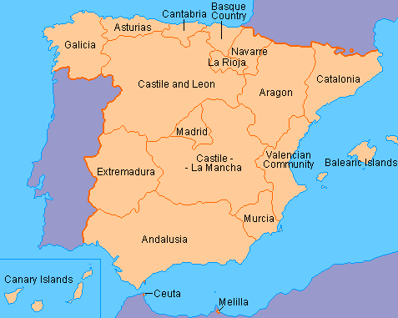

Slide 20
Work cited
Jackson Spielvogel blue world history book
Mounir A. Farah red world history book (W.S.)

