Slide 1
The Troubled Church
By: Ethan Trokey, Ashley McIntyre, and Dominic Knott
There once was a moose...

Slide 2
What is the air speed velocity of a 5oz. Swallow carrying a 1lb coconut?
African or European Swallow?
What? I don’t know that!!
AGHHHHHH!!!
The moose said wonderful things…

Slide 3
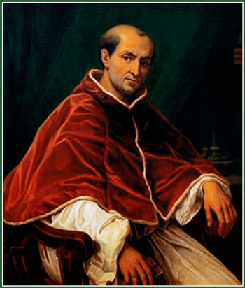
Pope Clement V
Moved papacy to France because of civil wars
Papacy was called the Babylonian Captivity because of its exile in France.
He was quite a moose…..

Slide 4
A very moosy moose…..

Slide 5
Sorry for the unneeded subtitles…
Those responsible have been sacked. Thank you.

Slide 6
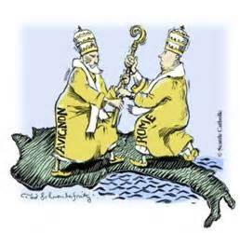
The Great Schism
Came about when the Italian pope refused to resign.
Church was faced with being led by 2 popes.
Results:
Undermined the popes authority.
Made people wonder if the pope was divinely chosen.

Slide 7
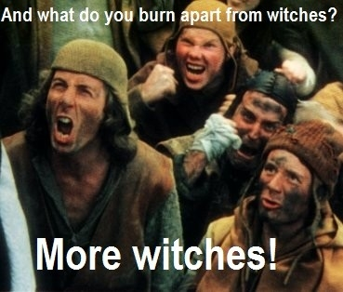
The moose was related to some witches…..

Slide 8
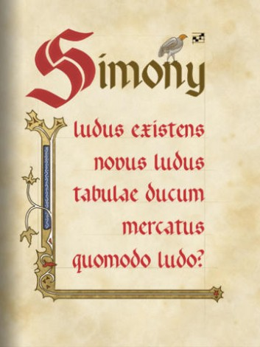
Calls For Reform
Simony was a main reason for reform.
People were tired of the abuses of the church
especially the fees charged for all church activities.
Some witchy moose’s…..

Slide 9
We’re again sorry for the unneeded subtitles…
We would like to inform you that those responsible for sacking the previous sackees have also been sacked.

Slide 10
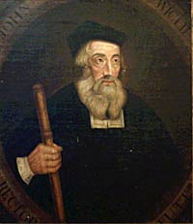
John Wycliffe
Criticized wealth, clergy, and popes claim to absolute authority.
The church didn’t want Wycliffe to translate the bible into English:
Reason: the doctrine stated only the clergy could interpret the holy text.

Slide 12
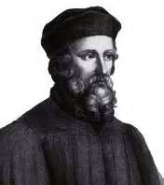
Jan hus
Czechs became aware of national identity.
They wanted to end German control.
Their religious and political grievances produced a situation.
These three elements became the reason Jan Hus became important
4. Jan Hus was burned on his way to Constance for being a Heretic, and the holy roman emperor was being ignored.
5.Jan Hus also had followers called Hussites, these Hussites were in a crusade until they were given certain liberties in exchange for their allegiance to the church.

Slide 13
Some Works Cited
http://www.christianity.com
https://www.christianhistoryinstitute.org/study/module/hus/
http://www.greatsite.com/timeline-english-bible-history/john-wycliffe.html
http://www.thenagain.info/webchron/westeurope/greatschism.html
http://www.christianitytoday.com/ch/1990/issue28/2824.html

