Slide 1
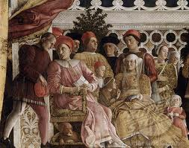
16-1 The Italian Renaissance
Josh Franek
Jimmy Gammil-toe
Tristan Nolan

Slide 2
KEY terms
Humanism: Intellectual movement that focused on secular
Secular: Doing activities or other things that have no spiritual or religious basis
Individualism: An emphasis on the dignity and worth of the individual person
Sonnet: A poem with 14 verses, 3 quatrains and 2 couplets at the end
Doge: The chief magistrate of Venice or Genoa

Slide 3
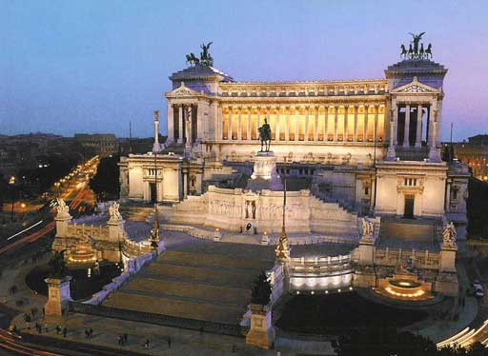
The Sistine Chapel

Slide 4
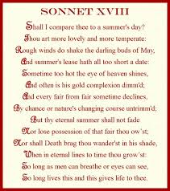
Example of an Italian renaissance sonnet

Slide 5
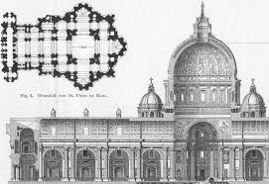
Italian Renaissance architecture

Slide 6
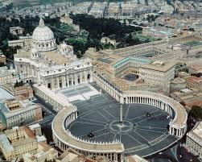
St. Peters Basilica

Slide 7
PEOPLE
Niccol di Bernardl di Machiavelli: Was a diplomat. Wrote a book called “The Prince,” it
realistically analyzed the politics of renaissance Italy.
Lorenzo de Medici: Was the grandson of Cosimo de Medici. Cosimo gained control over
Florence in 1434. Lorenzo ruled Florence from 1469-1492.
Michelangelo Buonarroti: Was a sculptor, artist, painter, poet and painted the Sistine
Chapel Ceiling. He learned to paint in Florence and his nickname was “The Father and Master of
All the Arts.”
Leonardo da Vinci: Math matician, artist, inventor, musician, renaissance man, and writer. He
also painted the “Mona Lisa” during intensive study in Florence in 1503.

Slide 8
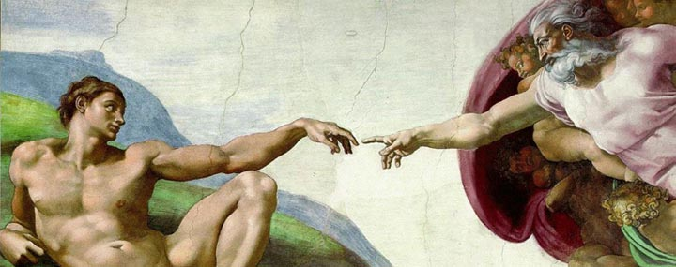
Painting on the Sistine chapel ceiling by Michelangelo Buonarroti

Slide 9
Toward the end of the 14th century A.D. a handful of Italian
thinkers declared they were living in a new age.
They said the new age would be a “rinascità” or rebirth of learning.
Leonardo da Vinci wrote left handed and backwards.
Most of his inventions came from him thinking that “The Great
Deluge” or flooding of the earth would come true.
The Medici family funded most of the artwork in the Italian
renaissance.
In the Italian renaissance Italy was divided into independent
city-states, each with a different form of government.
The city-states were very competitive and wars among them were
common

Slide 10
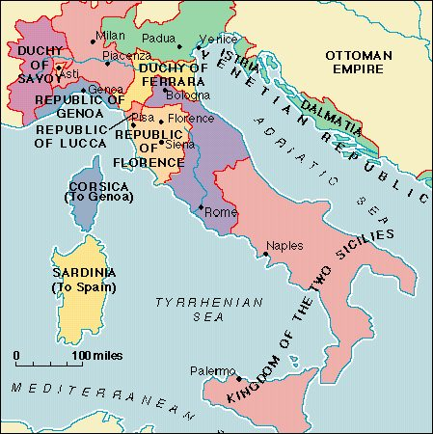

Slide 11
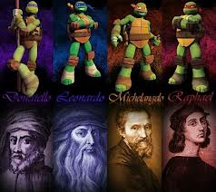

Slide 12
Citations
History.com. Italian Renaissance. A&E Television Networks. April 07, 2014
Bio.com. Leonardo da Vinci Biography. A&E Networks Television. April 07, 2014.
PBS. PBS. April 07, 2014

