Slide 1
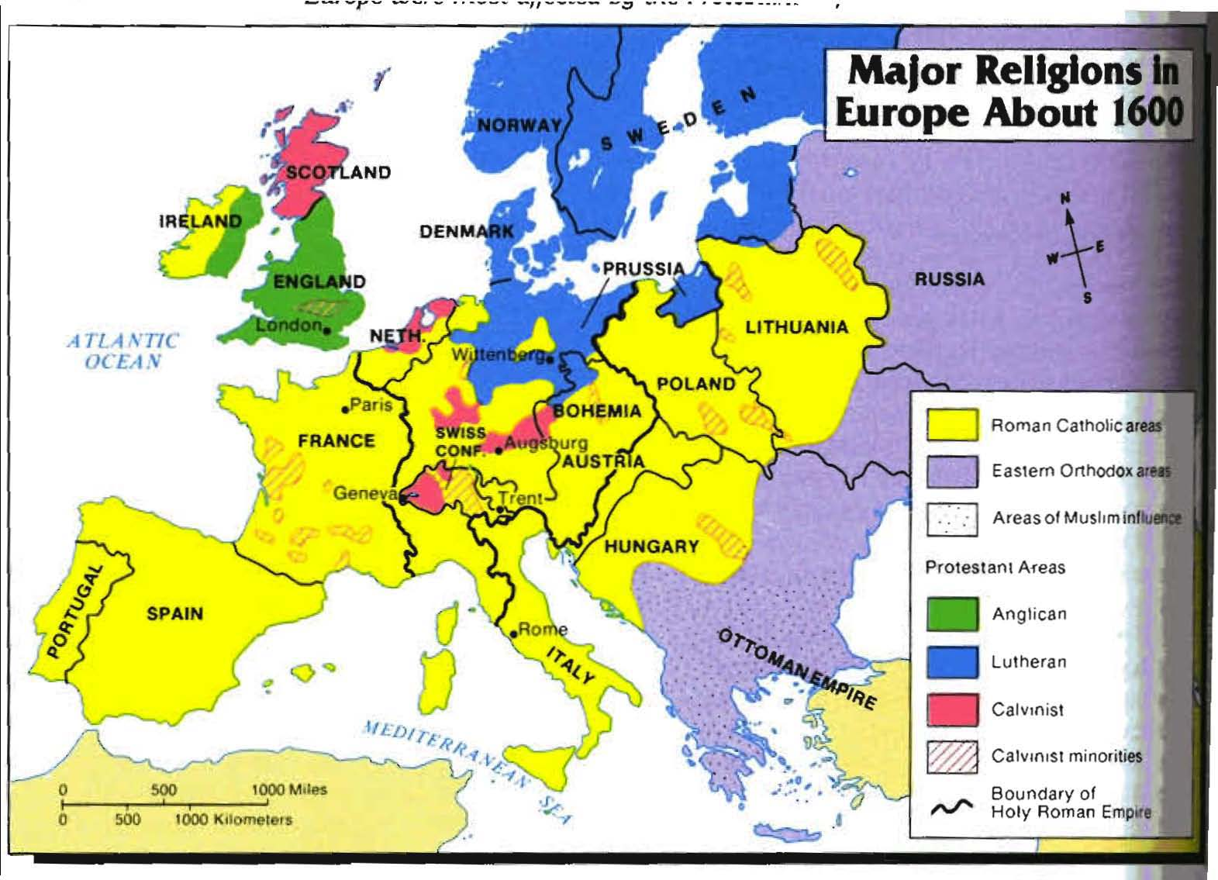
16.3 The Protestant Reformation
By: Myranda Pease
Donnie Meyer
Leah Lindemann

Slide 2
K
E
Y
T
E
R
M
S
Justification By Faith: salvation can be received by faith alone
Indulgences: pardons sold by the Catholic church to ease ones sins
Vocations: callings

Slide 3
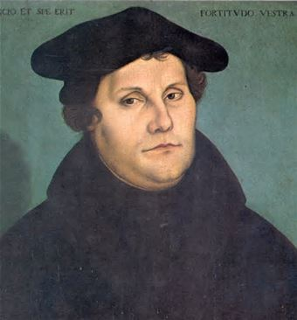
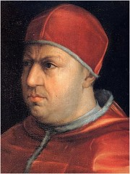
Martin Luther
German Monk
Born in 1483
Entered in monsetary in 1505
Justification of Faith
-persons can become good by gods mercy
A professor & priest in Wittenberg
Ninety Five Theses
Pope Leo X
Trying to raise money
Sold indulgences
1520 condemned Luther’s works
1521 excommunicated Luther
#popegrind

Slide 4
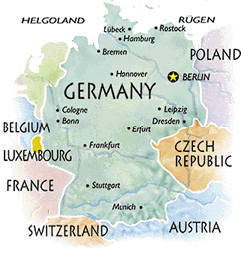
Extensive Information
Worms, Germany
German Princes met & tried to bring Luther back to the Church
Luther founded the Protestant faith after Worms
Focused more biblical teachings
Held in the peoples language
Pope Leo X raised money for St. Peters Basilica with indulgences
Sold church positions
Worms

Slide 5
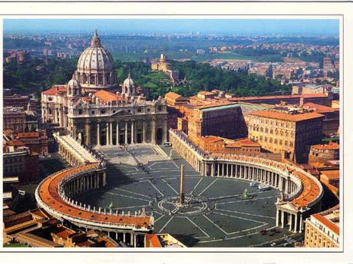
Additional Information
St. Peters Basilica
- Built on the site of St. Peter’s tomb
Built by Constantine
- Located in the Vatican City
Designed by Michaelagelo
448 feet high
Pope Leo X
-Was pope from 1513 to 1521
-The Reformation begin during his reign

Slide 6
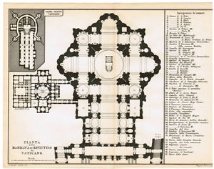
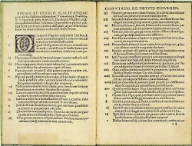
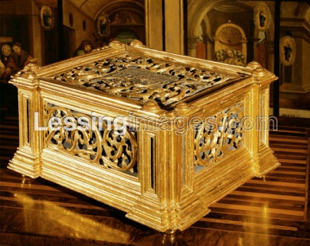
Blue print of the St. Peter’s Basilica
Ninety-Five Theses
Indulgence Box

Slide 7
Works Cited
"Leo X." Encyclopedia of World Biography. 2004, NELSON H. MINNICH, "Leo X
(1475–1521)." The Renaissance. 2008, "Leo X (pope)." The Columbia
Encyclopedia, 6th Ed. 2013, John Bowker, and "Leo X." World
Encyclopedia. 2005. "Leo X." Encyclopedia.com. HighBeam Research, 01
Jan. 2004. Web. 06 Apr. 2014.
"St Peter's Basilica - St Peter's Basilica Information and Pictures." St Peter's
Basilica - St Peter's Basilica Information and Pictures. Web. 07
Apr. 2014.

