Slide 1
Chapter 16 Section 4 The Spread of Protestantism
RikkiJo Carrier, Grant Harfst, Damian King
3rd hour

Slide 2
KEY TERMS:
Theocracy: Church-run state.
Predestination: A doctrine that states everyone's fate it determined by god.

Slide 3
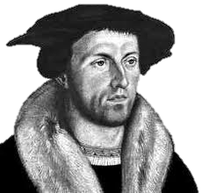
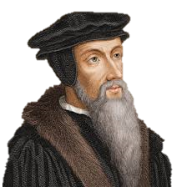
PEOPLE:
Huldrych Zwingli:
lived from 1484 to 1531
John Calvin:
Reformer

Slide 4
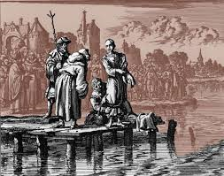
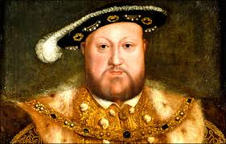
The Anabaptist:
protestant groups in Europe were called Antibaptist
Henry VIII:
married to Catherine of Aragon
6 children but only Mary survived.
Henry needed a male heir to take the thrown

Slide 5
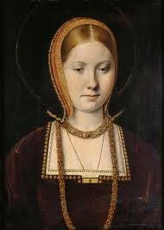
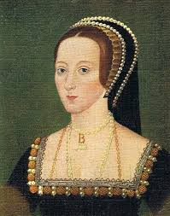
Catherine of Aragon
Queen of England
from 1509 until 1533
Anne Boleyn
Queen of England
from 1533 to 1536

Slide 6
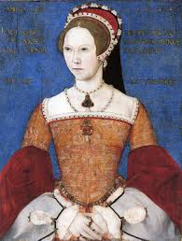
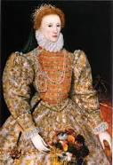
Queen Mary I of England
born February 18, 1516,
the daughter of King Henry VIII and Catherine of Aragon
Elizabeth I
Queen of England and Ireland
From 17 November 1558 until her death.

Slide 7
Zurich
Geneva

Slide 8
The Protestant Reformation in Europe formed one of the most significant periods of European history
it broke the almighty power of the Catholic Church
All of Henrys wives were:
1.Catherine of Aragon
2. Anne Boleyn
3.Jane Seymour
4. Anne of Cleves
5.Catherine Howard
6. Catherine Parr
Luther's ninety-five theses:
centers on practices within the Catholic church regarding:
baptism and absolution
People
Huldrych Zwingli
Father: Ulrich (peasant) Mother: Margaret Meili Wife: Anna Reinhard
(m. 2-Apr-1524)
Elizabeth I
Born: September 7, 1533, Palace of Placentia, Greenwich, United Kingdom
John Calvin
Parents:
Gérard Cauvin, Jeanne le Franc
Anne Boleyn
Died: May 19, 1536, Tower of London, London, United Kingdom

Slide 9
"The Spread of Protestantism in Europe." , The Reformation, Renaissance and Reformation, SOSE: History Year 7, VIC. Web. 04 Apr. 2014
"Anne Boleyn." Google. Web. 04 Apr. 2014.
"Elizabeth I." Google. Web. 04 Apr. 2014.
"Catherine of Aragon." Google. Web. 04 Apr. 2014
"John Calvin." Google. Web. 04 Apr. 2014.
"Huldrych Zwingli." Huldrych Zwingli. Web. 04 Apr. 2014.

