Slide 1
Catholic Reformation
16-5

Slide 2
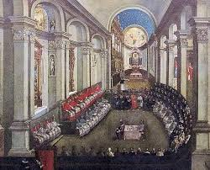
Council of Trent
Met until 1563
Reaffirmed catholic teachings that had been challenged by the Protestants
Salvation comes through faith and good works
Church traditions is equal to the bible as a source of religious truth
Latin vulgate translation of the bible was made the only acceptable version of the scripture
Forbade the selling of indulgences
Clergy were ordered to follow strict rules of behavior
seminary- theological school- to ensure better educated clergy

Slide 3
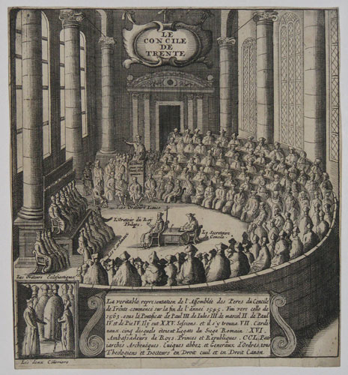
Council of Trent
Strengthened the Inquisition by censoring humanist and Protestant thinking
Published the Index of Forbidden Books, a list of works considered too immoral or irreligious for Catholics to read.
Masses were said in Latin
Maintain the Church’s elaborate art and ritual.

Slide 4
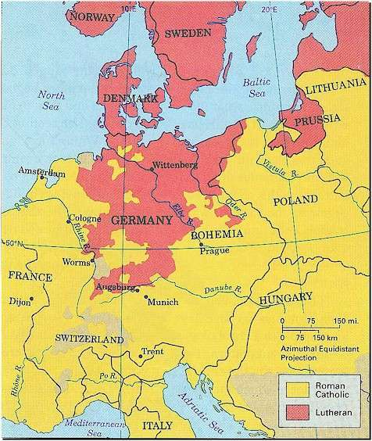
Spreading Catholicism

Slide 5
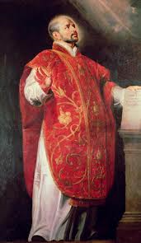
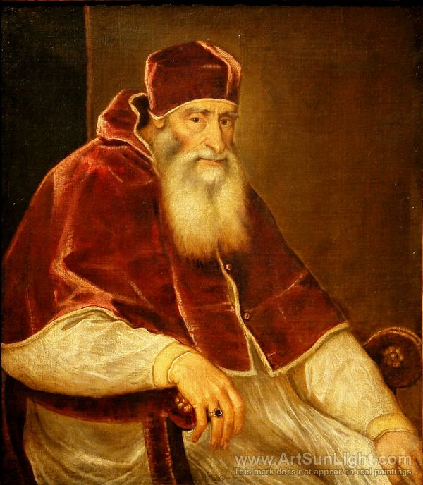
People
Pope Paul III- Set out to reform the church, called a council of bishops at Trent, Italy 1545 he also was apart of the council that forbade selling indulgences
The Jesuits- a new religious order, the society of Jesus.
Ignatius of Loyola-founded the Jesuits. He was a Spanish noble.

Slide 6
Extensive information
Some people remained Catholic during the Protestant Reformation
Catholicism's power was still threatened by protestants popularity in Northern Europe
Was the 19th ecumenical council in of the roman catholic church in 1545-1565
Had started before the spread of Luther.

Slide 7
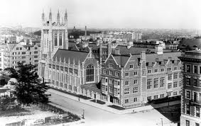
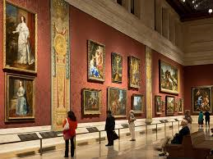
Key terms
Seminary- school for educating priests as ordered by the council of Trent.
Baroque- ornate, dramatic artistic style developed in Europe in the 1550’s.

Slide 8
Work Cited-MLA Format
"Council of Trent." CATHOLIC ENCYCLOPEDIA:. N.p., n.d. Web. 07 Apr. 2014.
The Editors of Encyclopædia Britannica. "Council of Trent (Roman Catholicism)." Encyclopedia Britannica Online. Encyclopedia Britannica, n.d. Web. 07 Apr. 2014.
"The Society of Jesus." CATHOLIC ENCYCLOPEDIA: The Jesuits (). N.p., n.d. Web. 07 Apr. 2014.
"Brief Biography of St. Ignatius of Loyola." Brief Biography of St. Ignatius of Loyola. N.p., n.d. Web. 06 Apr. 2014.

