Slide 1
Chapter 17 Section 1 Early explorations
3rd hour
Bobbi Francis
Emily Huesgen
Claire Schulte

Slide 2
Key Terms
Cartographers – map makers
Line Of Demarcation – An imaginary line running down the middle of the Atlantic ocean from the north pole to the south pole
Circumnavigation – circling the globe

Slide 3
People
Prince Henry the Navigator
Son of King John I of Portugal
Never made an ocean voyage
Bartholomew Dias
Left Portugal in August 1487
Discovered the southern tip of Africa in 1488
Vasco da Gama
Left Portugal and sailed to India
Christopher Columbus
Italian navigator
Had a plan to sail to India
Begged Queen Isabella to finance
Ferdinand Magellan
Portuguese soldier
Set sailed to find a western route
Ended in South America

Slide 4
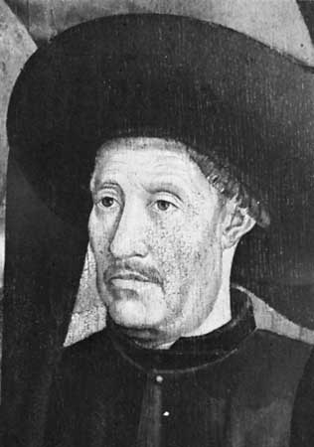
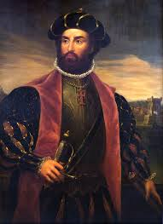
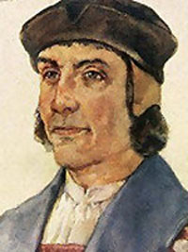
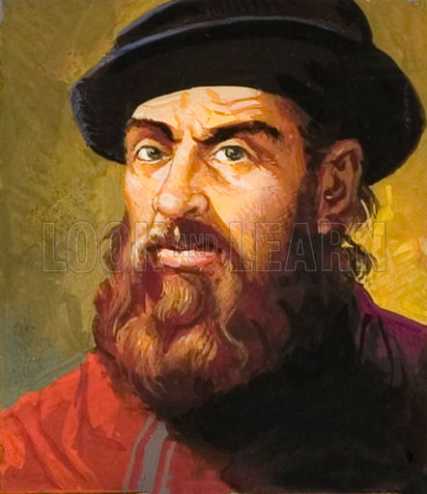
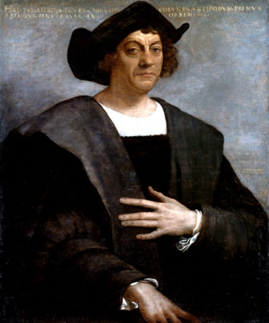
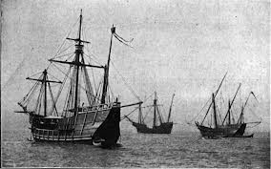

Slide 5
Additional Information
Western Civilizations began to expand
“ God, Glory, and Gold”
Europeans reached a greater level of technology
Most explorers were from Portugal
Spain and Portugal
Christopher Columbus thought he could reach Asia by sailing west
Native American Treatment

Slide 6
Extensive Information
Age Of Exploration Europe depended on Spices Spice trade controlled Mongul’s could not guarantee safe passage Motivations leading Europeans into exploration Requirements for sailing How they navigated New Advancements in sailing | Portugal Leads the Way First European country to venture through the Atlantic Gama tied trading with Muslims and Hindus Made it difficult for Muslims to accept Portuguese trade
Spain's Quest for Riches Columbus wanted to circumnavigate the globe to India Amerigo Vespucchi Portuguese wanted to claim the Americas Pope tried to settle dispute | Voyage of Magellan Wanted to find western route Mutiny Strait of Magellan South sea Scarcity of supplies

Slide 7
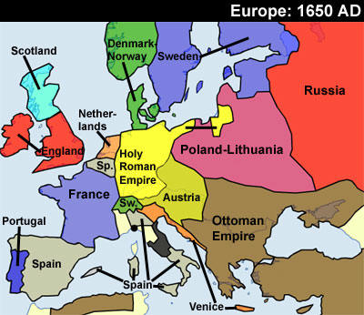
Map

Slide 8
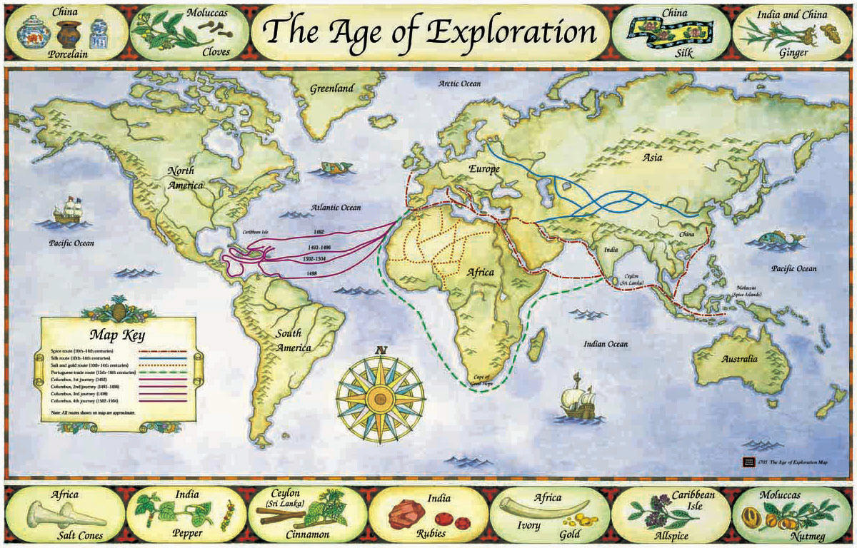

Slide 9
Citation
"Age of Exploration in Europe." Age of Exploration in Europe. Web. 02 Apr. 2014.
Fernandez-Armesto, Felipe. "Sponsorship of Expeditions." Encyclopedia Britannica Online. Encyclopedia Britannica. Web. 02 Apr. 2014.
"Ferdinand Magellan’s Fleet Sets Sail." Historical Articles and Illustrations » Blog Archive. Web. 02 Apr. 2014.
Spielvogel, Jackson J. "Exploration and Expansion." World History. New York: Glencoe/McGraw-Hill, 2008. Print.

