Slide 1
17-2 Overseas Empires
By: Dominic Knott
Ashley Mcintyre
& Ethan Trokey!

Slide 2
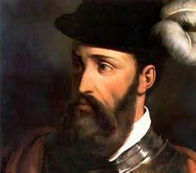
people
Pedro Alvares Cabrel - Led the Portuguese.
Hernan Cortes – A conquistador that landed in Mexico in 1519 with 600 men, 16 horses, & cannons .
Montezuma II – Aztec ruler.
Francisco Pizzaro – Invaded the Inca Empire in present day. Peru .sailed for spain.
Atahualpa – Incan ruler.
Henry Hudson – Claimed land for the Dutch along the Atlantic coast,
Jacques Cartier – Sailed up the St. Lawrence river.
Samuel de Champlain – French map maker, founded Quebec.
John Cabot – Explored the coast of present day Newfoundland

Slide 3
Key terms
Conquistador -Conquerors
Triangular Trade- Slave Trade
The Middle Passage- The middle leg of Triangular Trade

Slide 4
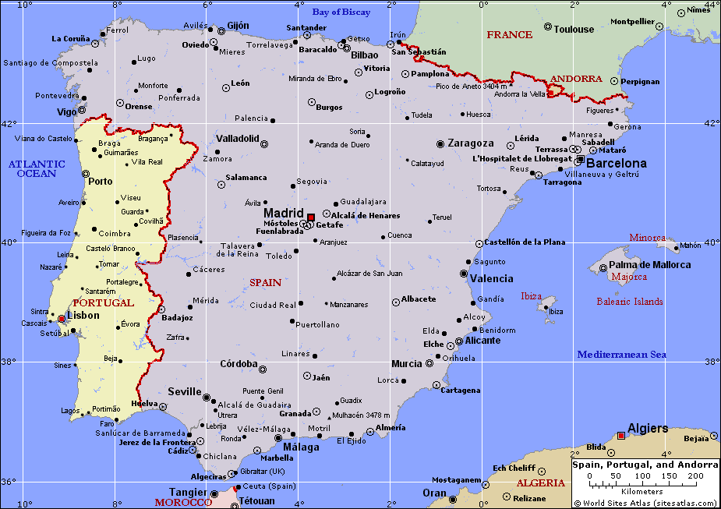
MAP

Slide 5
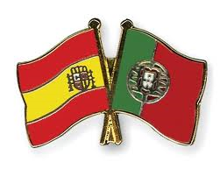
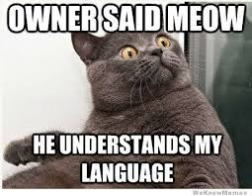
Portugal & Spain
Portugal's main interest lay in Africa and Asia.
After attacks on Portugal, they built naval bases along the Atlantic shore.
Portugal eventually colonized in present day brazil.
Settlers in Brazil grew income-producing crops.
Spanish conquistadors landed in America “ To serve God and his Majesty…”
Hernan Cortes landed in Mexico in 1519 with 600 men, 16 horses, And cannons.
Tenochtitlan's riches were beyond the Spaniards dreams
MEOW MEOW MEOW MEOW MEOW

Slide 6
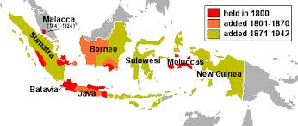
Colonies of the Netherlands
Netherlands were interested in expansion.
1600’s was the Golden Age.
The first Dutch expedition returned in 1599.
In 1619 the company set up headquarters at Batavia.
Dutch controlled trade.
Dutch set out for America.
BARK BARK BARK BARK BARK BARK BARK BARK BARK BARK BARK

Slide 7
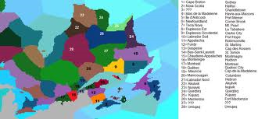
French and English Colonies
French and English Colonies played a small role in early voyages.
In 1524 an Italian captain, Giovanni de Verrazano to find a northwest passage.
In 1608 Samuel de Champlain found Quebec.
England showed interest in trade as well.
During 1600’s English founded settlements in the Americas.
BLUB BLUB BLUB BLUB BLUB BLUB BLUB BLUB BLUB

Slide 8
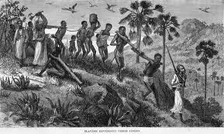
Slave trade
Europe was the starting point for about half of all transatlantic slaving voyages.
Due to this slave trade, Africa lost over 12.5 million people between 1525 & 1867.
Brazil was the center of slave trade.
The Caribbean was one of the two major broad regional markets for slaves to Africa.
North America played a minor role in slave trade
Slave trade was apart of Triangular Trade.
The Middle Passage was the middle leg of trade for slaves.
MOOOOOOOOOOOOOOOOOOOOOOOOO

Slide 9
I bet you think we forgot a cow…
DIDN’T YOU!?
NOOOOOOPE!!!!

Slide 10
WORK CITED!!!!!!
“The Trans-Atlantic Slave Trade Database Has Information on More than 35,000 Slave Voyages." Trans-Atlantic Slave Trade. Web. 03 Apr. 2014.
Farah, Mounir, and Andrea Berens. Karls. World History: The Human Experience. New York: Glencoe/McGraw-Hill, 1997. Print.
PA PA PA PA PA PA POW… PA PA PA PA PA PA POW

