Slide 1
17.3 Changing Ways of Life
BY: Hannah Kessels, Lindsey Hines, Jacob Remmler

Slide 2
Key Terms
Joint-Stock Companies
Entrepreneurs
Mercantilism
Bullion
Balance of trade

Slide 3
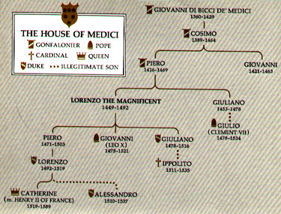
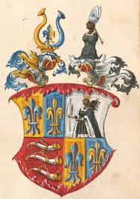
People
The Medici family
~from Florence, Italy.
The Fuggers family
~from Augsburg, Germany
Fugger family crest

Slide 4
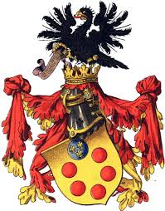
More about the Medici family
The Medici family, is one of Italy's most known clans.
Scientists are planning to look at the remains of the Medici corpses.
In 1743, the last family member ruled…
Medici family crest

Slide 5
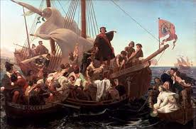
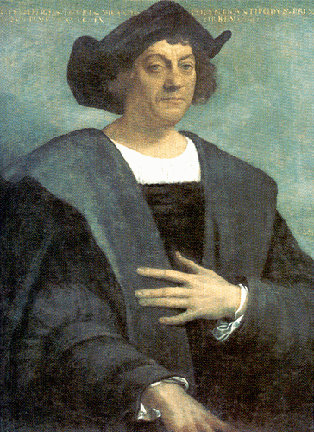
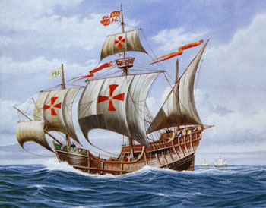
Christopher Columbus

Slide 6
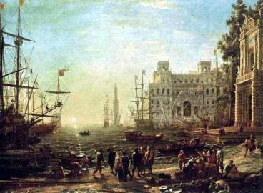
Global Exchange
Towns expanded
Europe's population is growing quickly
Trade began to spread worldwide
THIS WAS KNOWN AS THE COLUMBIAN EXCHANGE

Slide 7
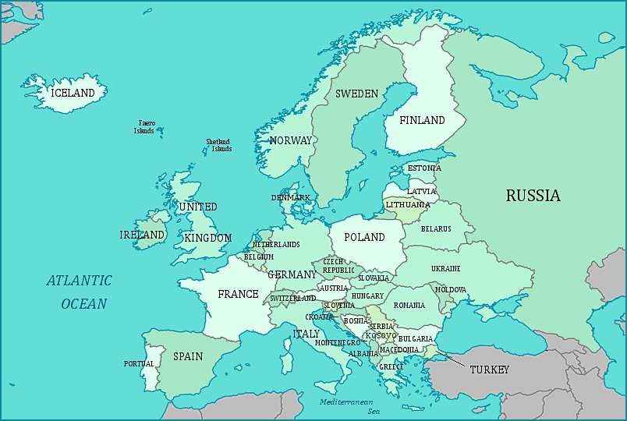
Augsburg
Florence

Slide 8
Mla format
"Bad Blood Flows as Medicis Go Digging Up Their Past." Australian Breaking NewsHeadlines & World News Online. Web. 03 Apr. 2014. <http://www.smh.com.au/articles/2004/05/07/1083911411065.html>.
"Fugger Family." Academic Dictionaries and Encyclopedias. Web. 03 Apr. 2014.
"Fugger." Princeton University. Web. 03 Apr. 2014. <https://www.princeton.edu/~achaney/tmve/wiki100k/docs/Fugger.html>.
“Fugger Family”. Givology: Historical Dictionary of the Renaissance. Web. April 7, 2014. <http://renaissance.academic.ru/213/Fugger_Family>.
Nature.com. Nature Publishing Group. Web. 03 Apr. 2014 . <http://www.nature.com/news/the- last-medici-may-not-have-died-of-syphilis-after-all-1.12435>.
“The Medici Family.“ Web. 02 Apr. 2014. <http://www.yesnet.yk.ca/schools/projects/renaissance/main/
medici.html>.

