Slide 1
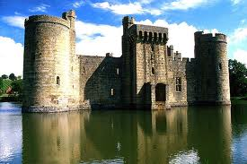
Domonik Cates, Matthew Thomas, Devon
Medieval life section 12-2

Slide 2
Key terms
Feudalism- was developed in western Euro up, Federalism was an highly decentralized formed of government that stressed alliances of material protection of between the monarchs and nobles of varying degrees of powers. This system was based on giving land to nobles in exchange for loyalty and military
Fife- under feudalism, an estate with its present, works granted to an noble for loyalty and military. Fifes were able to bye horses and battle equipment.
Vassal- a noble who healed land from a served a higher ranking lord. A noble could be a both a lord and a vassal, sense a noble could pelage his alleges to more than one god.
Homage- ties between a lord and a vassal were made official in solemn ceremony. The most important obligation was an military service. Vassals also pledged to pay ransom in the event of the lords captured in battle.

Slide 3
Key terms
Tournaments- mocle battles between 6 nights, as a show of military skills. Also loved to hunt, both men and women learned the art of fakerny and archery.
Chivalry- code called for knights to be brave in battle, fight fairly, keep promises, defend the church, and treat women of noble birth in a courteous man.
Manorialism- provided lords and pesants with food, shelter, and protection
Serfs- people who were bound to the manor and would not leave it without permission

Slide 4
people
Knights- were mounted warriors, for royal army.
Nobleman's son began training for knighthood at age 7.Beginning as a page or assistant.
They followed a code of chivalry
Lords- a nobleman; had almost total authority.
Lords collected rents in goods from peasants and settled disputes between his vassals.

Slide 5
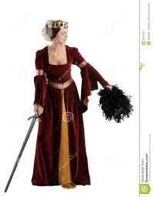
lady
Or noblewomen/ had few if any rights
A noblewomen could be wed as early as her twelfth birthday to a man her father selected.
She would lay in bringing up children and taking care of household.
They took pride in their needlework; tuning out cloth and fine embroidery.
Learned to make effective medicines from plants and herbs.

Slide 6
Peasant
Poverty and Hardship characterized peasant life, and few serfs lived beyond the age of 40.
Famine and disease were constant danger.
In times of war the peasants were first and hardest hit.
Invading knights trampled crops and burned villages.
Tiny one room houses with dirt floors; no chimney.

Slide 7
Life in the castle
The medieval castle was both fortress and home. The first castles raised in the A.D. 900s were square towers encircled by wooden ramparts.
By the A.D. 1100s castles had become mighty stone fortresses.
The castle was surrounded by a moat- a body of water encircling the castle. Could be crossed when a drawbridge was let down.
Inside it was crowded, smelly, dirty, and damp.
Not even the lord or lady had their own room.

Slide 8
Manorial system
The first improvement was the plow. The new plow made deeper cuts in the ground and had a device called a mould-board that pushed the soil sideways.
Next was the tree field system. They had a cycle on how and what was grown during the year. Helped preserve the soil.
Normally produced only enough food to support the peasants and the lords household.
Improvements gradually boosted productivity and eased the threat of famine.

Slide 9
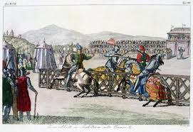
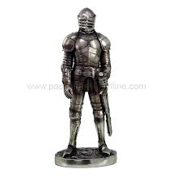
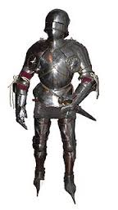
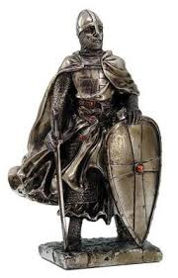

Slide 10
Guided reading 12.2
Castle
Manor
Hierarchy
Knight/ a royal army
Estate
Minstrels
Page
Rent in goods/ Justus
Chivalry
Holy
Serf
Goods
Three field system
Warriors fiefs

