Slide 1
Amber Brown 7th Justin Foster Edward Goben Andy Presser 12-2 Medieval Life

Slide 2
Feudalism
Feudalism was a highly decentralized from government that stressed alliances of mutual protection between monarchs and nobles of varying degrees of power.
Was a highly decentralized form of a government
For safety and defense would form a small community's around a lord or master
Lord would grant land grants or “fiefs” to his nobles, barons, and bishops
The lowest echelon of society was peasants
The lord would offer peasants protection in these feudalism

Slide 3
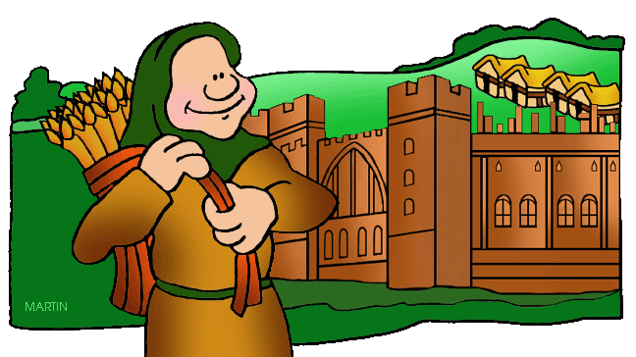
Fiefs
To support the cavalry, Martel began granting warriors fiefs, or estates with peasants
A fief was a vassal’s source of income
A fief was basically a favor awarded to a vassal

Slide 4
Vassal
A noble who served a lord of the next higher rank.
It is believed that the first vassals came from England
Vassals either lived in castles
They sometimes owed there own manner
If the vassal died the family would find a suitable man to take his place.
That man would take over everything the other vassal owned.

Slide 5
Homage
Special honor or respect

Slide 6
Tournament
Medieval sport that included jousting
Jousting with lances
Usually done on horse back
A tournament was a series of mounting horses and armed combat.
A lots of knights would compete in these tournaments.

Slide 7
Chivalry
The behavior of knights was governed by a code of chivalry

Slide 8
Manorialism
It is a political economic and social system

Slide 9
Serf
People who were bound to the moral and could not leave it without permission.

Slide 10
Knights
A mounted soldier guarding under a king in the Middle Ages

Slide 11
Lords
They are the judges and would solve disputes when ever they needed to be settled.

Slide 12
Ladies
Medieval ladies followed a similar schedule to her lord. Much of there times was spent on overseeing the running of the household.

Slide 13
Peasants
Peasants lived in a hardship and in poverty a few lived past 40. They where in constant danger and in times of war.

Slide 14
Charles Martel
Born 686 A.D.
Died 741 A.D

Slide 15
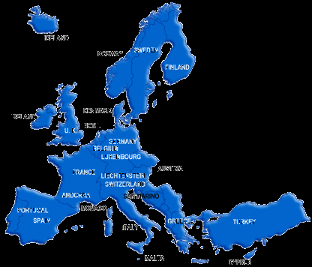
Map of Europe

