Slide 1
The Medieval Church
By: Mitchell Freeman, John Fowler, Isaiah Bell, James Gan

Slide 2
Key terms of the Medieval Church
Sacraments - or church's rituals: baptism, penance , Eucharist and matrimony
Abbot - monastery head
Abbes - the director of a convent
Cardinals - high church officials in Rome ranking directly below the pope
Lay investiture - secular rulers gave the symbols office
Heresy - the denial of basic church teachings
Excommunication - expulsion from the Church
Friars - wandering preachers

Slide 3
Important People
Pope Gregory I - sent monks to England. Converted the Anglo-Saxons to Catholicism.
Benedict - founded a monastery at Monte Cassino
Innocent III - one of the most powerful popes
Gregory VII - monk named Hildebrand. Cardinals elected him.
Francis of Assisi - founded the Franciscan friars about A.D. 1210
Dominic - organized the Dominican friars in A.D. 1215

Slide 4
Guided Reading
Pope – spiritual, political, and social leader
Masses – church rituals said in Latin
Pope, bishops, and priests were secular clergy
Monks and nuns were regular clergy
Christian teachings were spread among peasants
Gregory I and monasteries – spread Christianity throughout Ireland

Slide 5
Additional Info.
Everyone in medieval England believed in God, Heaven, and Hell.
The people of the city pay 10% of what they earned in a year to the Church. Their taxes are called tithes.
Tithes were kept in “tithe barns” and seeds used as payment were usually eaten by rats or poisoned by their urine.
If you did not pay, your soul went to hell and never got to see God himself.
The Church had total control over the people. Peasants worked on church land without pay.

Slide 6
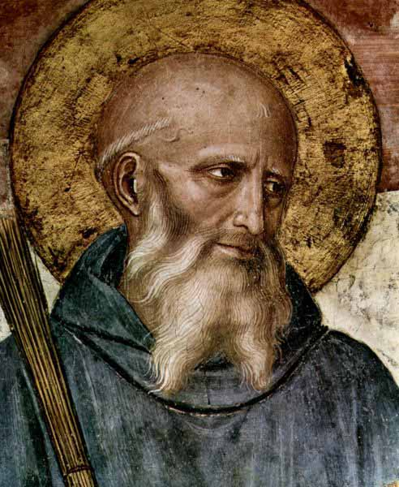
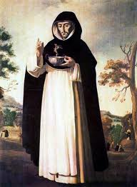
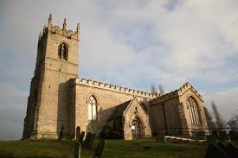
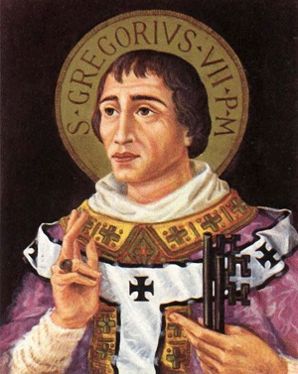
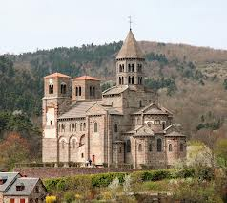
Images

Slide 7
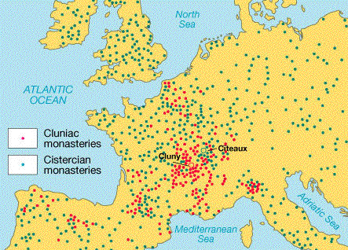
Map

Slide 8
Work cited
http://www.historylearningsite.co.uk/medieval_church.htm/web/2008
Blue World History 2008/Jackson J. SpielVogel

