Slide 1
Rise of European Monarchy section 12-4
By: Dalton Duncan, Tyler Greer, Eran Walters

Slide 2
Key Terms
Common Law- common law is a body of English law based on tradition and court decisions, not specific laws
Common law used traveling judges to apply the law equally throughout the land
In each community the judges met with a grand jury.

Slide 3
Key Terms
Grand jury-the grand jury, in English law, a group of people who decide weather the evidence of a crime justifies bringing a person to trial.
The grand jury submits the names of the suspects and evidence for the trial.
Works with the petit jury to establish guilt or innocence of the accused.

Slide 4
Key Terms
Petit Jury- Group of people who determine the guilt or innocence of a person on trial.
Worked with the grand jury and traveling judge.
Decided if the person on trial is innocent or guilty.

Slide 5
Key Terms
Middle Class- A class of society that originally fell between nobility and peasants, earning Their income from business and trade.
A new social class.
Did not fit in the normal medieval social order of nobles, clergy, and peasants.
They played an increasingly important role in government.

Slide 6
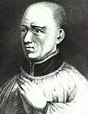
Thomas A’ Becket
Born in 1118 A.D.*
Son of an English merchant
King henry the II appointed him as a chancellor
Killed by king henry the II knights in 1170 A.D. because Thomas apposed henry’s plan to try clergy in royal court.

Slide 7
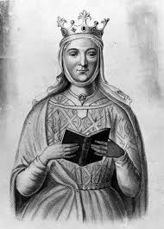
Eleanor of Aquitaine
Once married to a French king named Louis VII
She married Henry the II
Her marriage soon soured with henry
Even though Henry and Eleanor's relationship became estranged she continued to influence royal policies through her sons Richard I and John

Slide 8
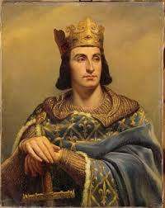
Phillip Augustus
Born in 1165*
Took the throne when he was 15*
Ruled France from 1180 A.D. to 1223 A.D.
Determined to strengthen the monarchy of France
During his 43 year reign Phillip doubled the area of his domain.
By appointing local officials he formed a semi permanent royal army weakening the power of feudal lords.

Slide 9
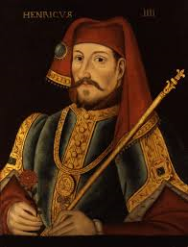
Henry the IV
Born in 1553 A.D. *
King of France from 1589 to 1610 A.D.
Had a major quarrel with pope Gregory VII
The pope wanted to free the church from secular control but henry refused
The pope proclaimed henry deposed and urged the German nobles to elect another ruler

Slide 10
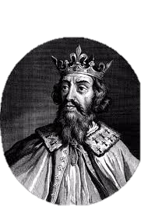
Alfred the Great
Born between 847-849*
Died on October 26; 899
King of England from 871-899
Born in Wantage, Berkshire
Alfred was the 5th son of Aethelwulf.

Slide 11
ATG cont.
Located in Oxford, England
(Alfred ordered me made)
Reading tool
Example of Anglo-Saxon jewelry

Slide 12
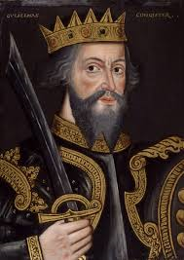
William The Conqueror
Born around 1028 BC.
Born in Falaise, Normandy, France
First Norman king of England
From 1046 to 1055 he dealt with baronial rebellions
Died on September 9, 1087

Slide 13
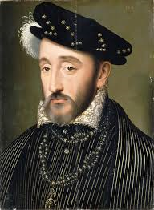
Henry the II
Born in the year 1133 in Le Mans, Maine (now France)
Ascended the throne October 25, 1154 (21 years old)
Reigned for 34 years, 8 months, 11 days
Died July 6, 1189 near the city of Tours

Slide 14
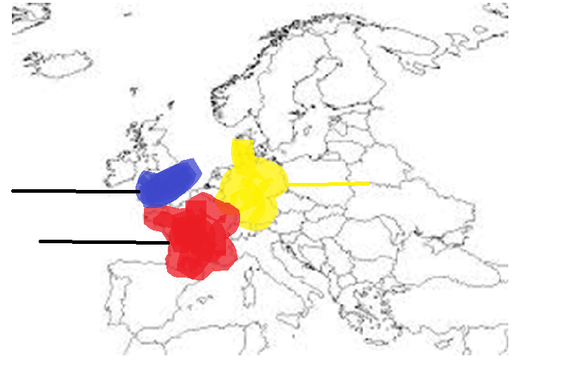
Map of Europe
Germany
England
France

Slide 15
Works cited
www.bbc.co.uk
www.royal.gov
www.biographybase.com
www.biography.com
www.eyewitnesstohistory.com

