Slide 1
Chapter 13 Section 1
The Crusades
By. Ryan Weerts
Brandy Cordova
BreAnna Slape

Slide 2
Key Terms!
The Crusades- From the Latin word “Crux” which means cross.
The Crusades were basically the European Christians who undertook a series of military expeditions to recover the holy land from the Muslims.
There were nine expeditions in all.

Slide 3
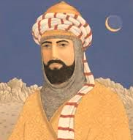
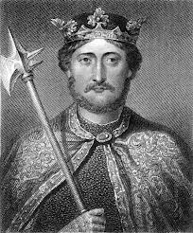
Significant People
Saladin
Diplomatic and forceful leader
United Muslim forces
In A.D. 1187, he captured Jerusalem
Richard I
King of England
was one of the men who assembled warriors for the third crusade
Worked with Holy Roman Emperor Frederick Barbarossa of Germany and King Philip August of France

Slide 4
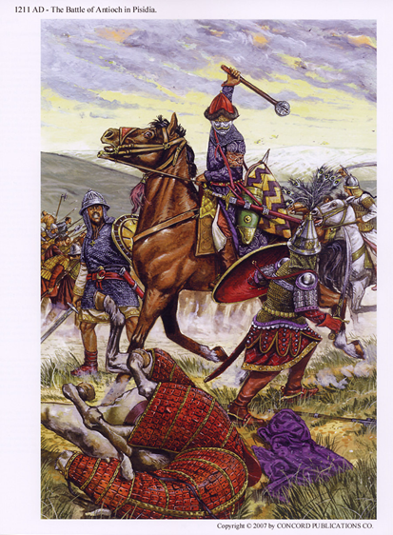
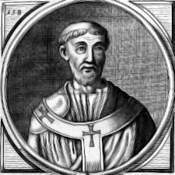
The Seljuk Turks
A Muslim person from central Asia
In the late A.D. 1000s they took Jerusalem.
Caused the pilgrimage to increase
Threatened the Byzantine Empire
Pope Urban II
mounted a platform outside the church at Clermont, France on a November day in A.D. 1095

Slide 5
Guided Reading
Muslims allowed Jews and Christians to live and travel in Jerusalem for 400 years, beginning in the A.D. 600s. (Page 318)
Seljuk Turks closed Jerusalem to Jewish and Christian pilgrims and threatened the city of Constantinople. (Page 319)
Pope Urban II called for the first Crusade in A.D. 1096. (Page 319)
Crusades strengthened contacts between the Crusaders and the sophisticated and learned civilizations of the Byzantines and the Muslims. (Page 319)

Slide 6
The Crusades strengthened contacts between the Crusaders and the sophisticated and learned civilizations of the Byzantines and the Muslims. (Page 319)
Muslims had recaptured Jerusalem, reclaimed all of Palestine (Page 318, 320)
Crusades increased the power of kings (Page 321)
Decreased the power of nobles and their system of feudalism (Page 321)
Western Europe saw in increase in the trade of spices, sugar, silk, and the other luxury items. (Page 321)
Increasingly sophisticated technology entered Europe in the form of ships, navigational aids, and military skills and equipment. (Page 321)

Slide 7
Extensive Information
By A.D. 1100 conditions in Europe had begun to improve.
Transformation of medieval society began with a holy war over the city Jerusalem.
Those who fought were called Crusaders because they vowed to “take up the cross”.
Jerusalem and the entire region of Palestine fell to Arab invaders in the A.D. 600s.

Slide 8
Crusades | Year | Summary
First | 1095-1099 | At the urging of Pope Urban II in 1095, the First Crusade succeeded in taking Jerusalem and was the most successful from the European point of view. When Jerusalem fell in 1099, crusaders massacred Jews, Christians and Muslims alike. Then the leaders divided up the land into territories, each governed by a European feudal lord.
Second | 1147-1149 | The Second Crusade started when Europeans lost control of Edessa, territory that they had previously controlled, to the Muslims. Led by King Louis VII of France and King Conrad III of Germany, the Europeans failed to regain any land and the crusade was a failure from a European point of view.
Third | 1189-1192 | The Third Crusade was a response to Jerusalem’s fall in 1187 to Saladin. Three great armies from Europe were led by Richard the Lion-hearted of England, Philip II of France, and the Holy Roman emperor Frederick Barbarossa, Europe’s greatest warrior. However, Frederick accidentally drowned, the other two kings bickered, and the whole crusade failed from a European point of view.

Slide 9
`

Slide 10
Words Cited
Karls, Farah. World History The Human Experience. Columbus: Glencoe McGraw-Hill, 1999. 318-21. Print.
The Crusades. N.p., n.d. Web. 10 Mar. 2014. <http://mrkash.com/activities/crusades.html>

