Slide 1
Economic and Culture Revival
By: Reid Dauster, Nellie Maitland, Blake Coleman, Gabriella Sauvage

Slide 2
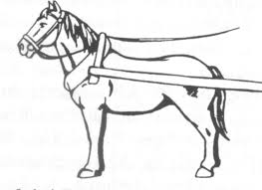
Lead to an increase in agricultural productivity
The plow
Collar harness
Using a horse instead of an ox
3-Field System of Planting

Slide 3
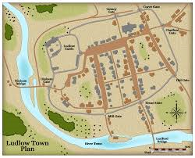
Medieval towns
Located by water ways and well traveled roads
Stone walls and narrow winding streets
This resulted in very little sanitation and disease and the Black Plague.

Slide 4
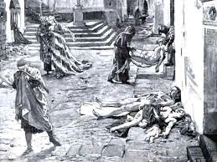
The Black Plague
Justinian had the plague from 541-542

Slide 5
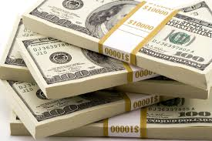
Money Economy
Replaced the Barter System

Slide 6
The Guild
Purpose was to maintain a monopoly of the local market for its members

Slide 7
Burgess: People who made money from developing the Money Economy
Merchants: Bankers and Artisans

Slide 8
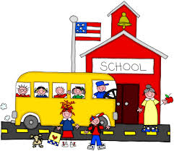
Schooling
Taught…
Law and Medicine
Liberal arts
Theology
Latin Classics
Roman Law
Islamic Scholarship on Science

Slide 9
Scholasticism
Emphasized reason and faith in the interpretation of Christian doctrine

Slide 10
Vernacular Literature
People spoke the language of their everyday speech instead of latin

Slide 11
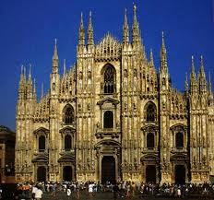
The New Gothic Cathedral
Higher Ceilings
Flying Buttresses
Stained Glass Windows
Pointed Arches
More Open Interior

Slide 12
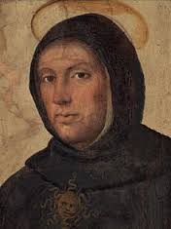
Thomas Aquinas
1225-1274
Born in Roccasecca, Italy
Most influential work is the Summa Theologica
Philosopher and a Theologian
Authority in the Catholic Church
Prolific Writer
Died at the Cistercian Monastery of Fossanoba

Slide 13
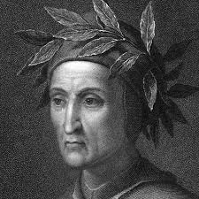
Dante Alighieri
An Italian poet and philosopher
Best known for his epic poem the Divine Comedy
Born May 21, 1265 in Florence, Italy
Died September 13, 1320 in Ravenna, Italy

Slide 14
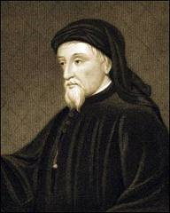
Geoffrey Chaucer
Born circa 1340 in London, Italy
1357 became a public servant to Countes Elizabeth of Ulster,
was a servant to the British court throughout his life time
Died October 25, 1400 in London, England
The first to be buried West Minister Abbey Poets Corner

Slide 15
Citation
"Medieval Maps." TimeRef. N.p., n.d. Web. 04 Mar. 2014.

