Slide 1
Chapter 13.3 Strengthening of Monarchy
CURTIS RIGDON
MATTHEW SCHIMSA
KRYSTEN COLLINS
DAVID WEBB

Slide 2
KEY TERMS
Cortes- assemblies of nobles, clergy, and town officials in medieval Spain.

Slide 3
People
Joan Of Arc- 1429 at 17-years old inspired the French army in the battle of Orleans to victory
Louis XI- United all French feudal lands under his crown. Defeated Charles The Bold in A.D. 1477 to capture burgundy.
Richard III- From Louis the XI and fell to the forces of Henry Tudor in 1485
King Henry VII- Defeated Richard III in 1485 and became the first Tudor King
Ferdinand of Aragon & Isabella of Castile- Armies forced the surrender of the last Moorish stronghold at Granada in 1492

Slide 4
Guided Reading
The Hundreds Years’ War between France and England grew out of a Feudal dispute. Pg. 332
Edward III claimed sovereignty over all of England and France in A.D. 1328. pg. 329
English forces repeatedly defeated France until Joan of Arc led some of the French forces. Pg. 330
The hundreds years war actually lasted from A.D. 1337 to A.D. 1453. pg. 329
Two of the major Technological developments of the Hundred Years’ War were the use of the long bow and firearms as tools in war. Pg.330

Slide 5
Guided Reading (2)
Louis XI encouraged a war between a ruler Charles the Bold, and the Swiss that led to the division of Burgundy and the unification of France. Pg. 330
The Wars of the Roses were between the house of York, led by Edward and Richard, and the house of Landcaster, led by Henry Tudor. Pg. 332
Muslims, Jews, and Christians were all able to live and work in the kingdoms of Aragon and Castile until A.D. 1492. pg. 332
Muslims lived in Spain for a total of 7 Centuries

Slide 6
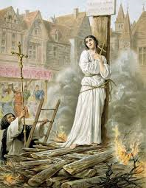
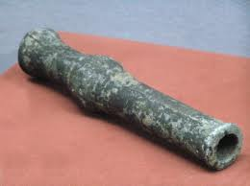
Additional Information
Joan of Arc was burned to death on May 30, 1431
French army surrendered the battle at Cercy on the 26th of August in 1346

Slide 7
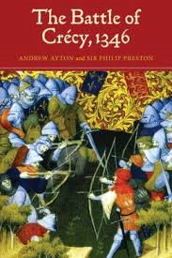
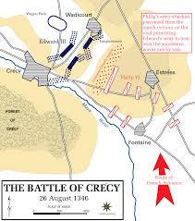
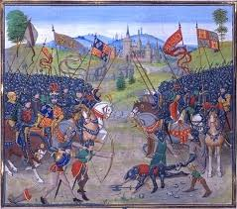
Additional Information
The major battles of the “Hundred Years War” was Battle of Crecy and Battle of Agincourt.
During the “Hundred Years War” the English’s monarchy’s power was limited by Parliament.

Slide 8
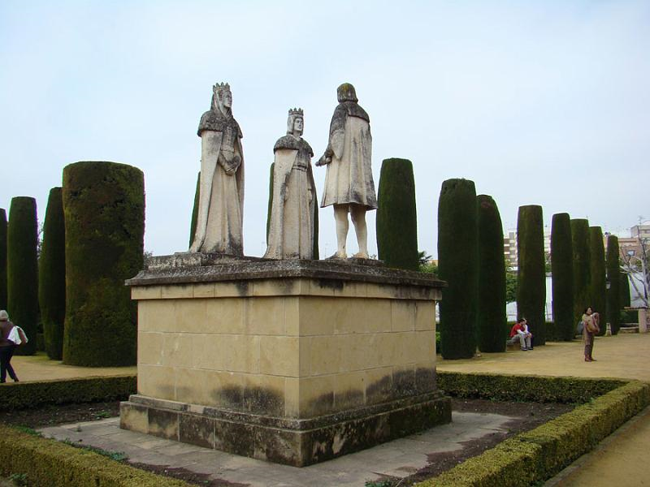
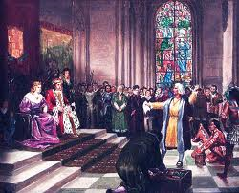
Ferdinand and Isabella
After the marriage of Ferdinand of Aragon and Isabella of Castile, they ended religious toleration by declaring all of Spain to be Catholic.
Any Spaniard who believed in a different thought of mind were forced to convert or to be exiled.

Slide 9
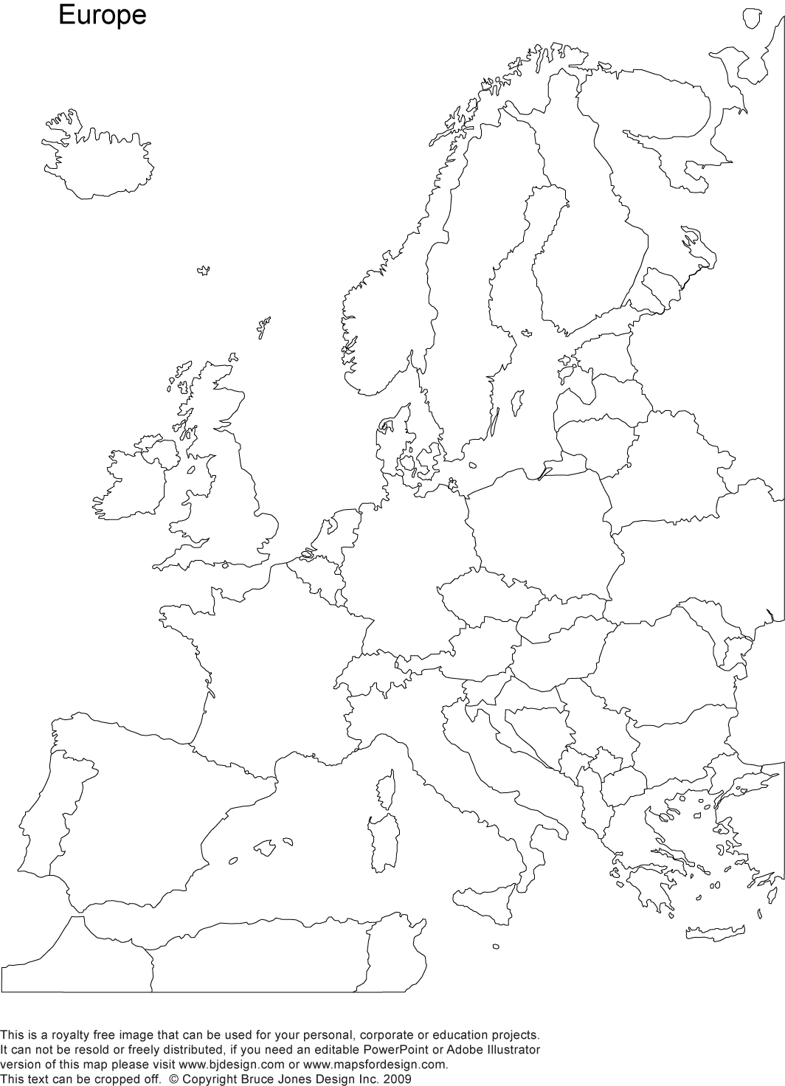
Map

Slide 10
Work-cited
http://www.joanofarc.us/death_of_joan_of_arc.html
http://www.luminarium.org/encyclopedia/100years.htm

